Slide 1
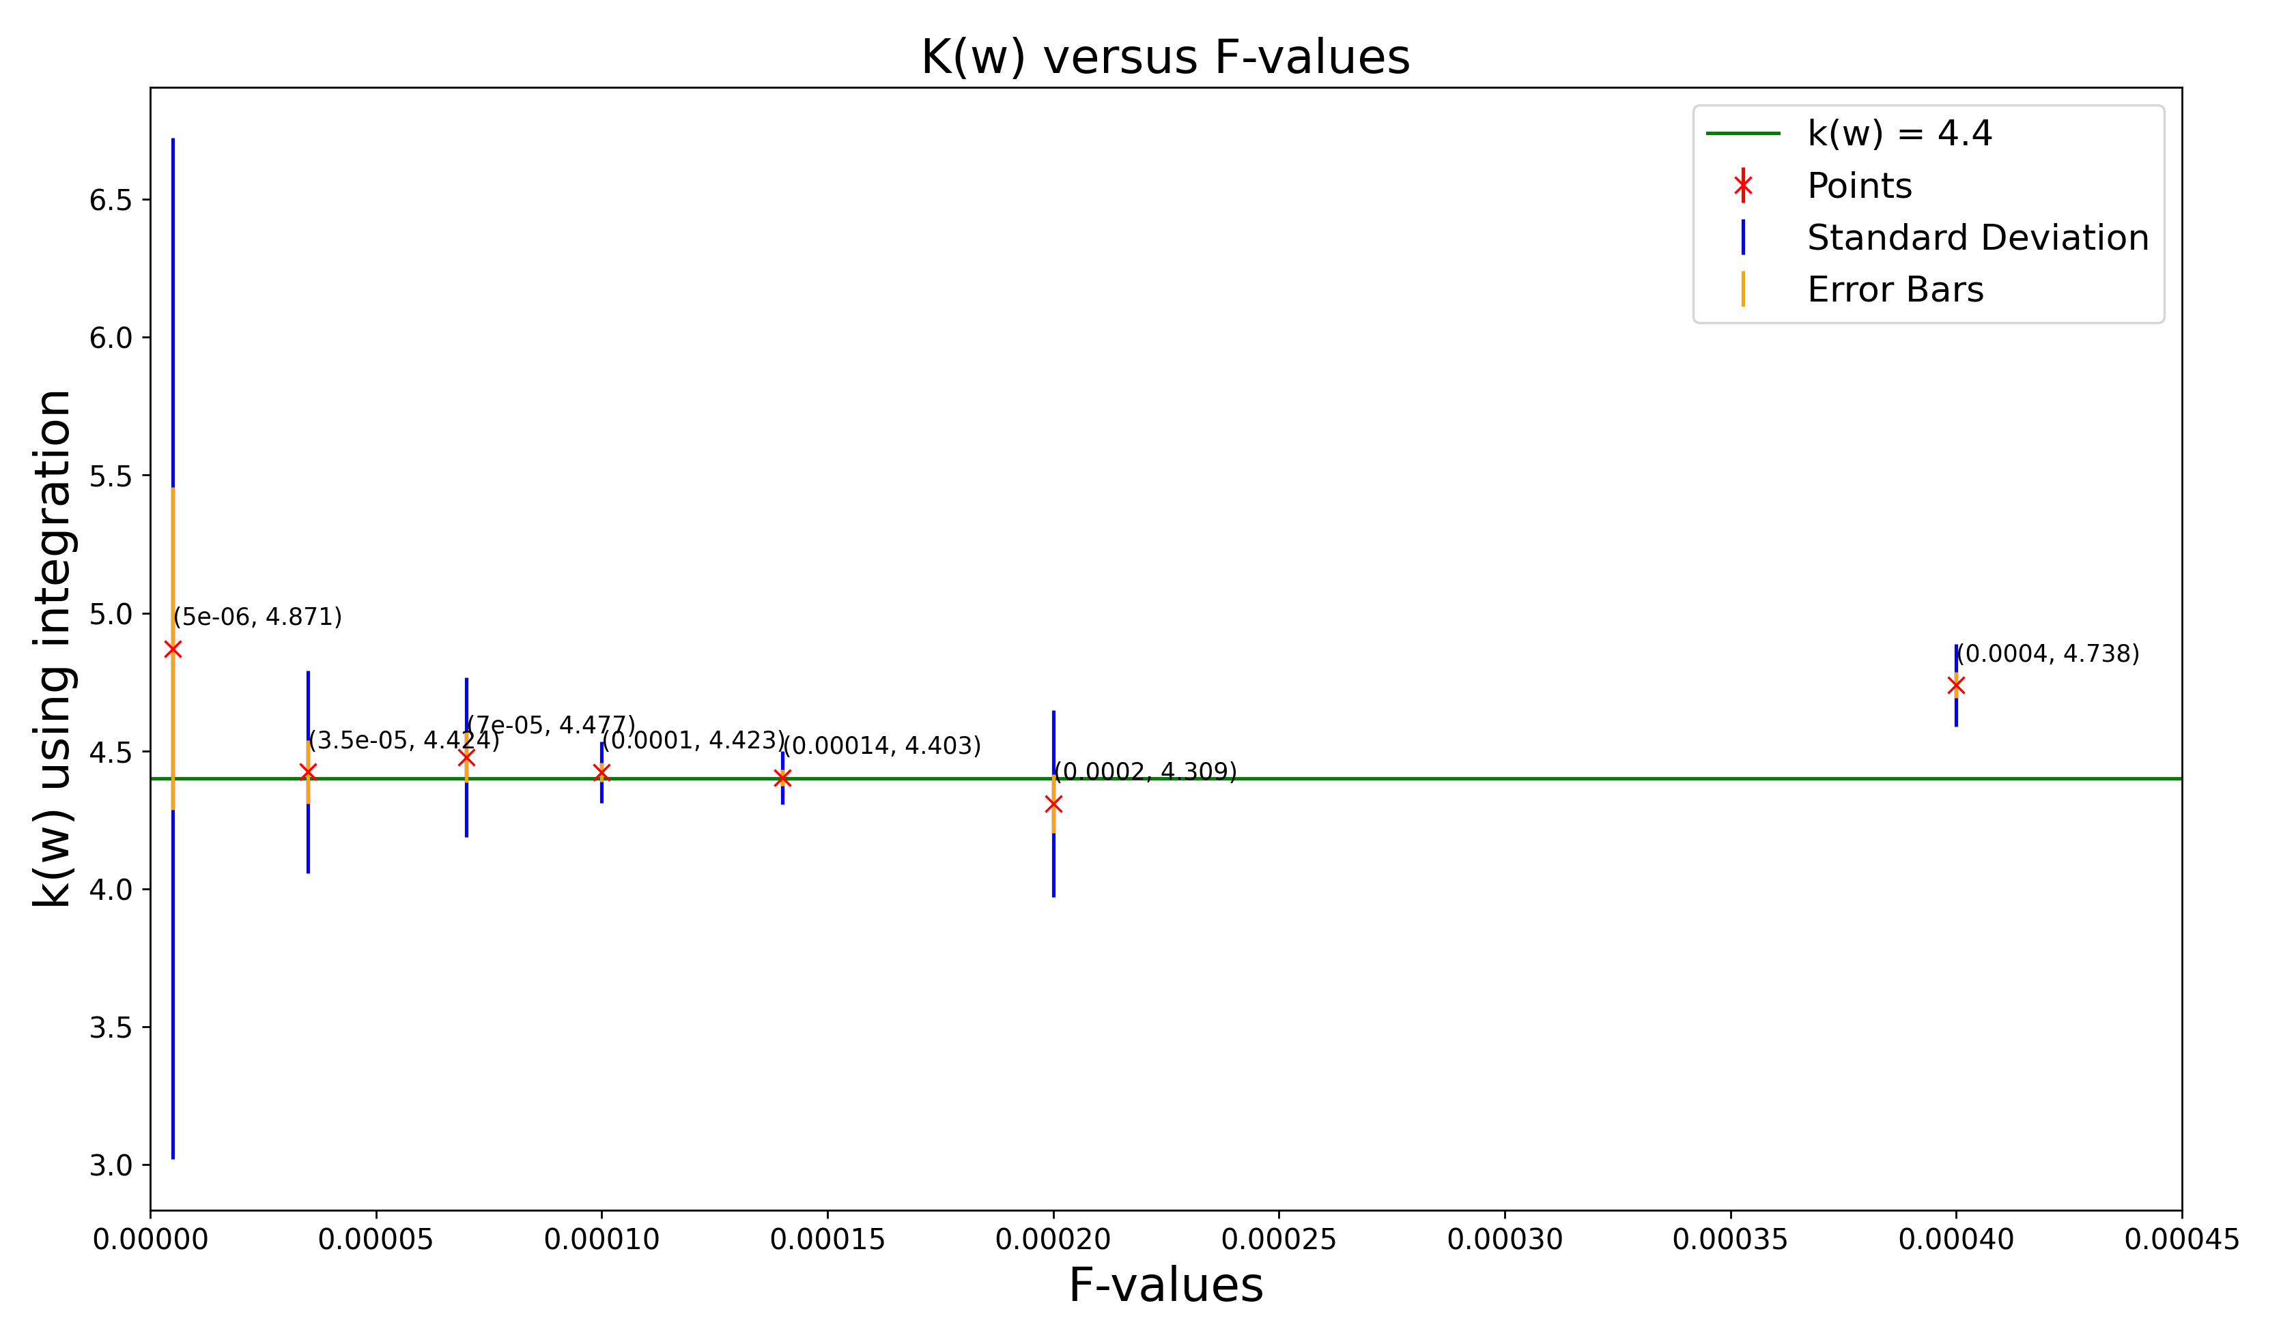
Plot of k(w) versus F-values for Temp = 300K

Slide 2
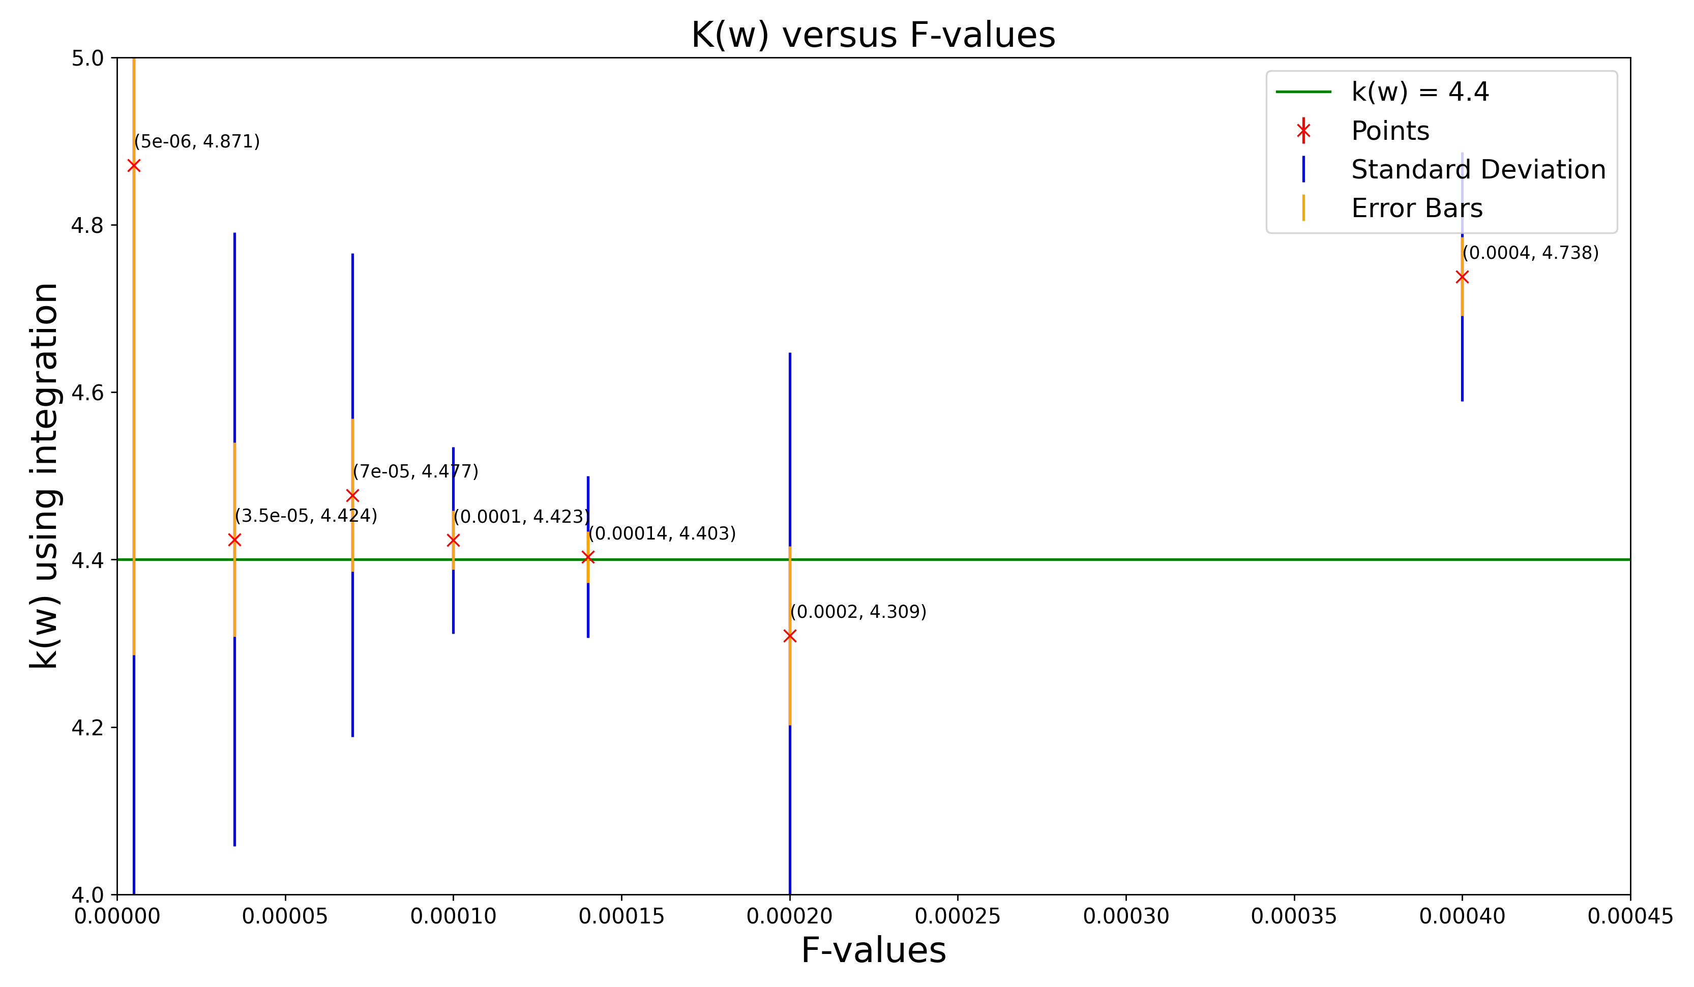
Plot of k(w) versus F-values for Temp = 300K (Zoom In)

Slide 3
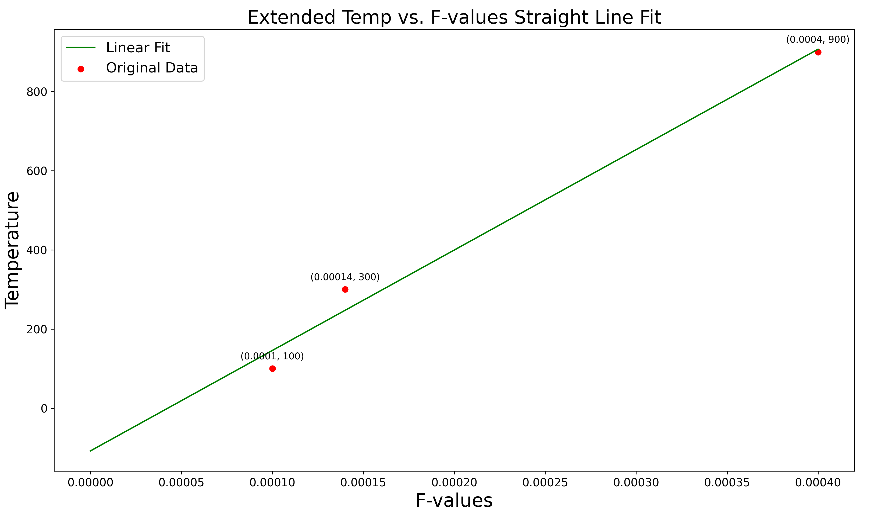
Possible Graph Fits for T vs F-optimized

Slide 4
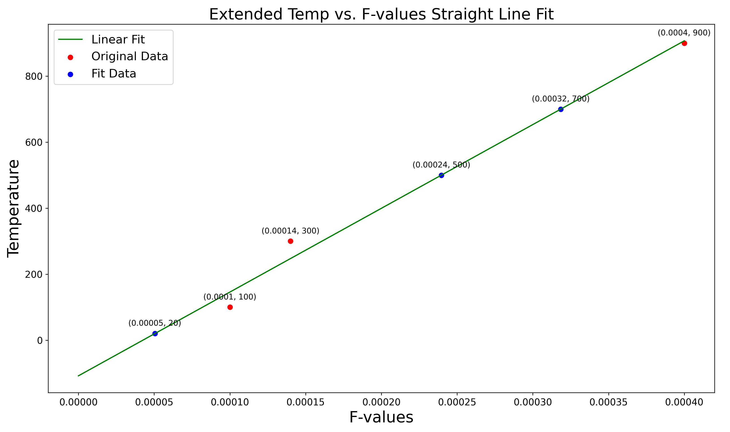
Possible Graph Fits for T vs F-optimized

Slide 5
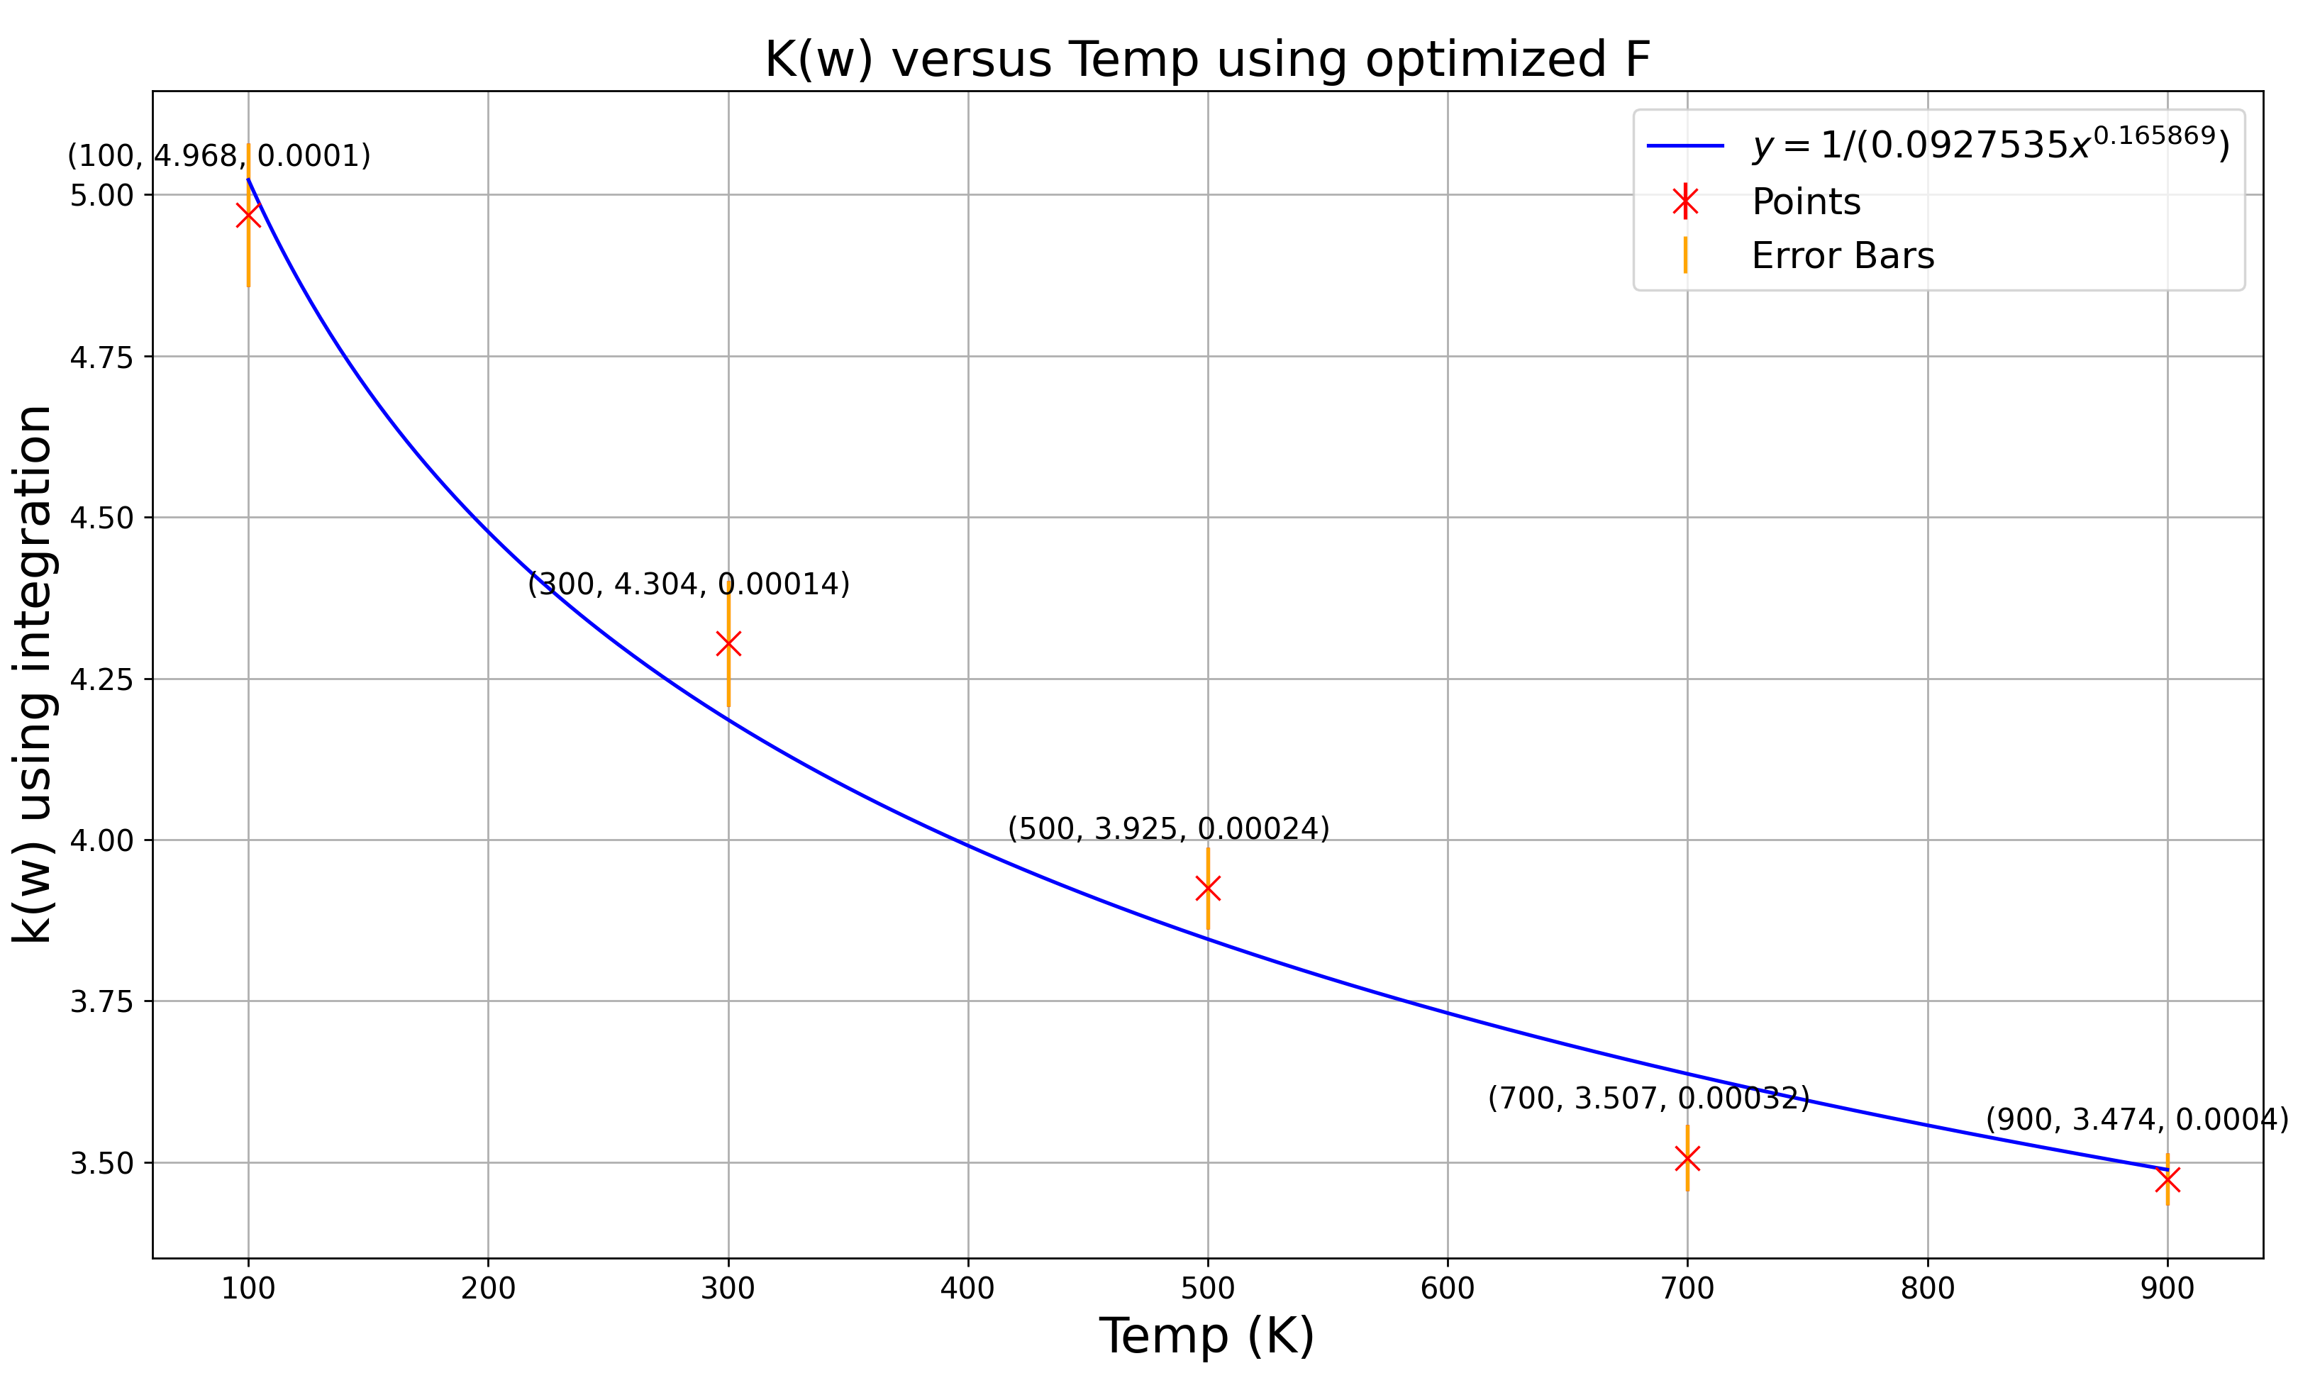
Plot K(w) versus Temp using Optimized F-values

Slide 6
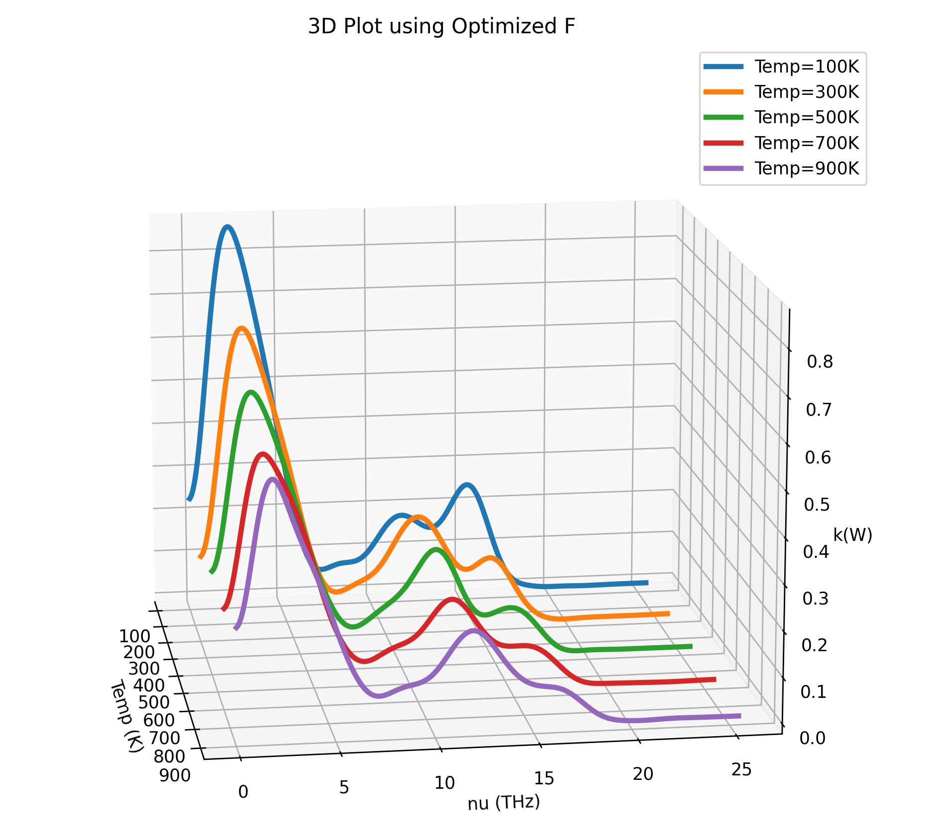
3D Plot using Optimized F with all Temp

Slide 7
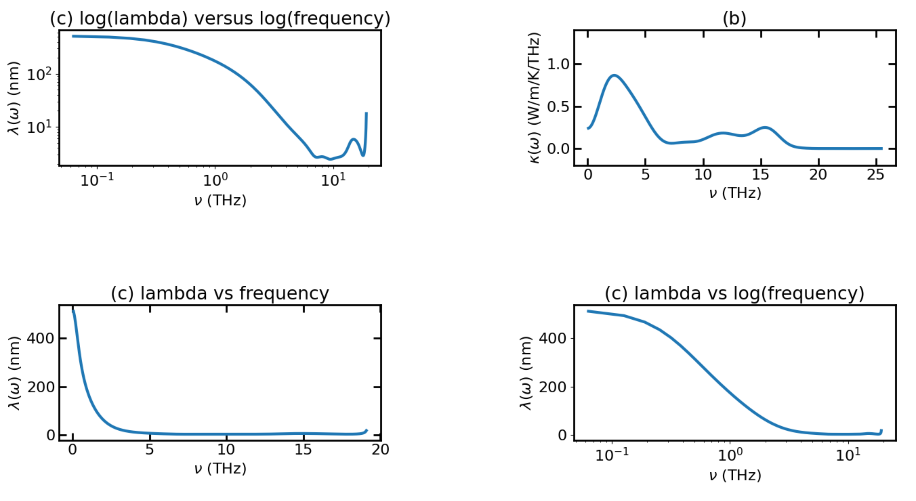
Temp = 100K – Avg Plot of lambda vs frequency (cut out the part that Gc or kw = 0 at after around 18THz)

Slide 8
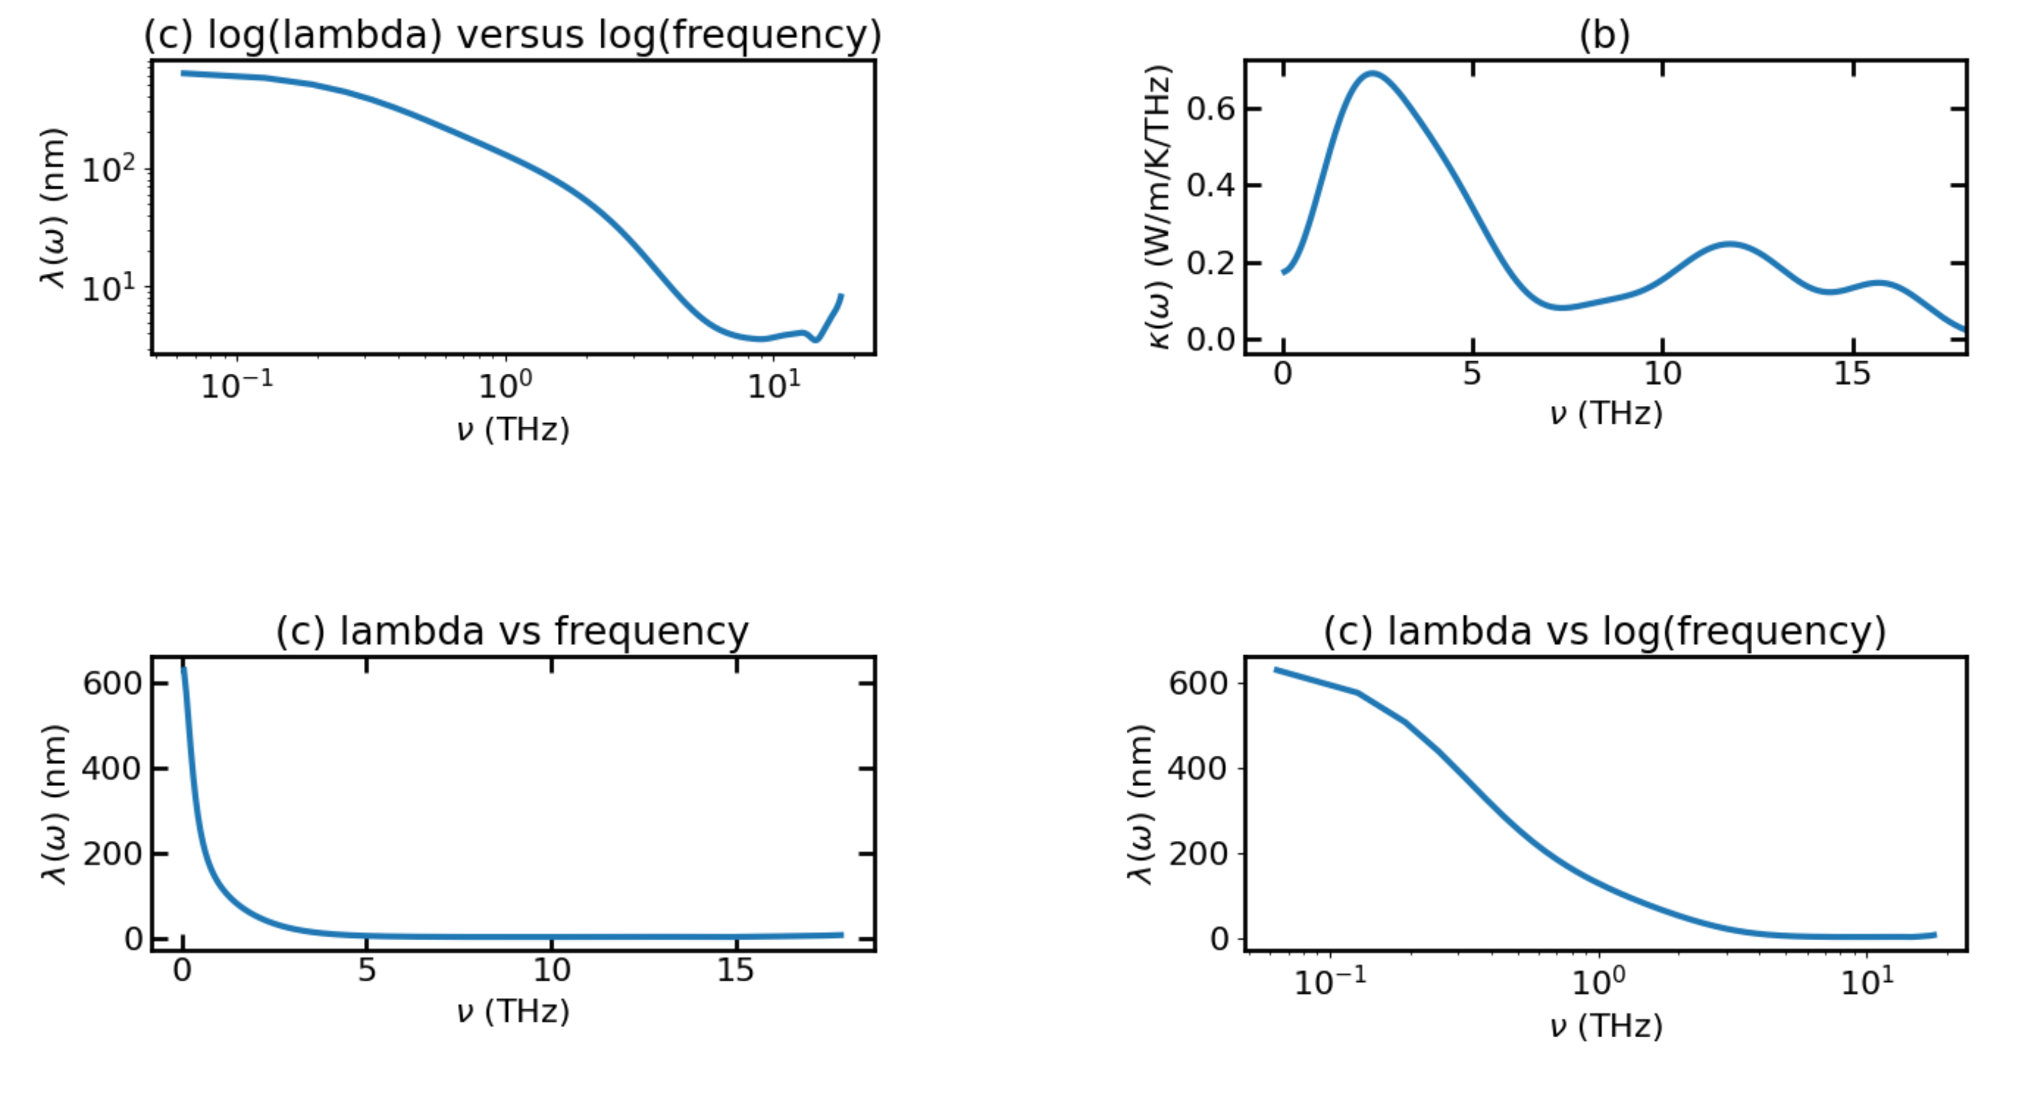
Temp = 300K – Avg Plot of lambda vs frequency (cut out the part that Gc or kw = 0 at after around 18THz)

Slide 9
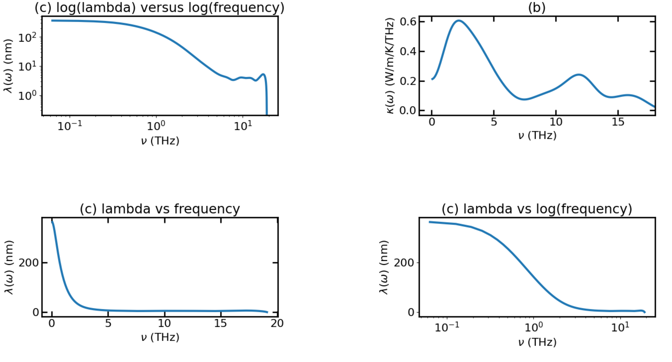
Temp = 500K – Avg Plot of lambda vs frequency (cut out the part that Gc or kw = 0 at after around 18THz)

Slide 10
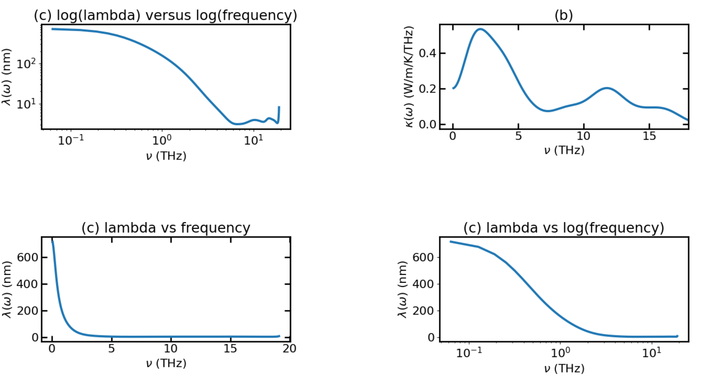
Temp = 700K – Avg Plot of lambda vs frequency (cut out the part that Gc or kw = 0 at after around 18THz)

Slide 11
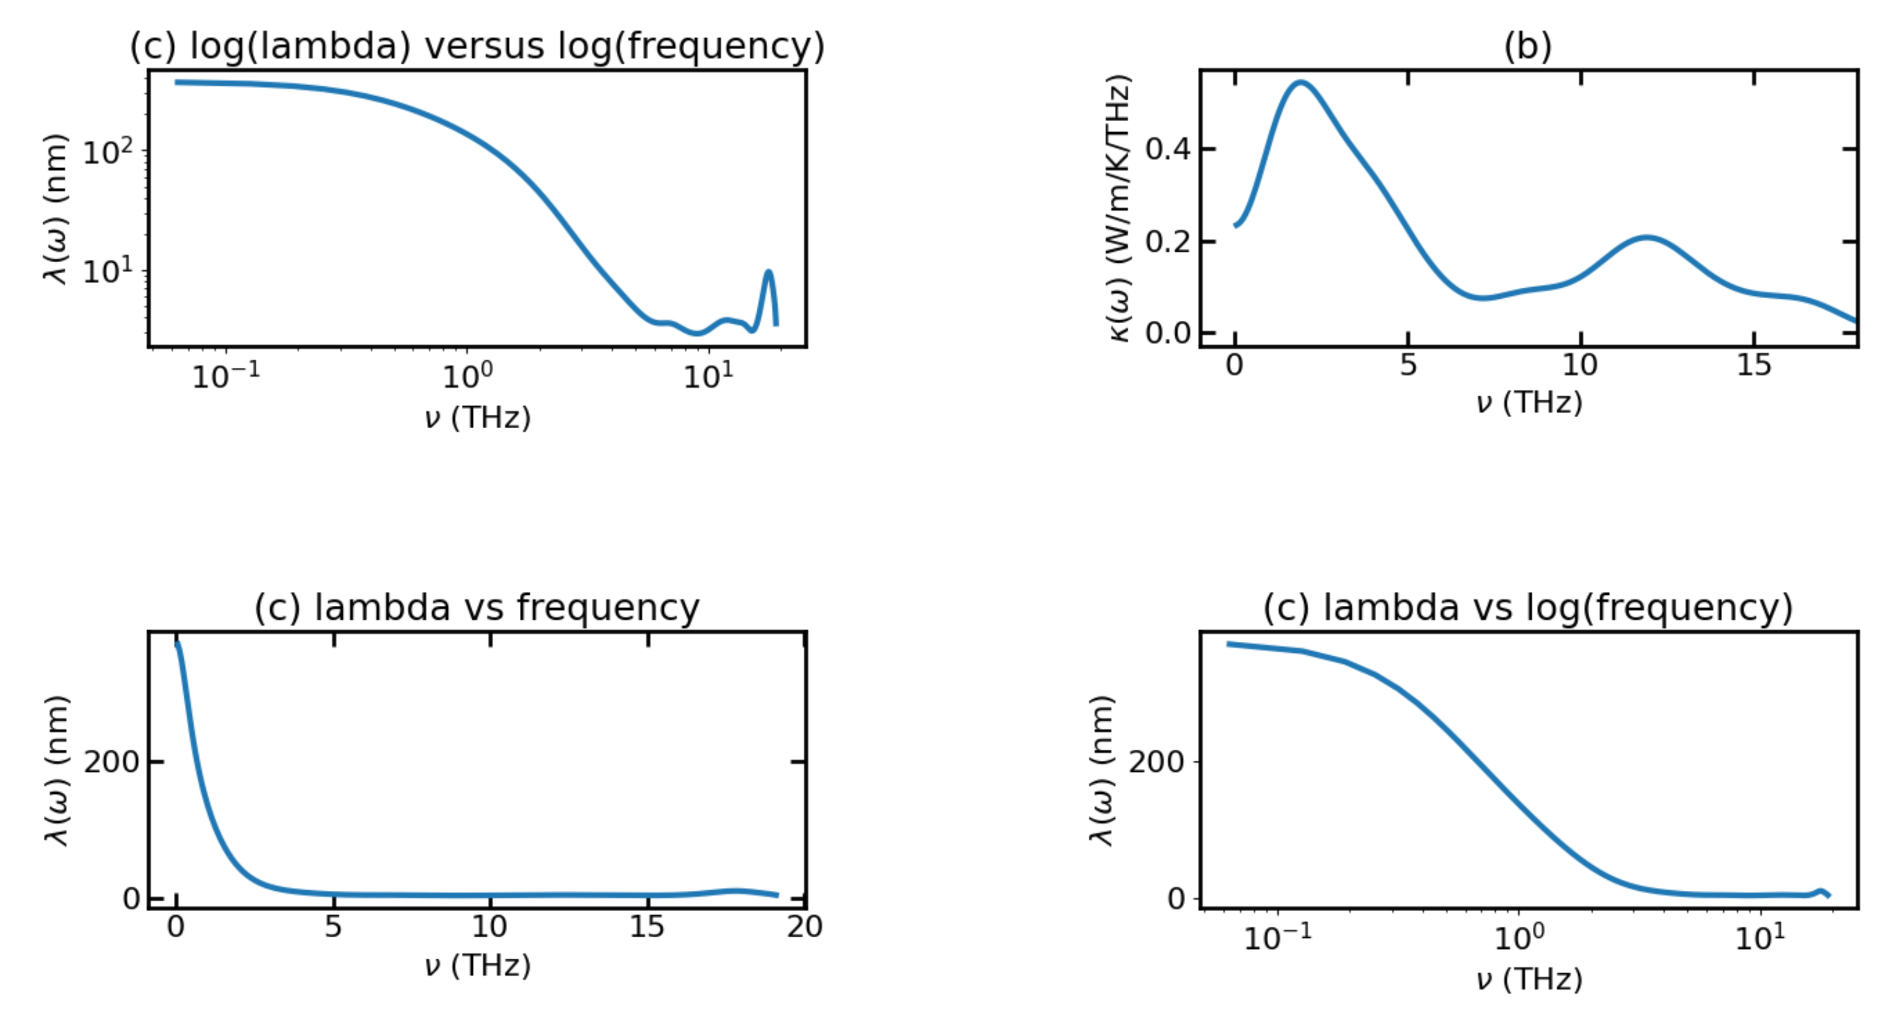
Temp = 900K – Avg Plot of lambda vs frequency (cut out the part that Gc or kw = 0 at after around 18THz)

Slide 12
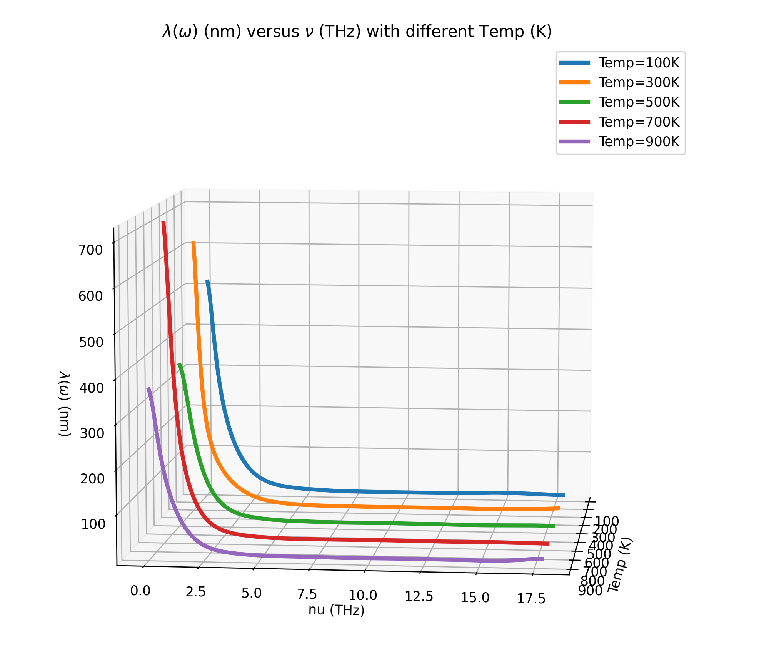
MFP versus Temp using Optimized F for each Temp

Slide 13
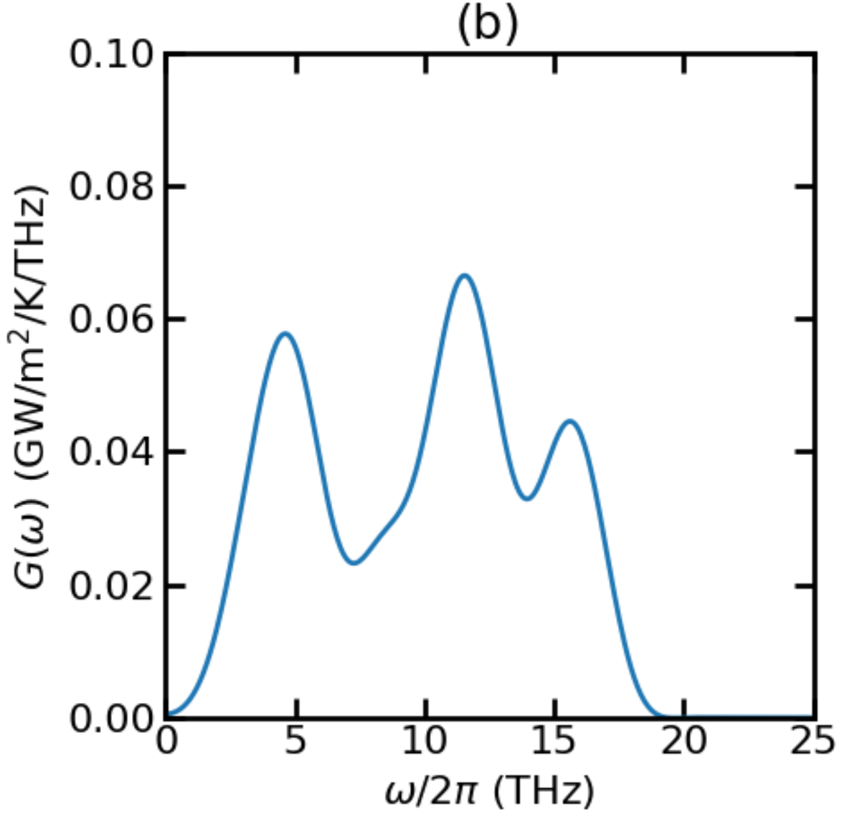
Thermal Conductance for T = 100K

Slide 14
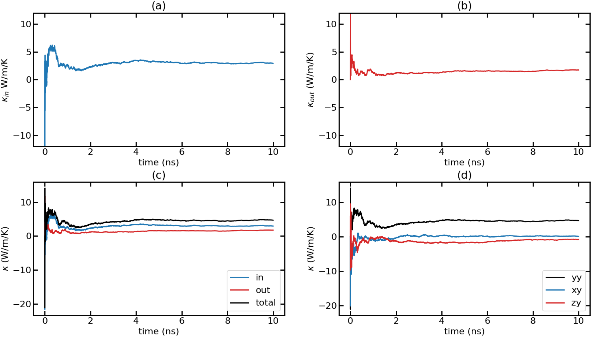
Time-dependent thermal conductivity (k(t) Vs. t) for T = 100K with F = 0.0001 Run 1

Slide 15
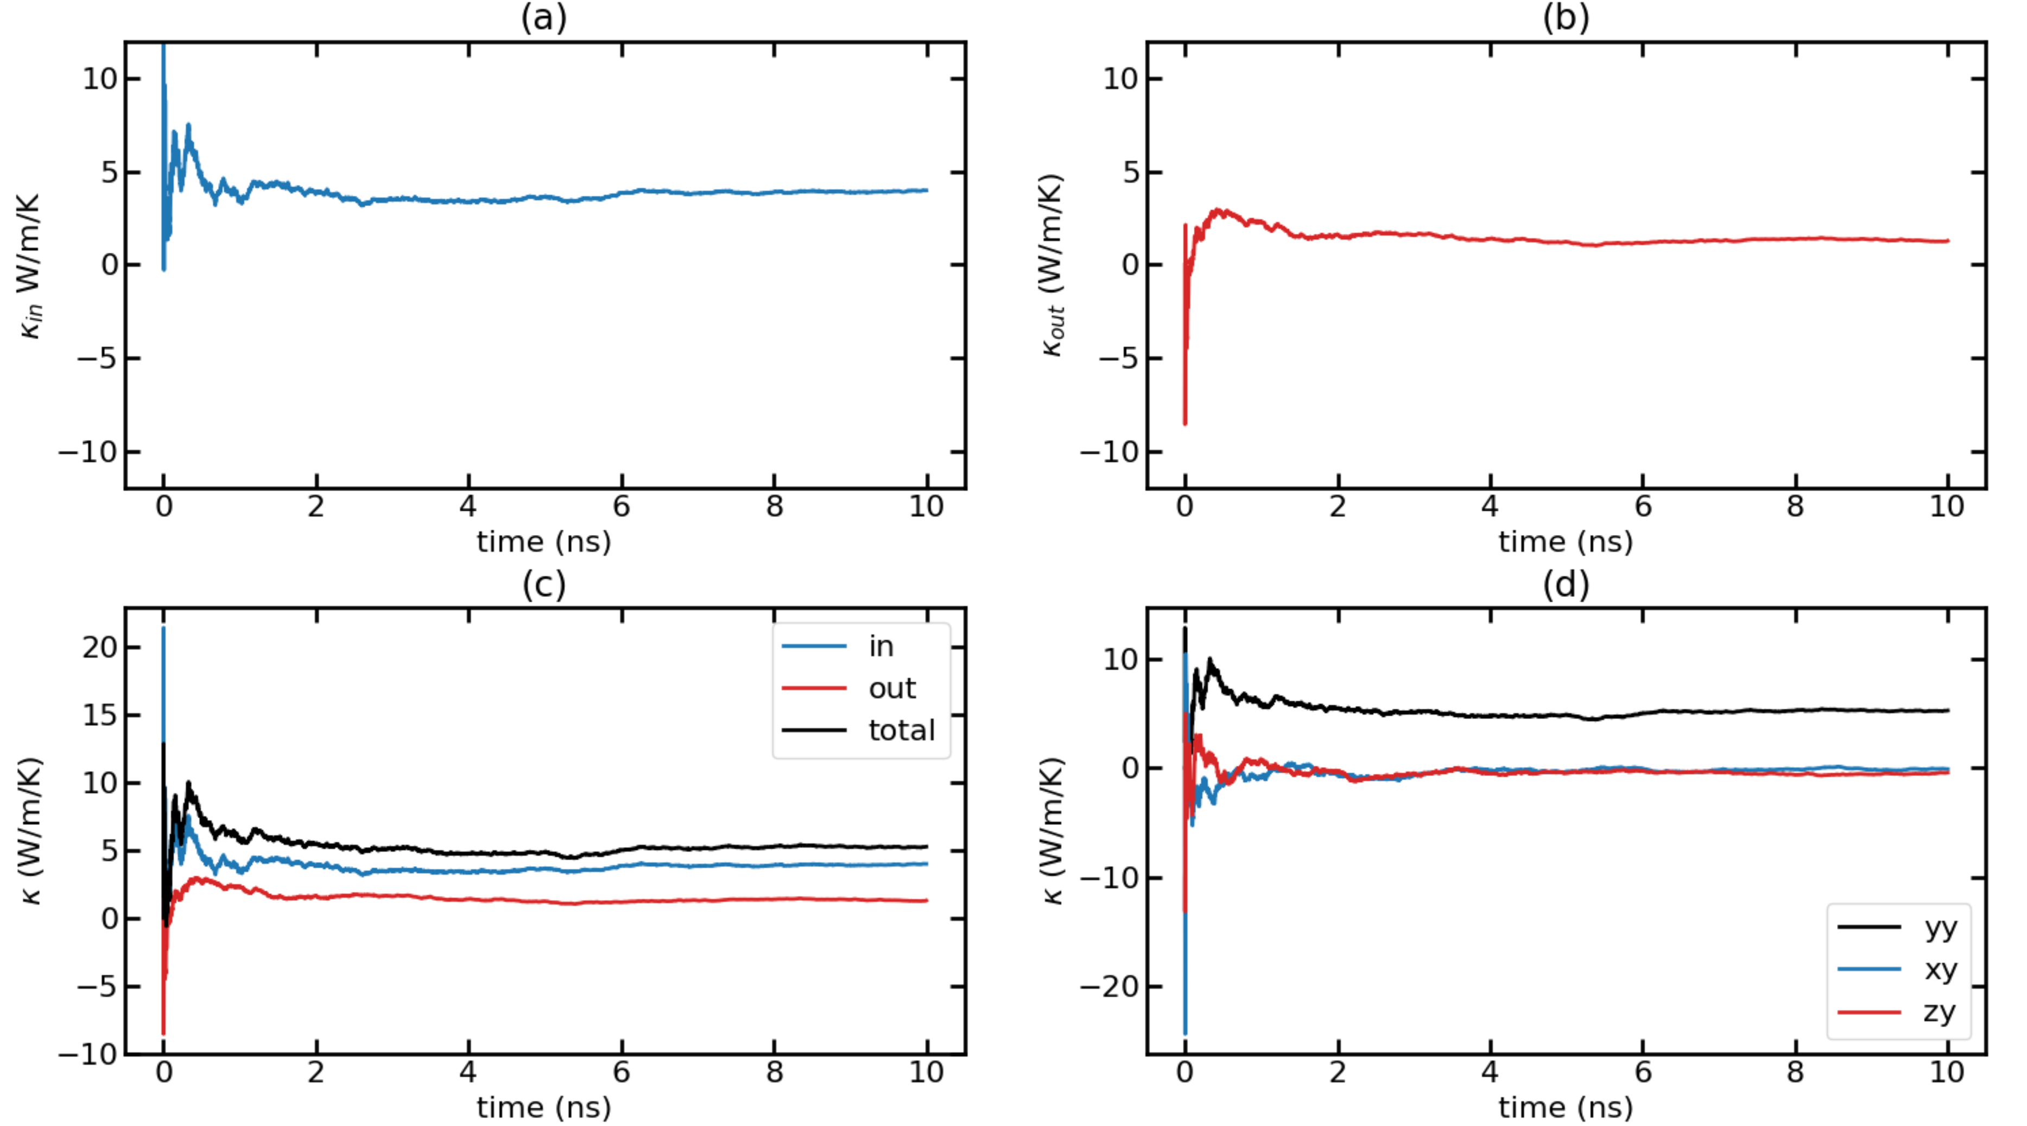
Time-dependent thermal conductivity (k(t) Vs. t) for T = 100K with F = 0.0001 Run 2

Slide 16
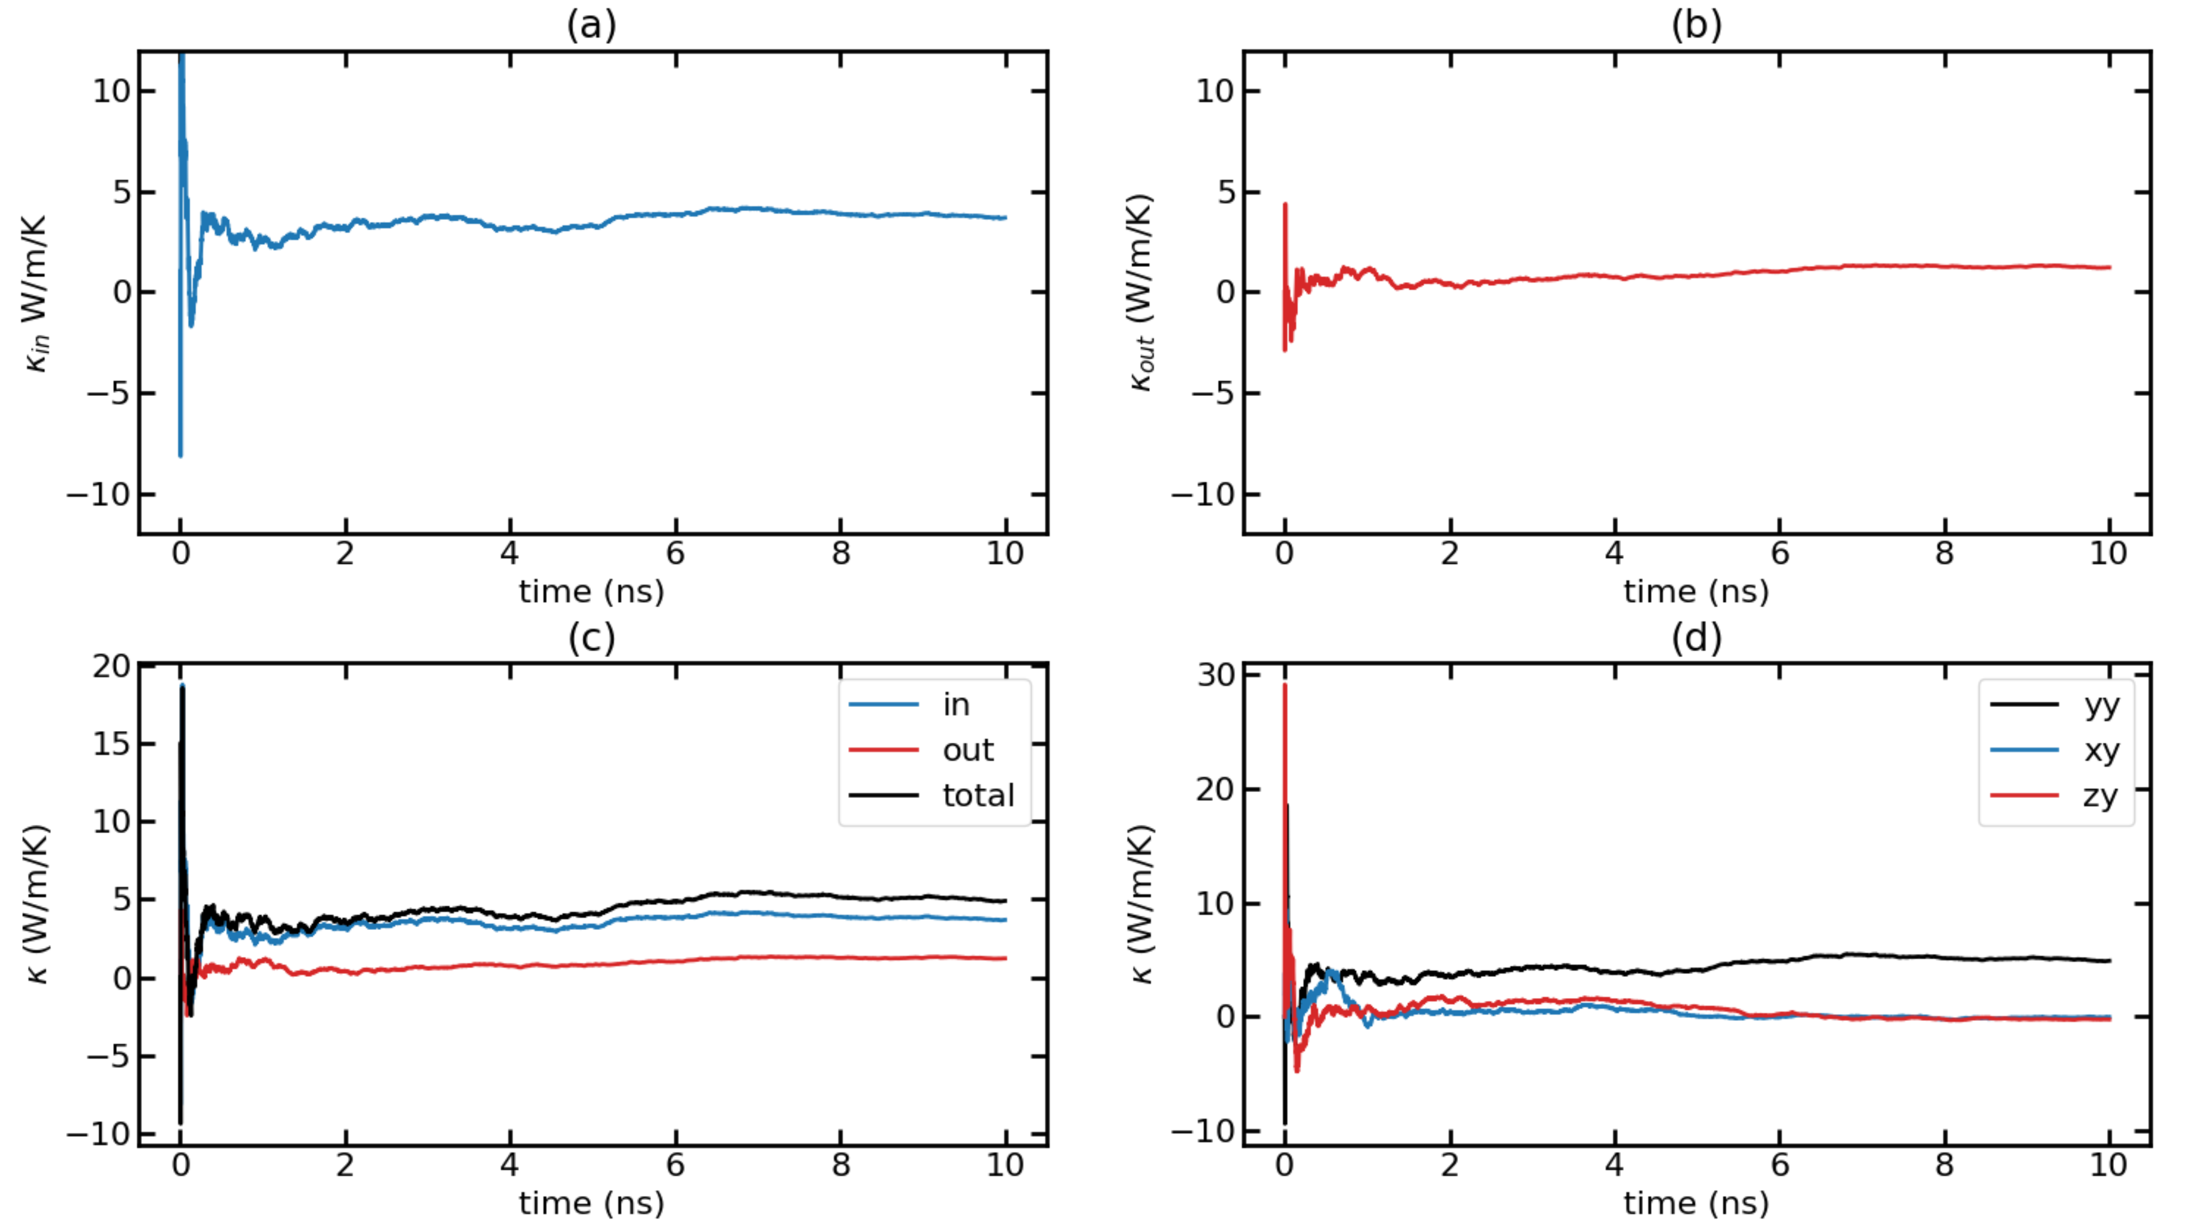
Time-dependent thermal conductivity (k(t) Vs. t) for T = 100K with F = 0.0001 Run 3

Slide 17
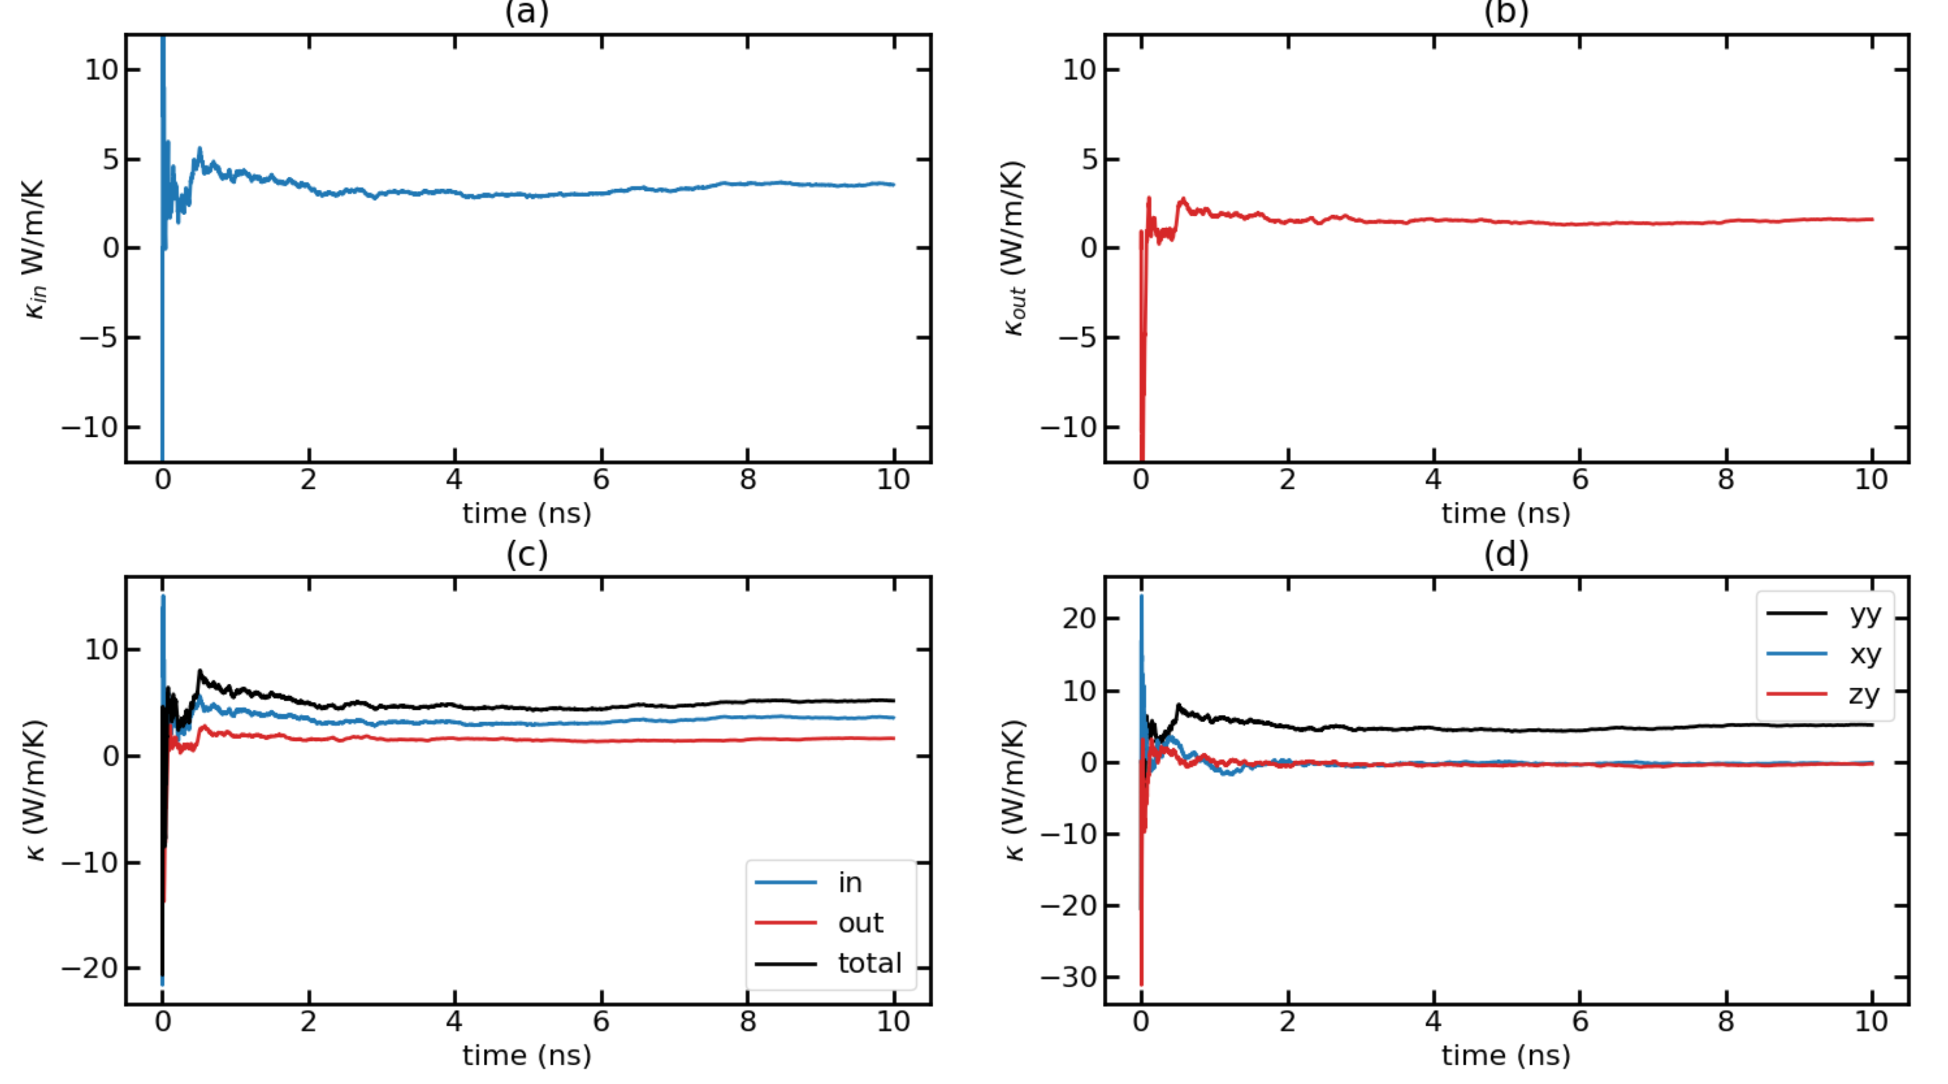
Time-dependent thermal conductivity (k(t) Vs. t) for T = 100K with F = 0.0001 Run 4

Slide 18
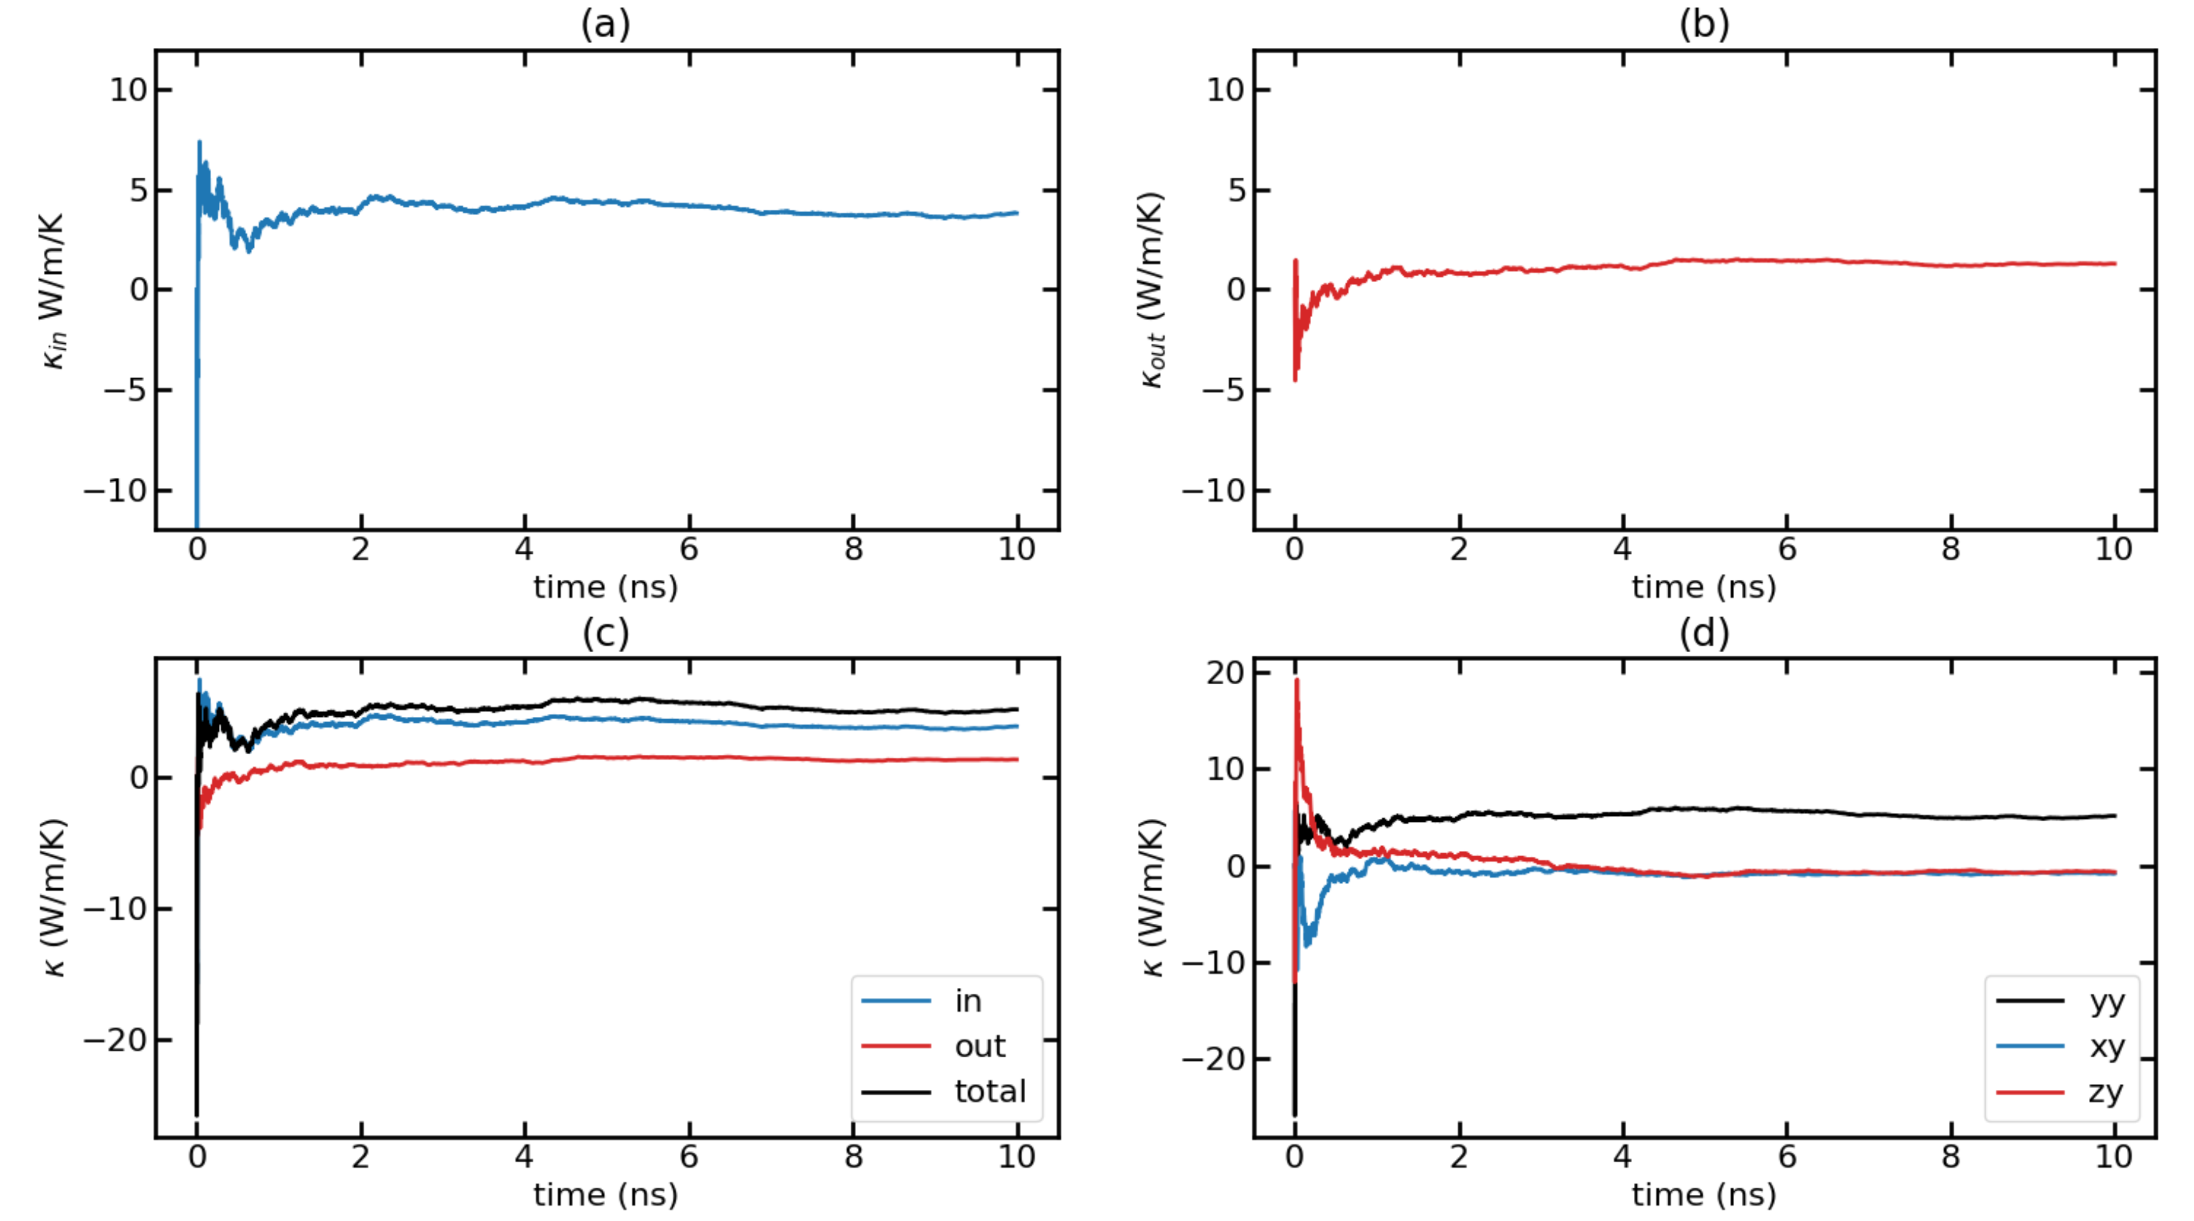
Time-dependent thermal conductivity (k(t) Vs. t) for T = 100K with F = 0.0001 Run 5

Slide 19
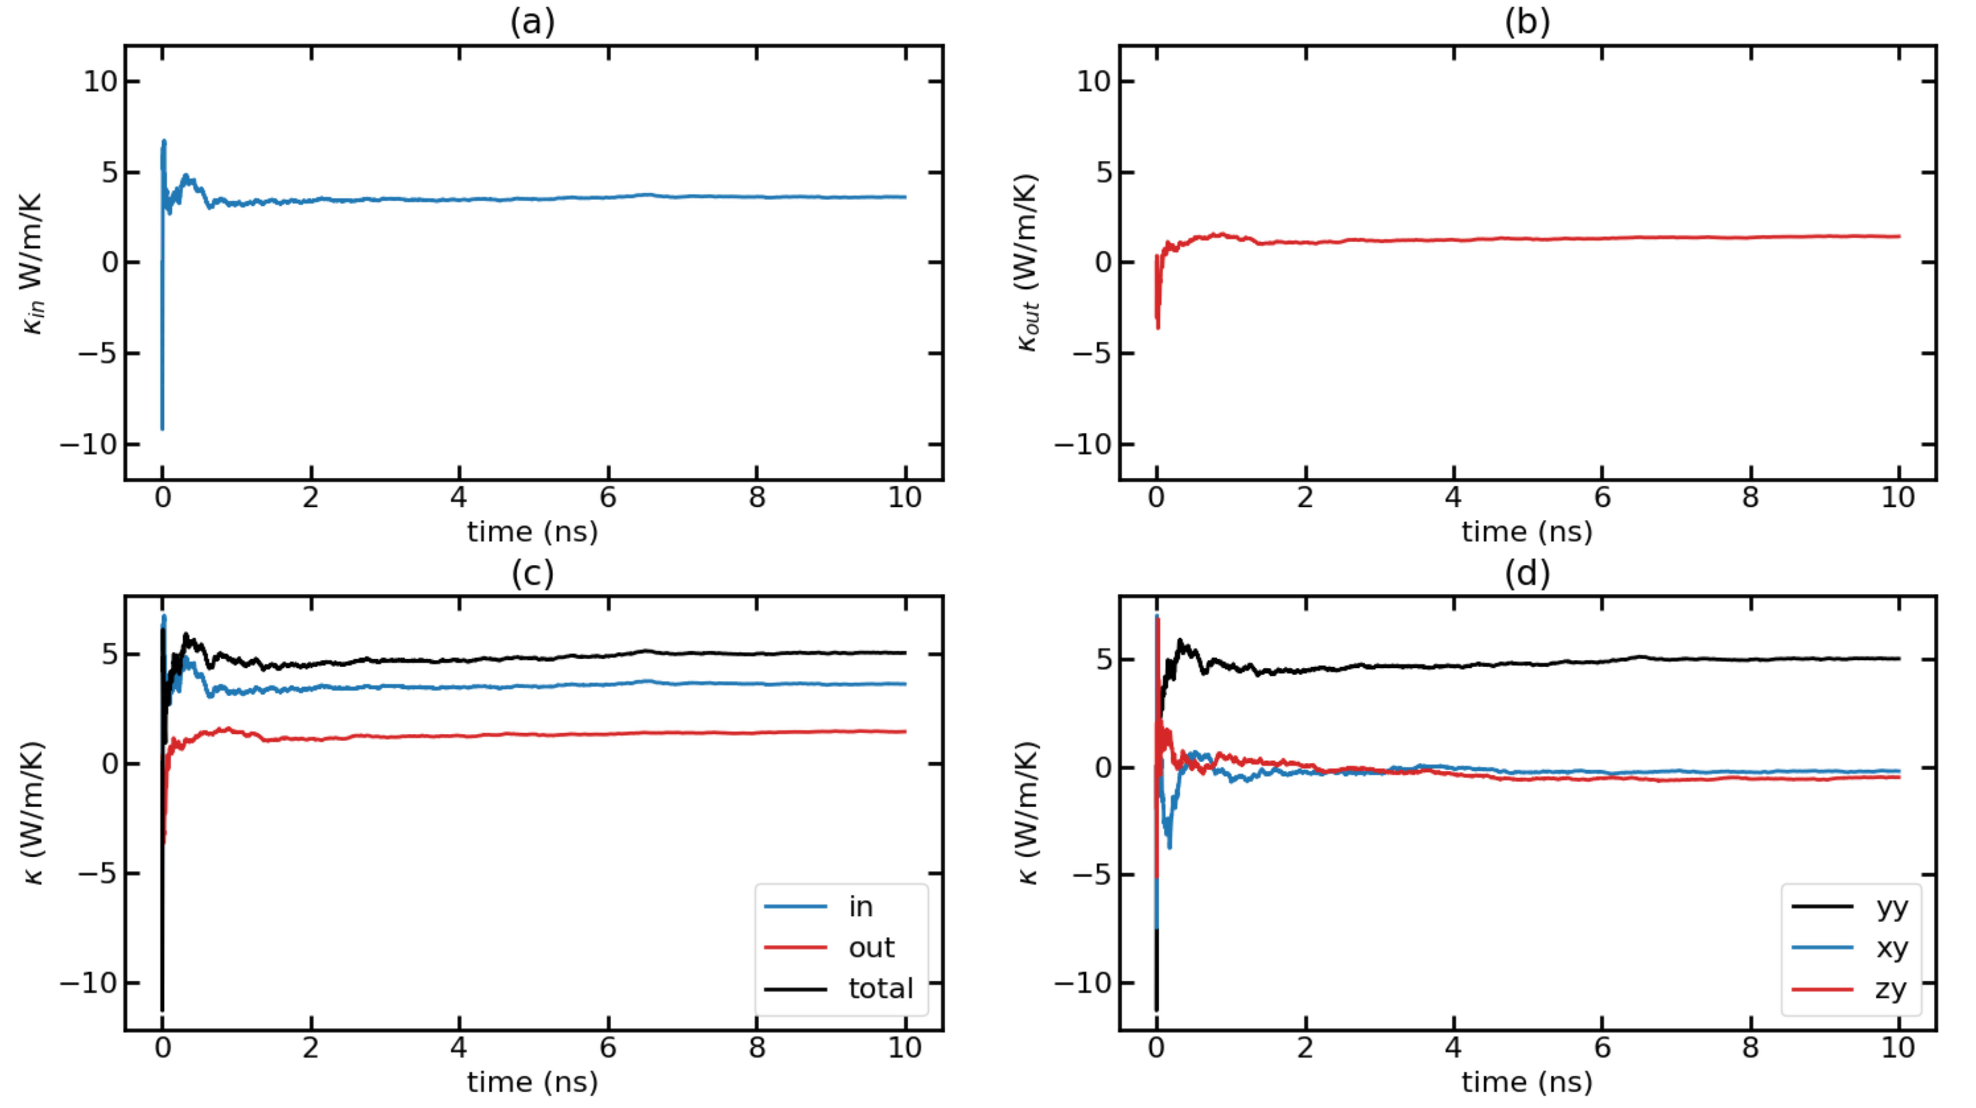
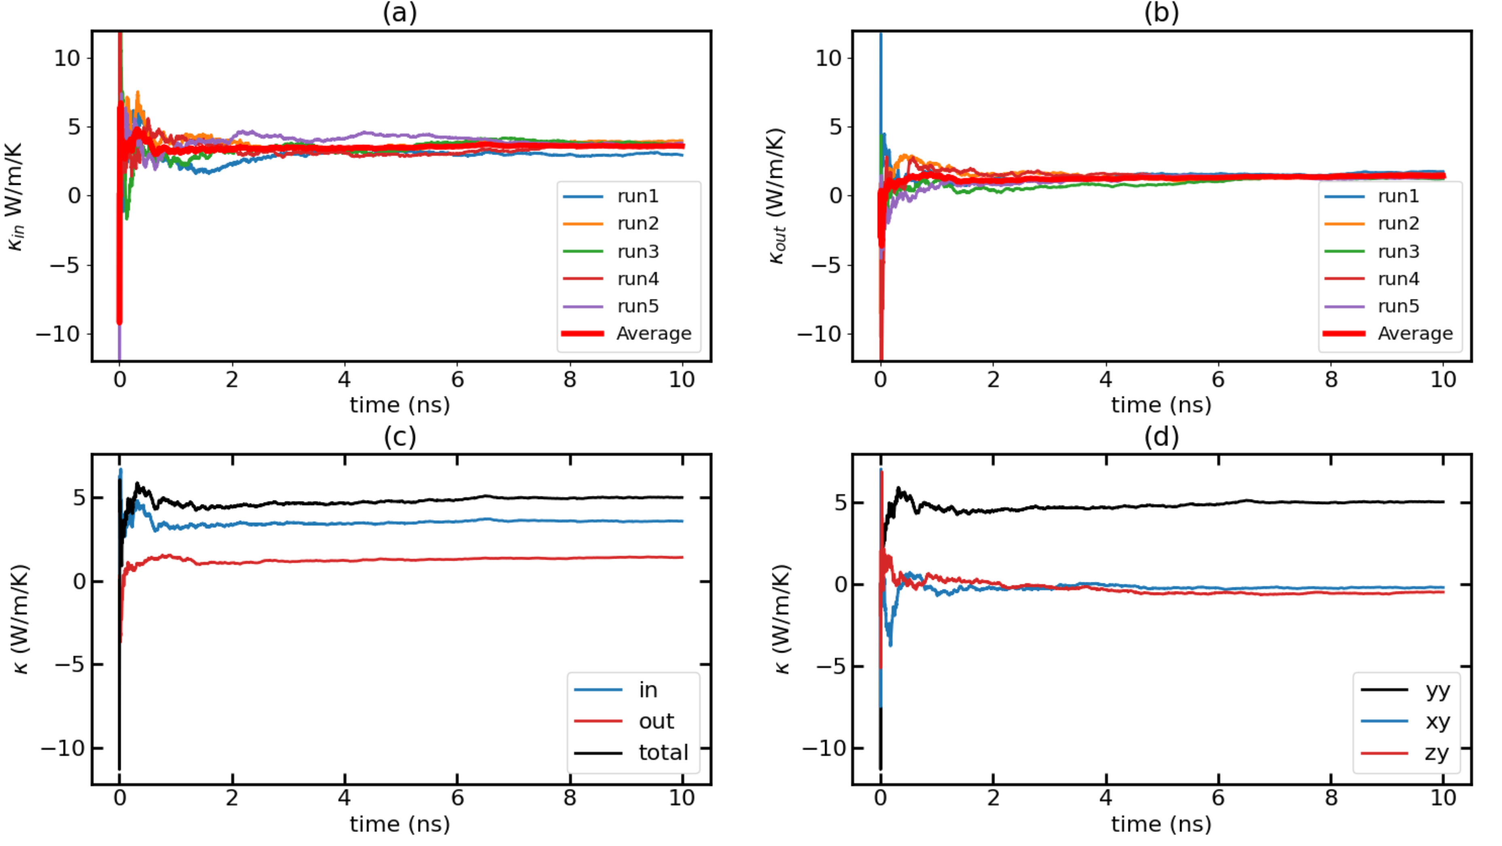
Time-dependent thermal conductivity (k(t) Vs. t) for T = 100K with F = 0.0001 Average Run

Slide 20
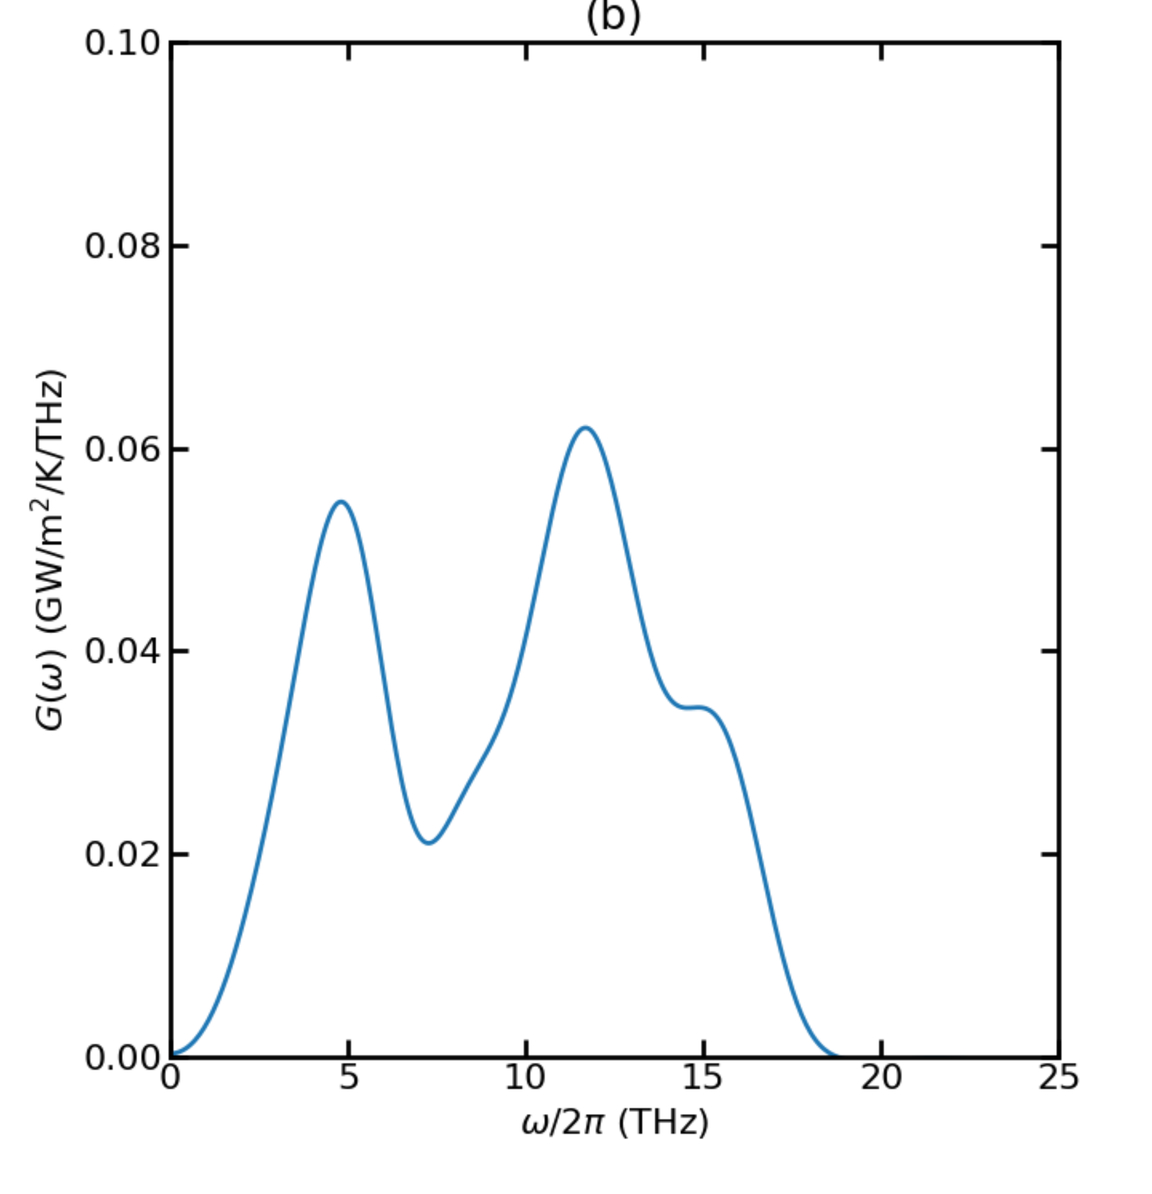
Thermal Conductance for T = 300K

Slide 21
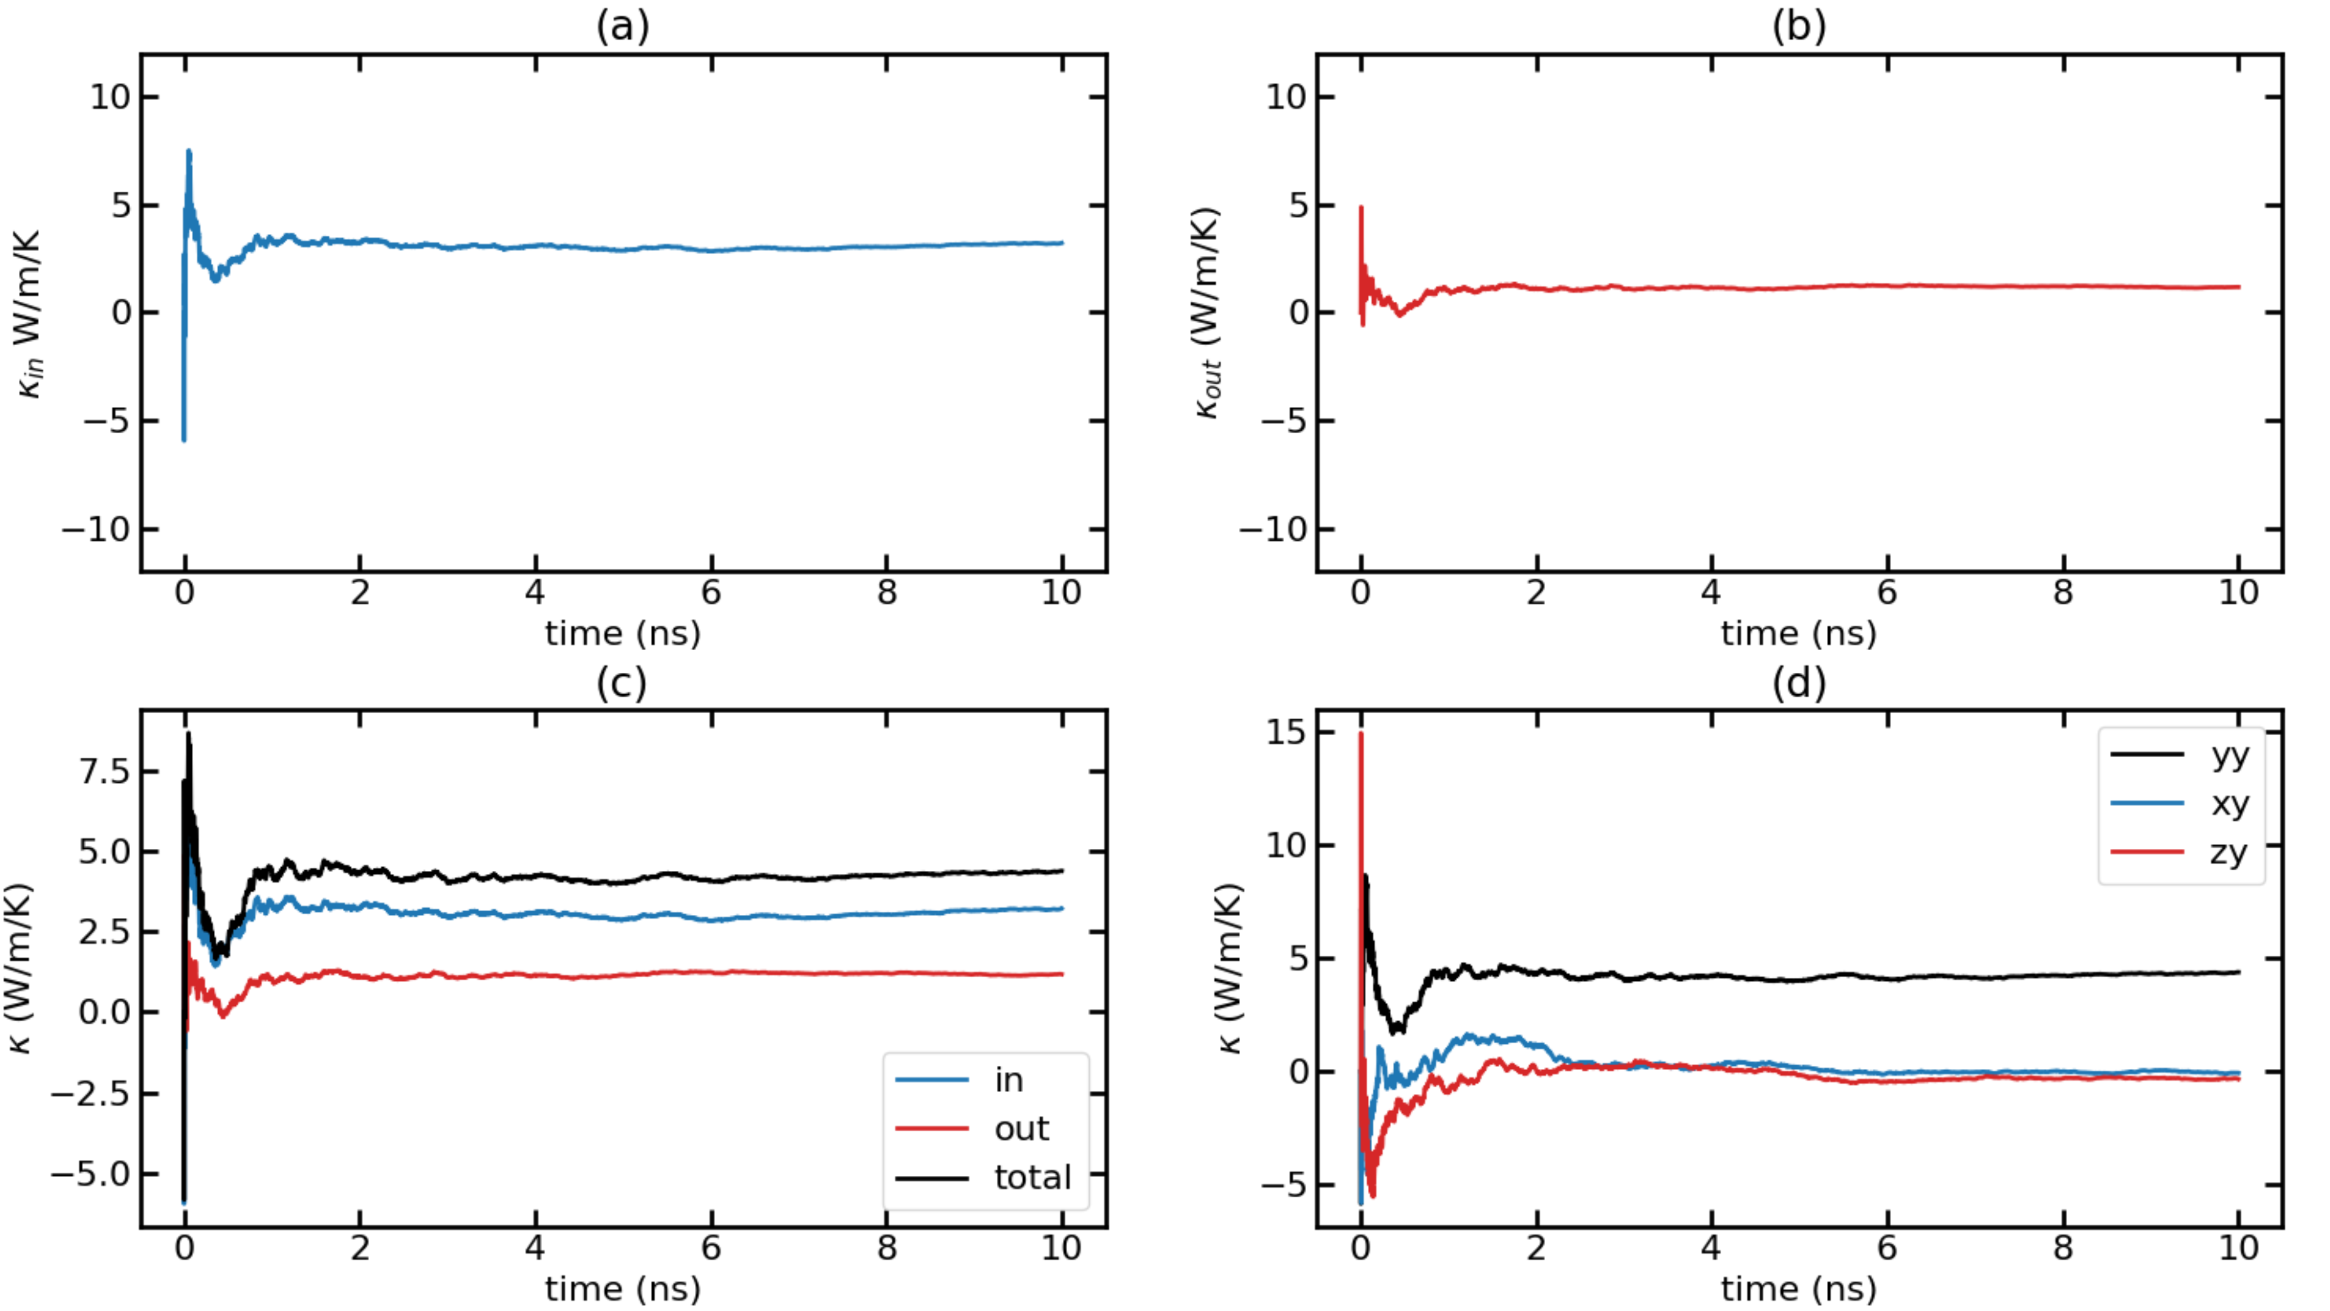
Time-dependent thermal conductivity (k(t) Vs. t) for T = 300K with F = 0.00014 Run 1

Slide 22
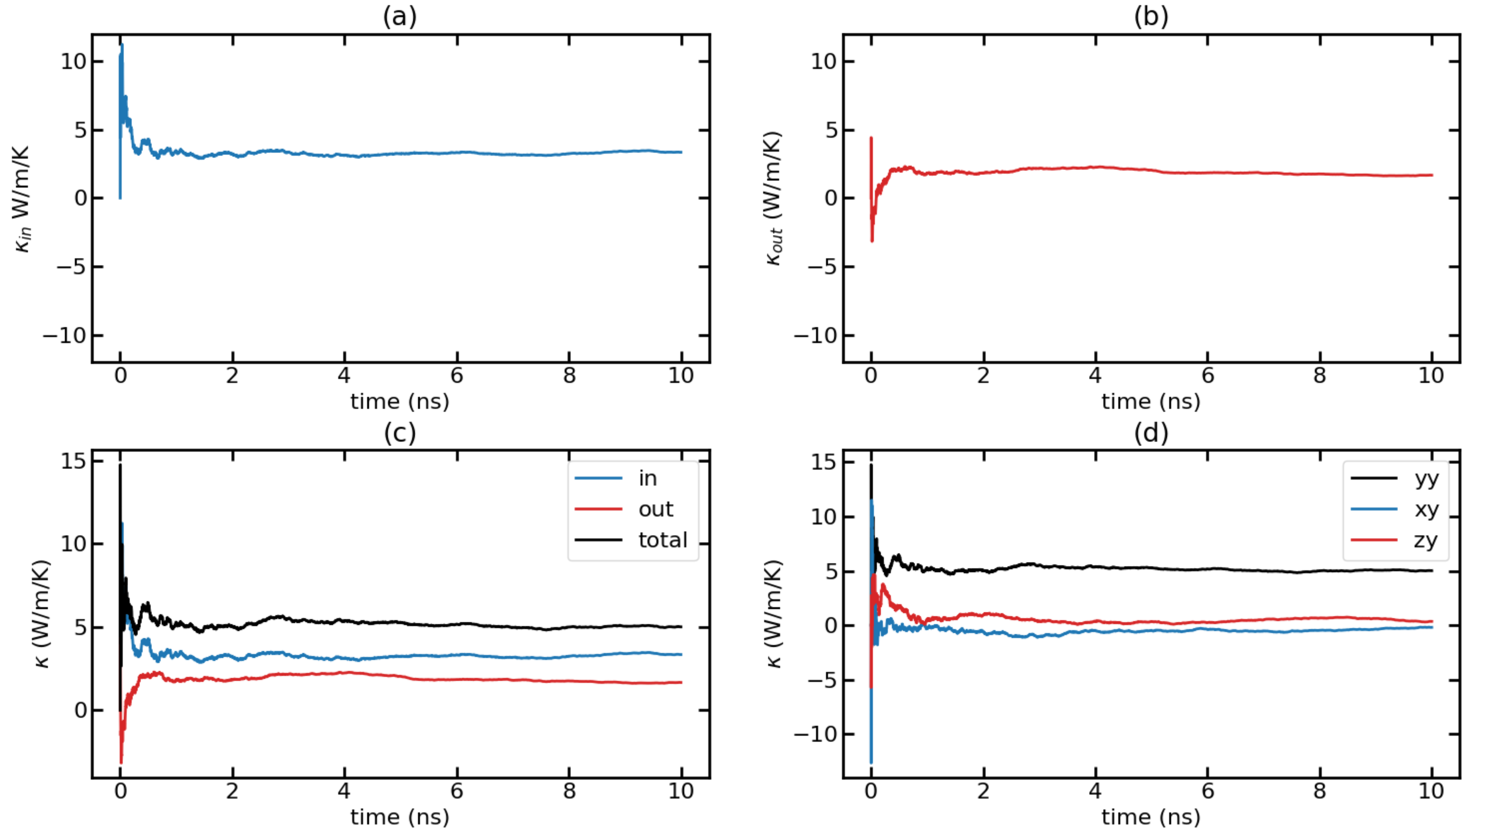
Time-dependent thermal conductivity (k(t) Vs. t) for T = 300K with F = 0.00014 Run 2

Slide 23
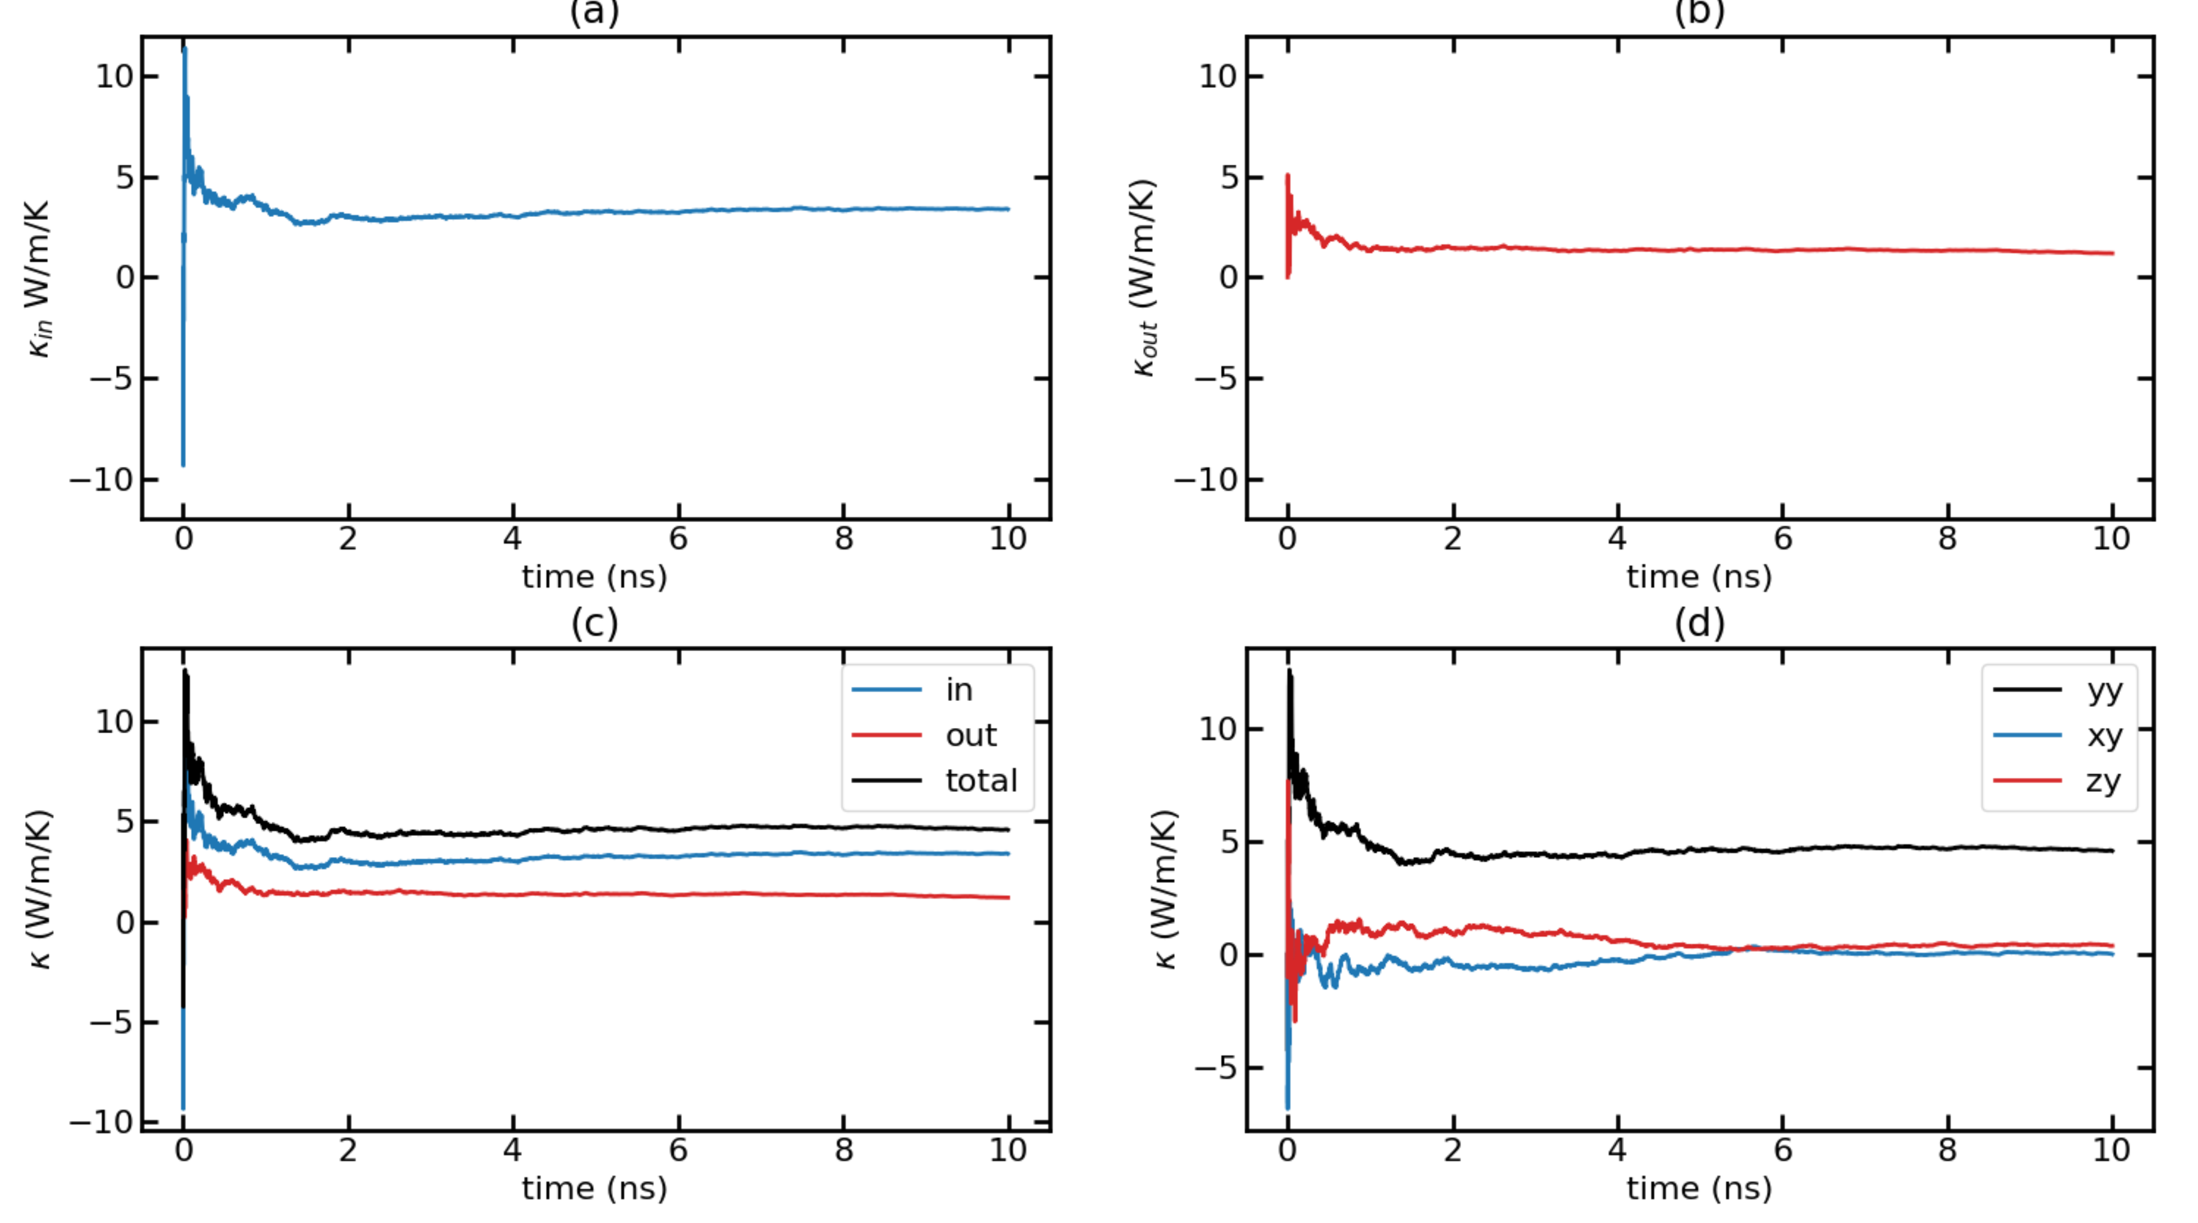
Time-dependent thermal conductivity (k(t) Vs. t) for T = 300K with F = 0.00014 Run 3

Slide 24
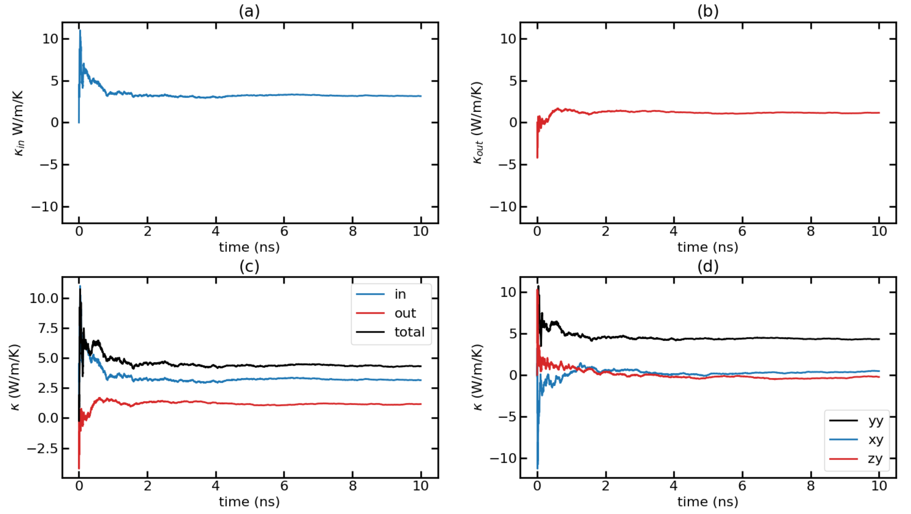
Time-dependent thermal conductivity (k(t) Vs. t) for T = 300K with F = 0.00014 Run 4

Slide 25
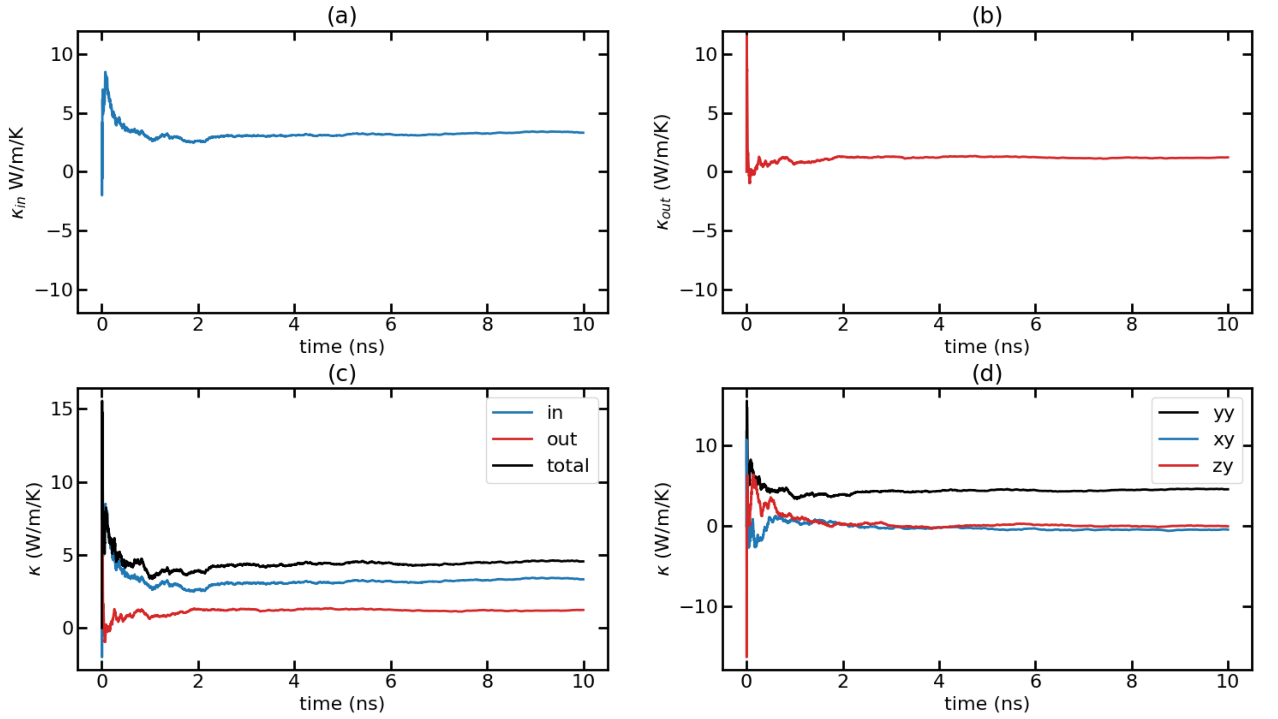
Time-dependent thermal conductivity (k(t) Vs. t) for T = 300K with F = 0.00014 Run 5

Slide 26
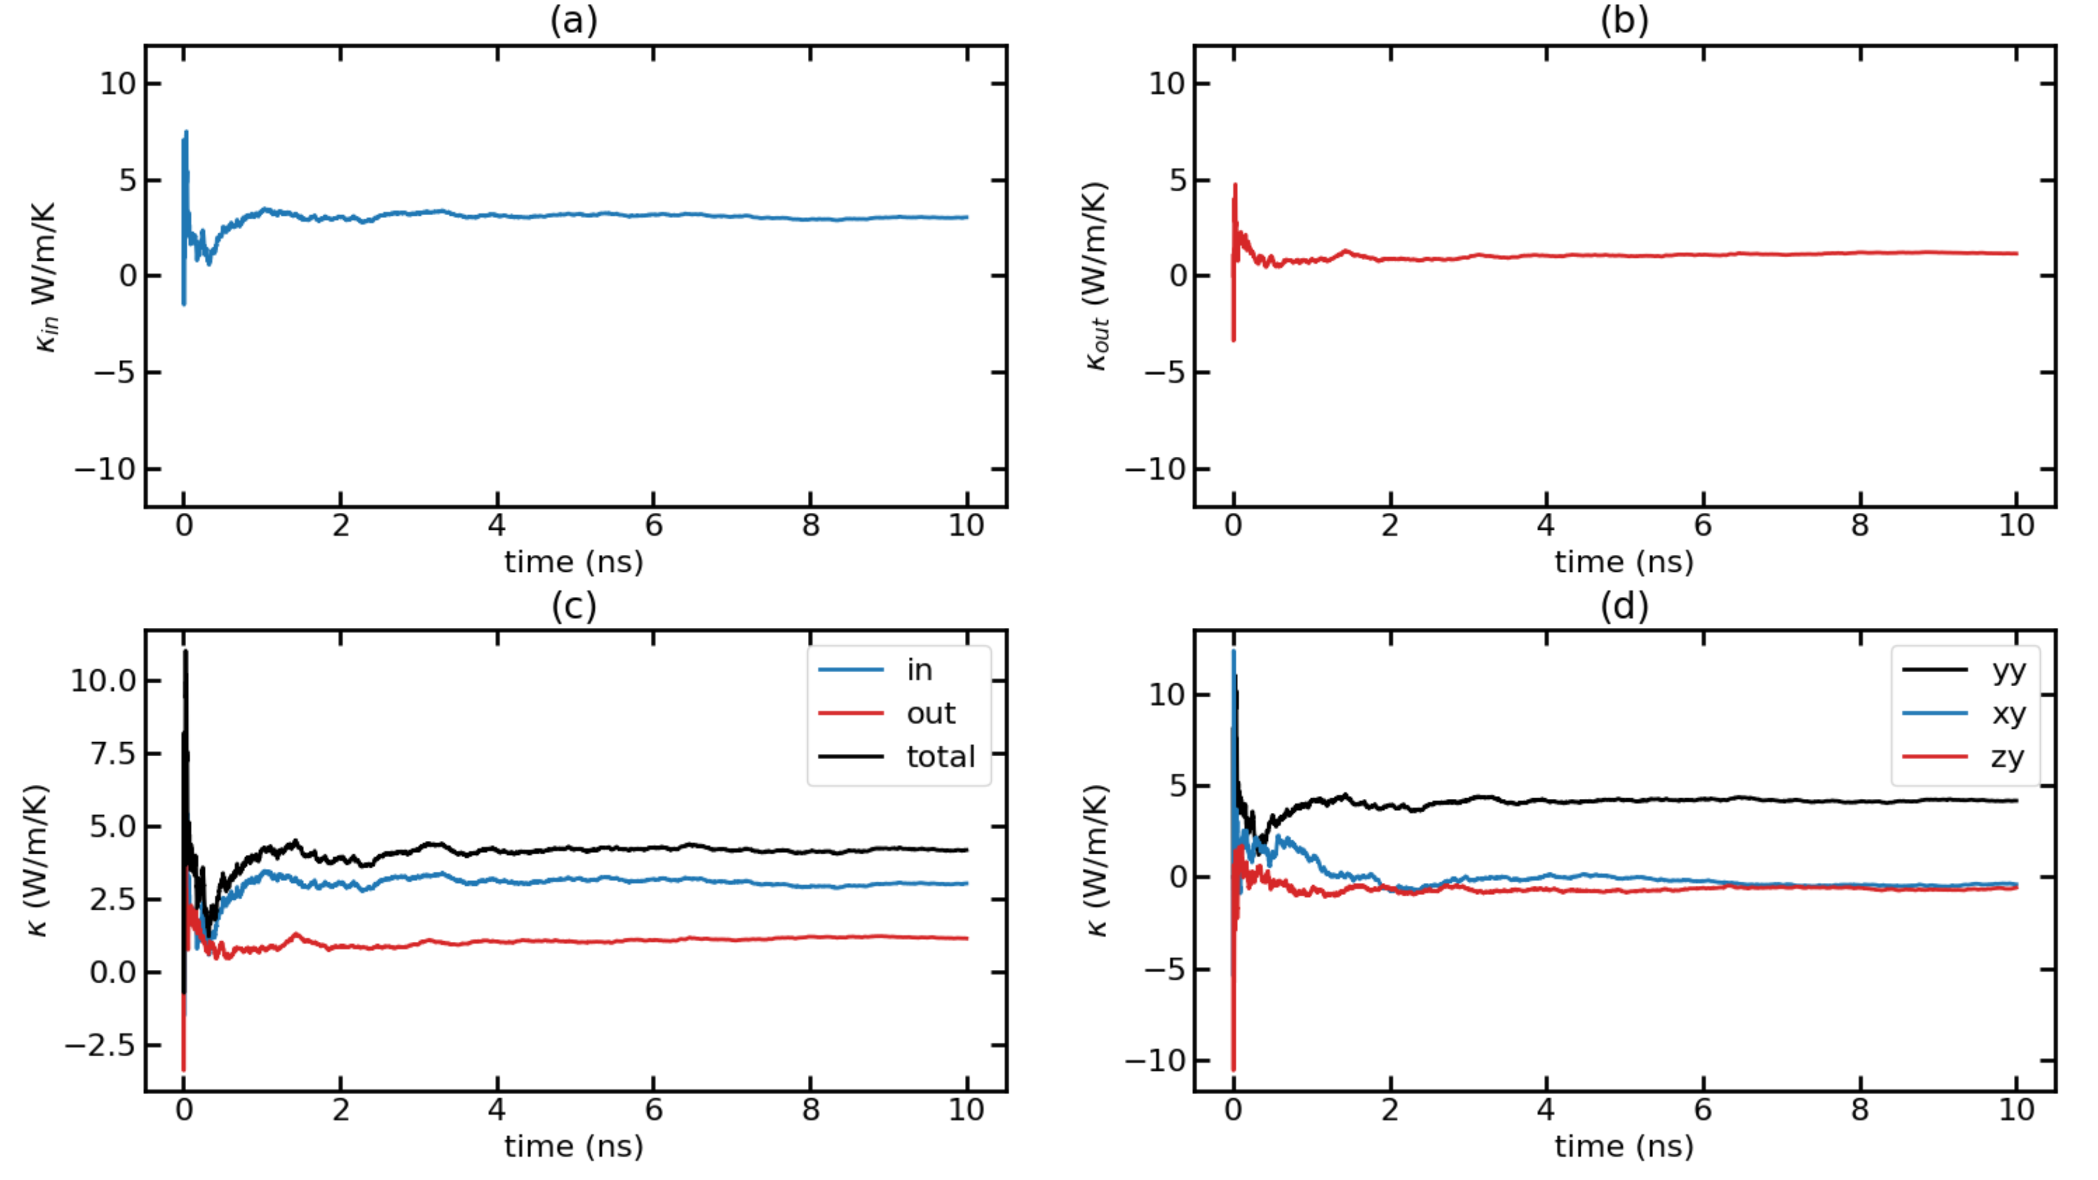
Time-dependent thermal conductivity (k(t) Vs. t) for T = 300K with F = 0.00014 Run 6

Slide 27
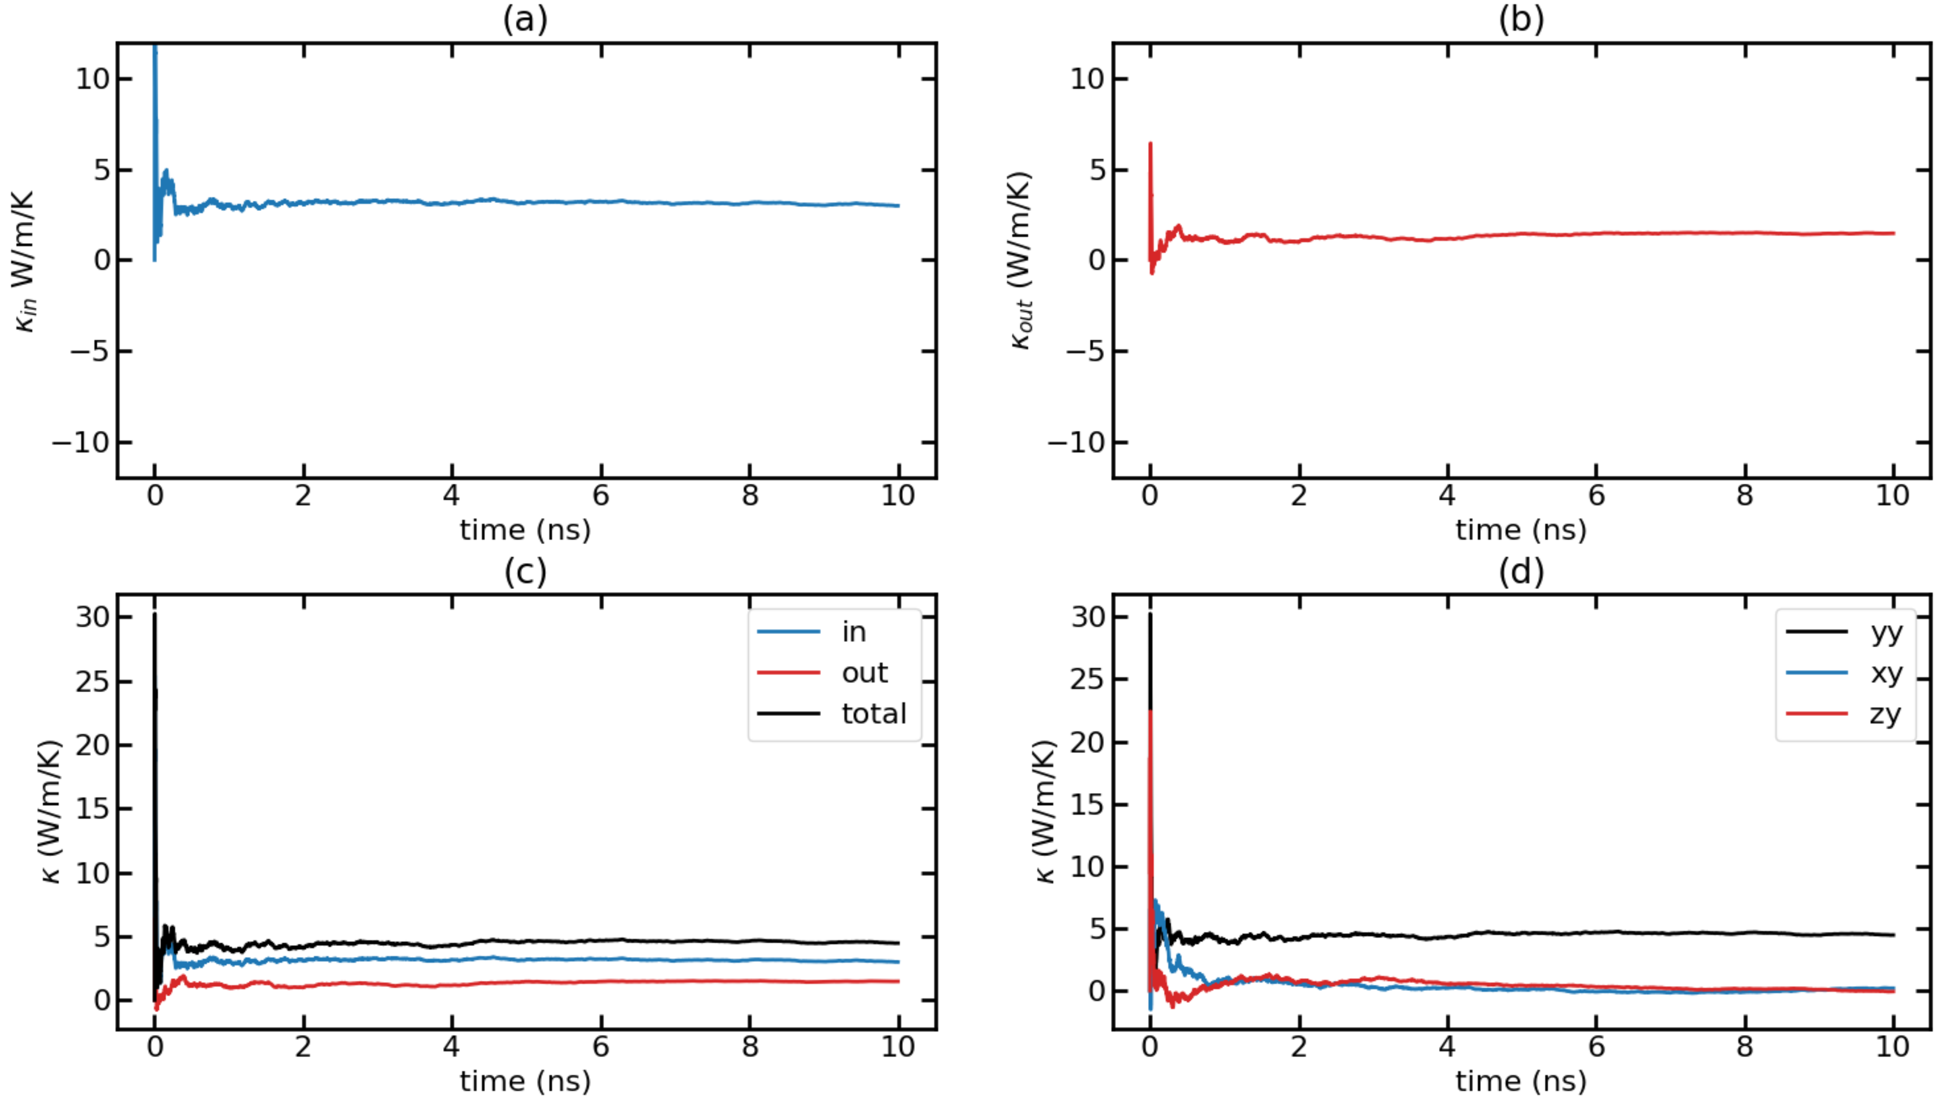
Time-dependent thermal conductivity (k(t) Vs. t) for T = 300K with F = 0.00014 Run 7

Slide 28
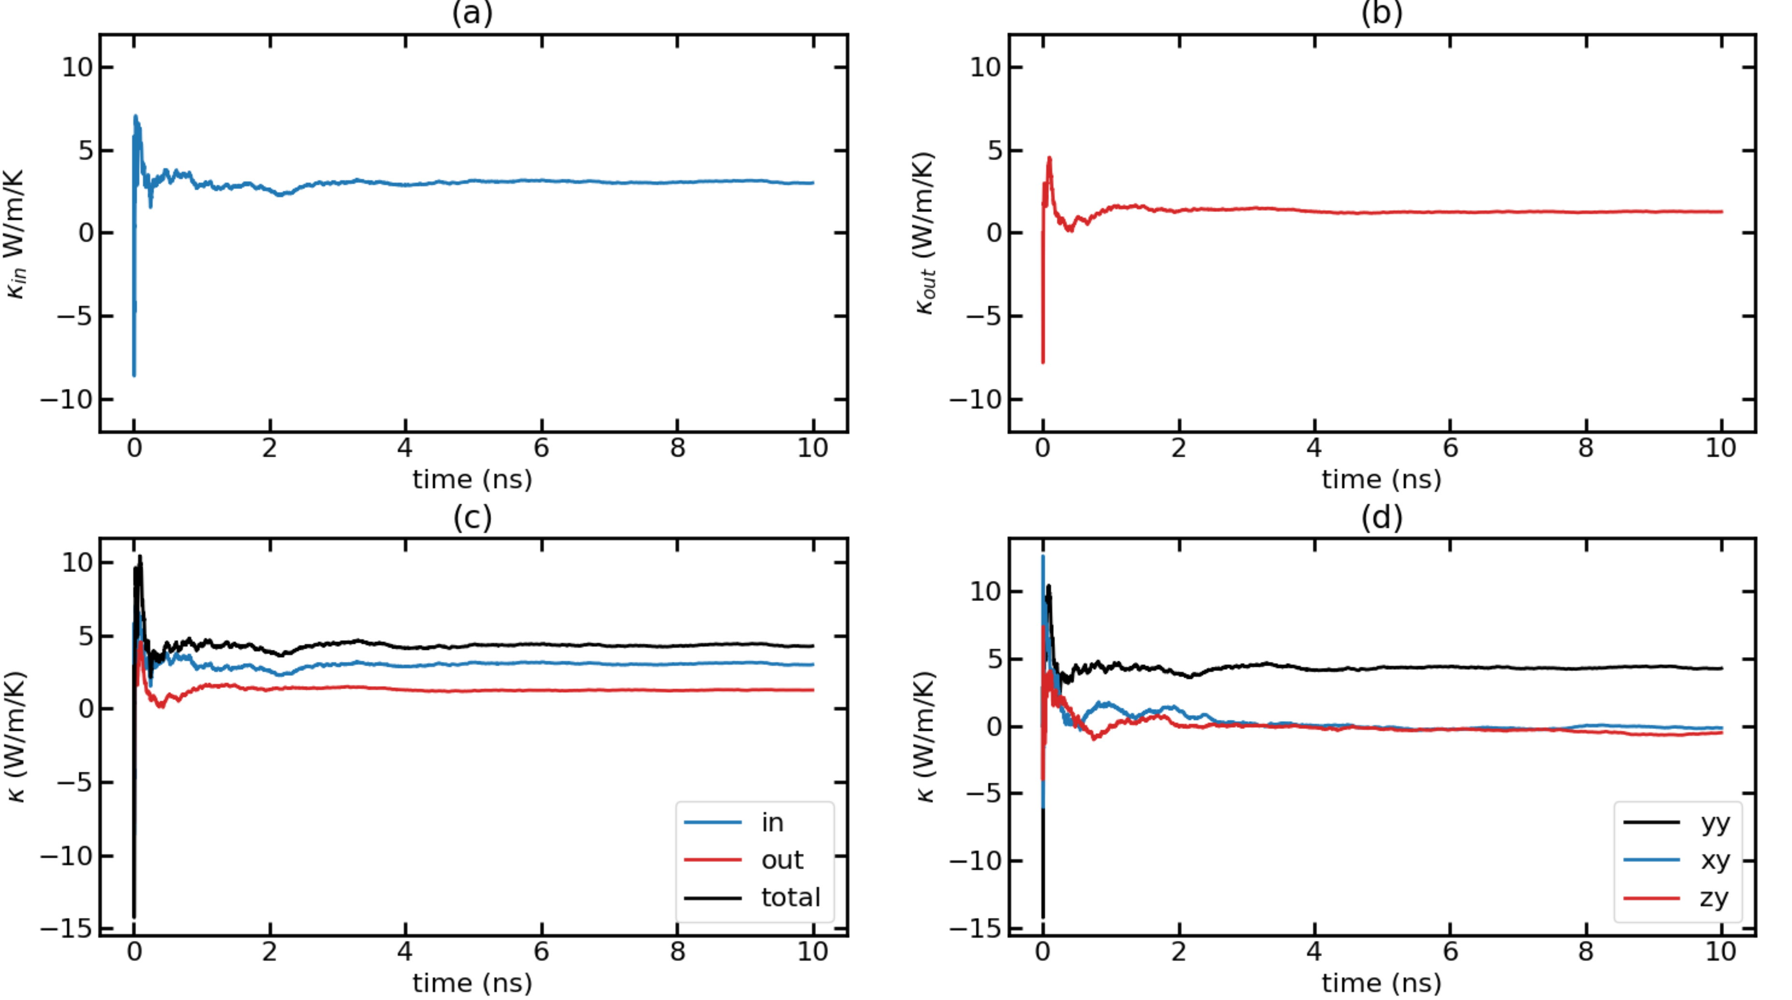
Time-dependent thermal conductivity (k(t) Vs. t) for T = 300K with F = 0.00014 Run 8

Slide 29
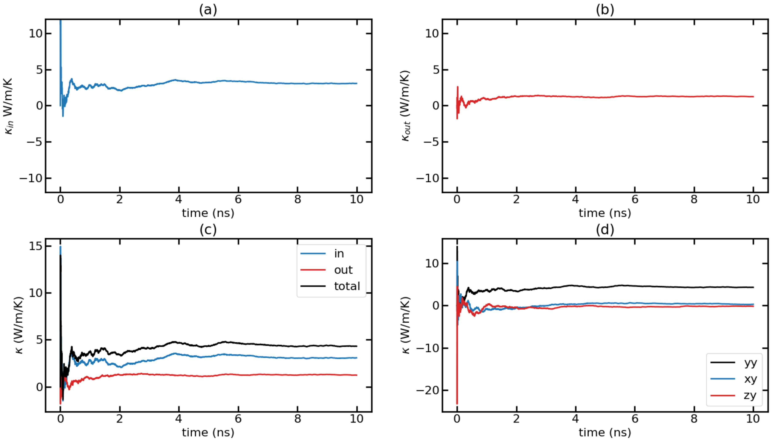
Time-dependent thermal conductivity (k(t) Vs. t) for T = 300K with F = 0.00014 Run 9

Slide 30
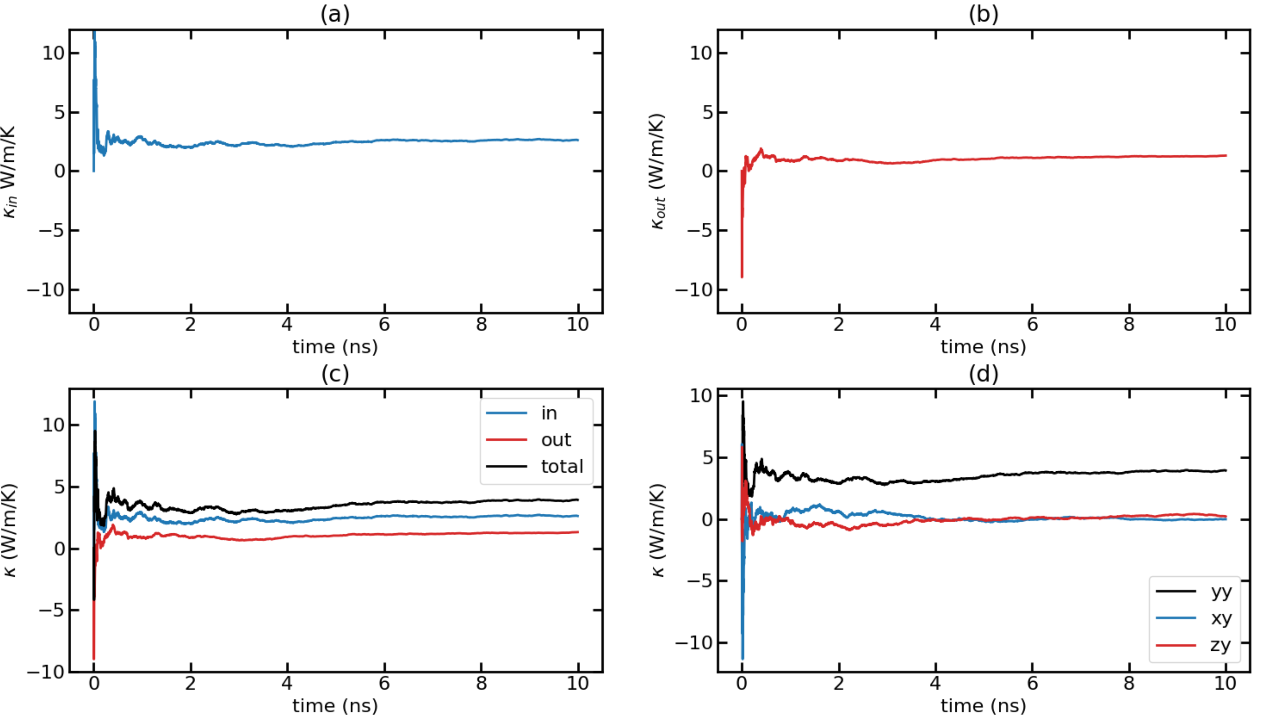
Time-dependent thermal conductivity (k(t) Vs. t) for T = 300K with F = 0.00014 Run 10

Slide 31
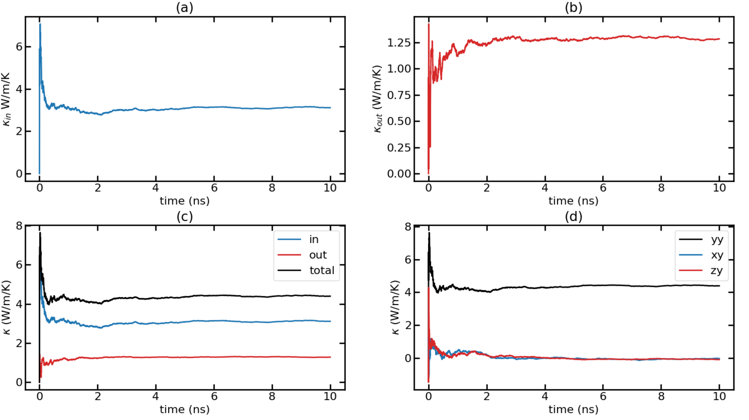
Time-dependent thermal conductivity (k(t) Vs. t) for T = 300K with F = 0.00014 Avg Runs

Slide 32
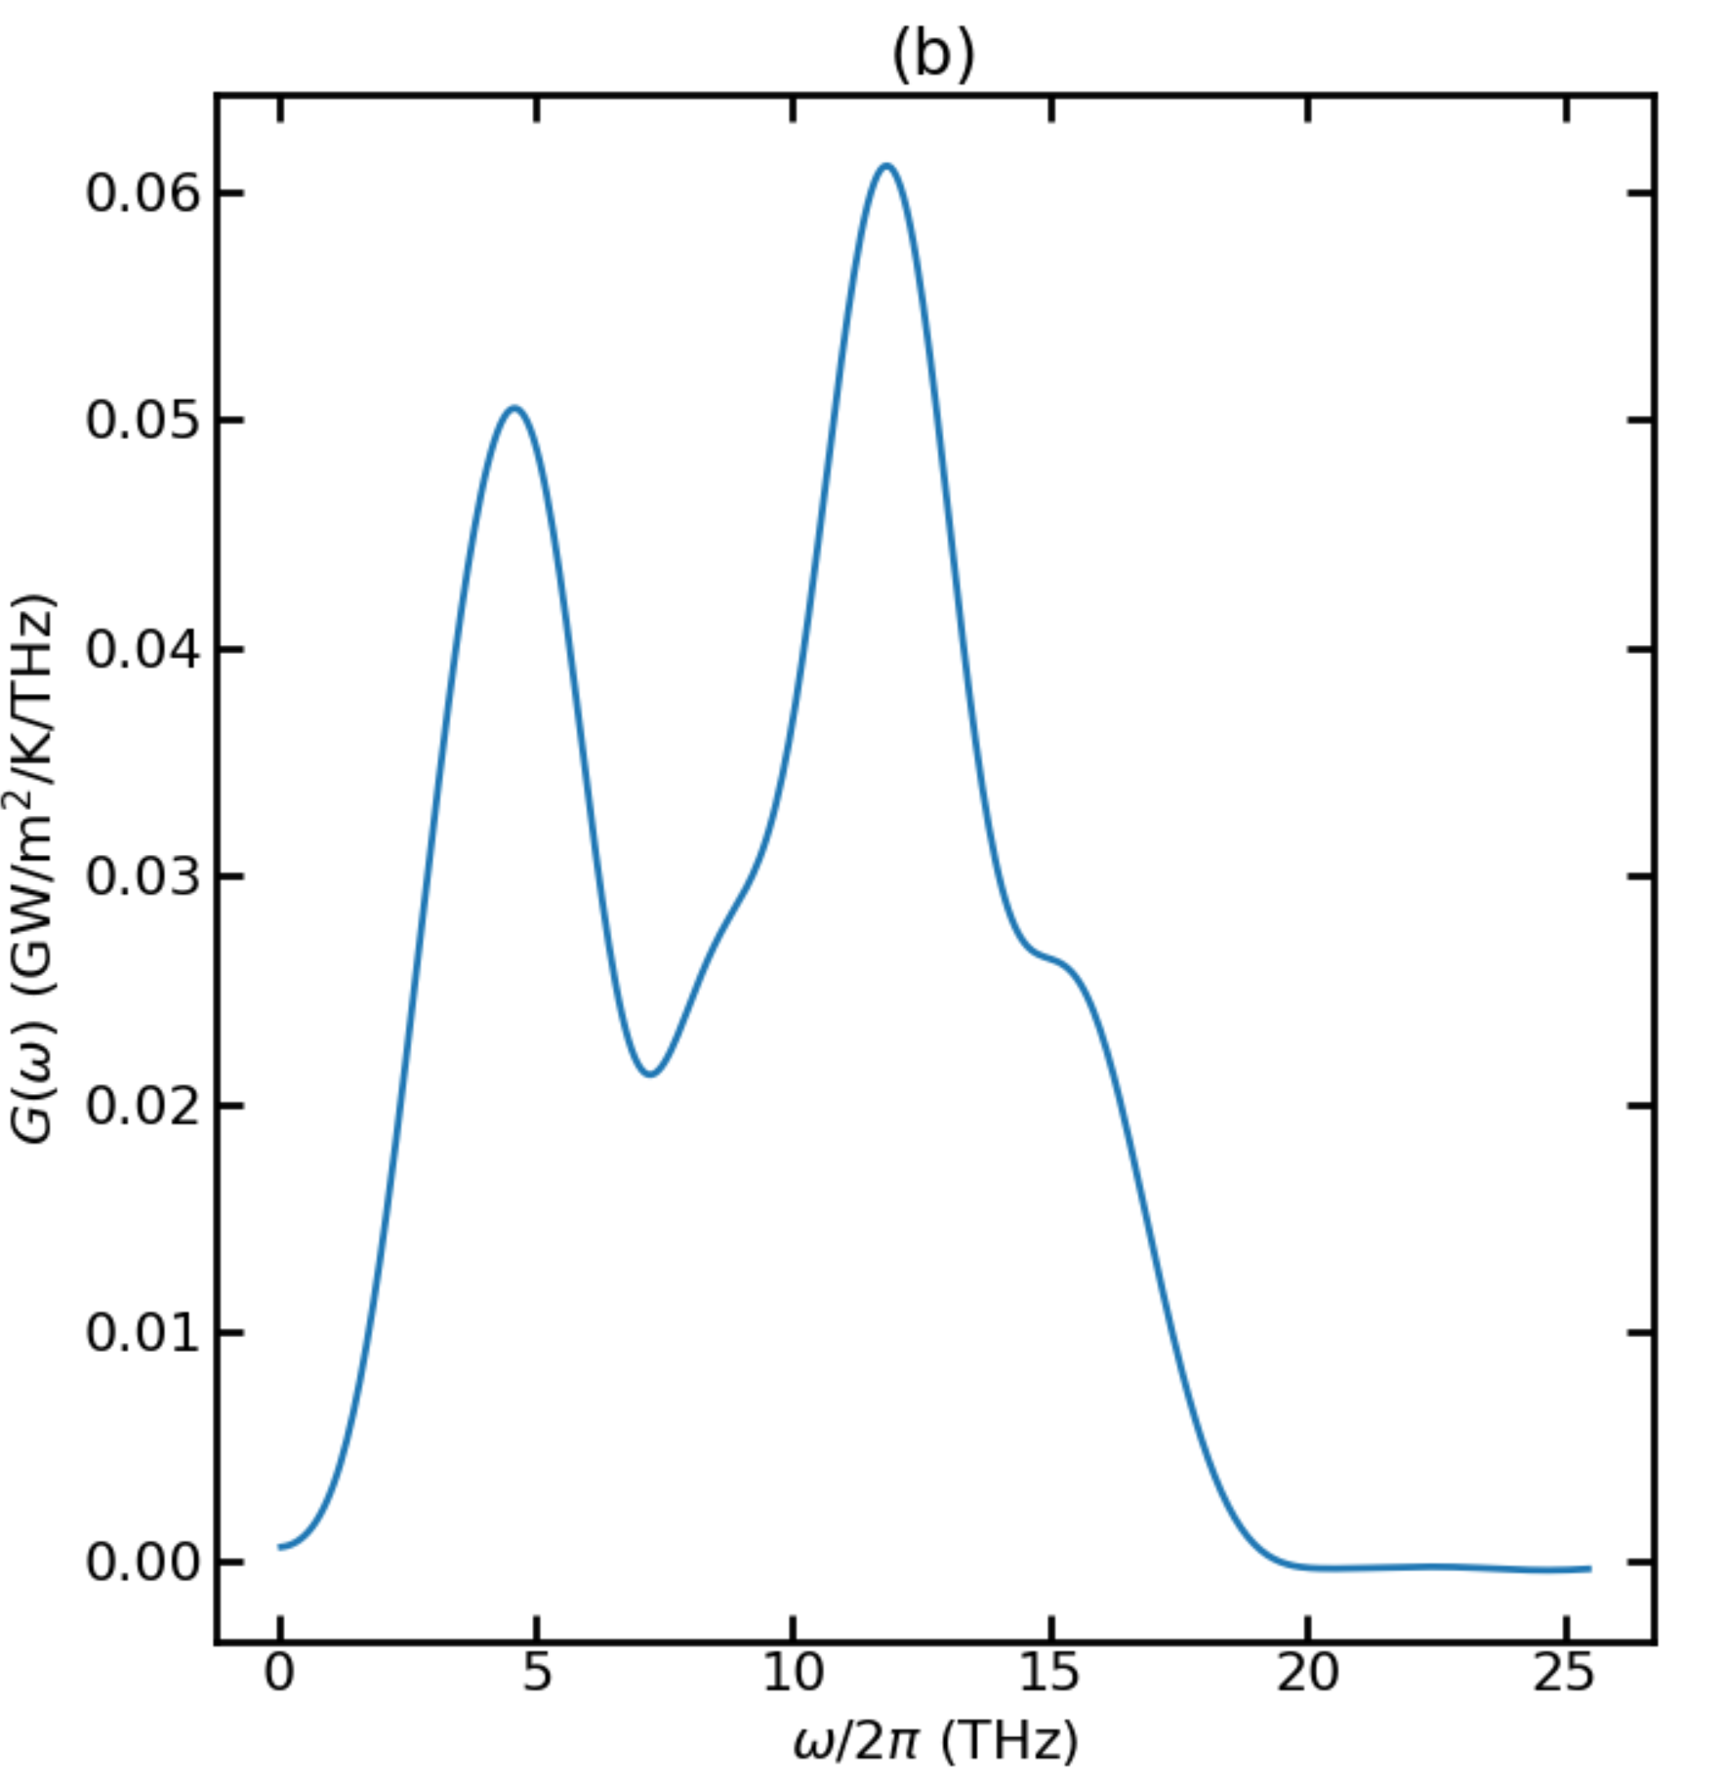
Thermal Conductance for T = 500K

Slide 33
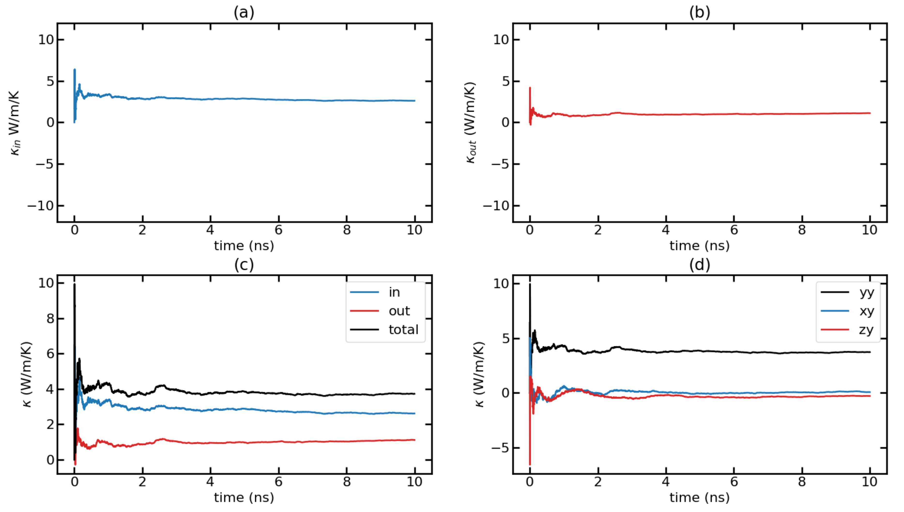
Time-dependent thermal conductivity (k(t) Vs. t) for T = 500K with F = 0.00024 Run 1

Slide 34
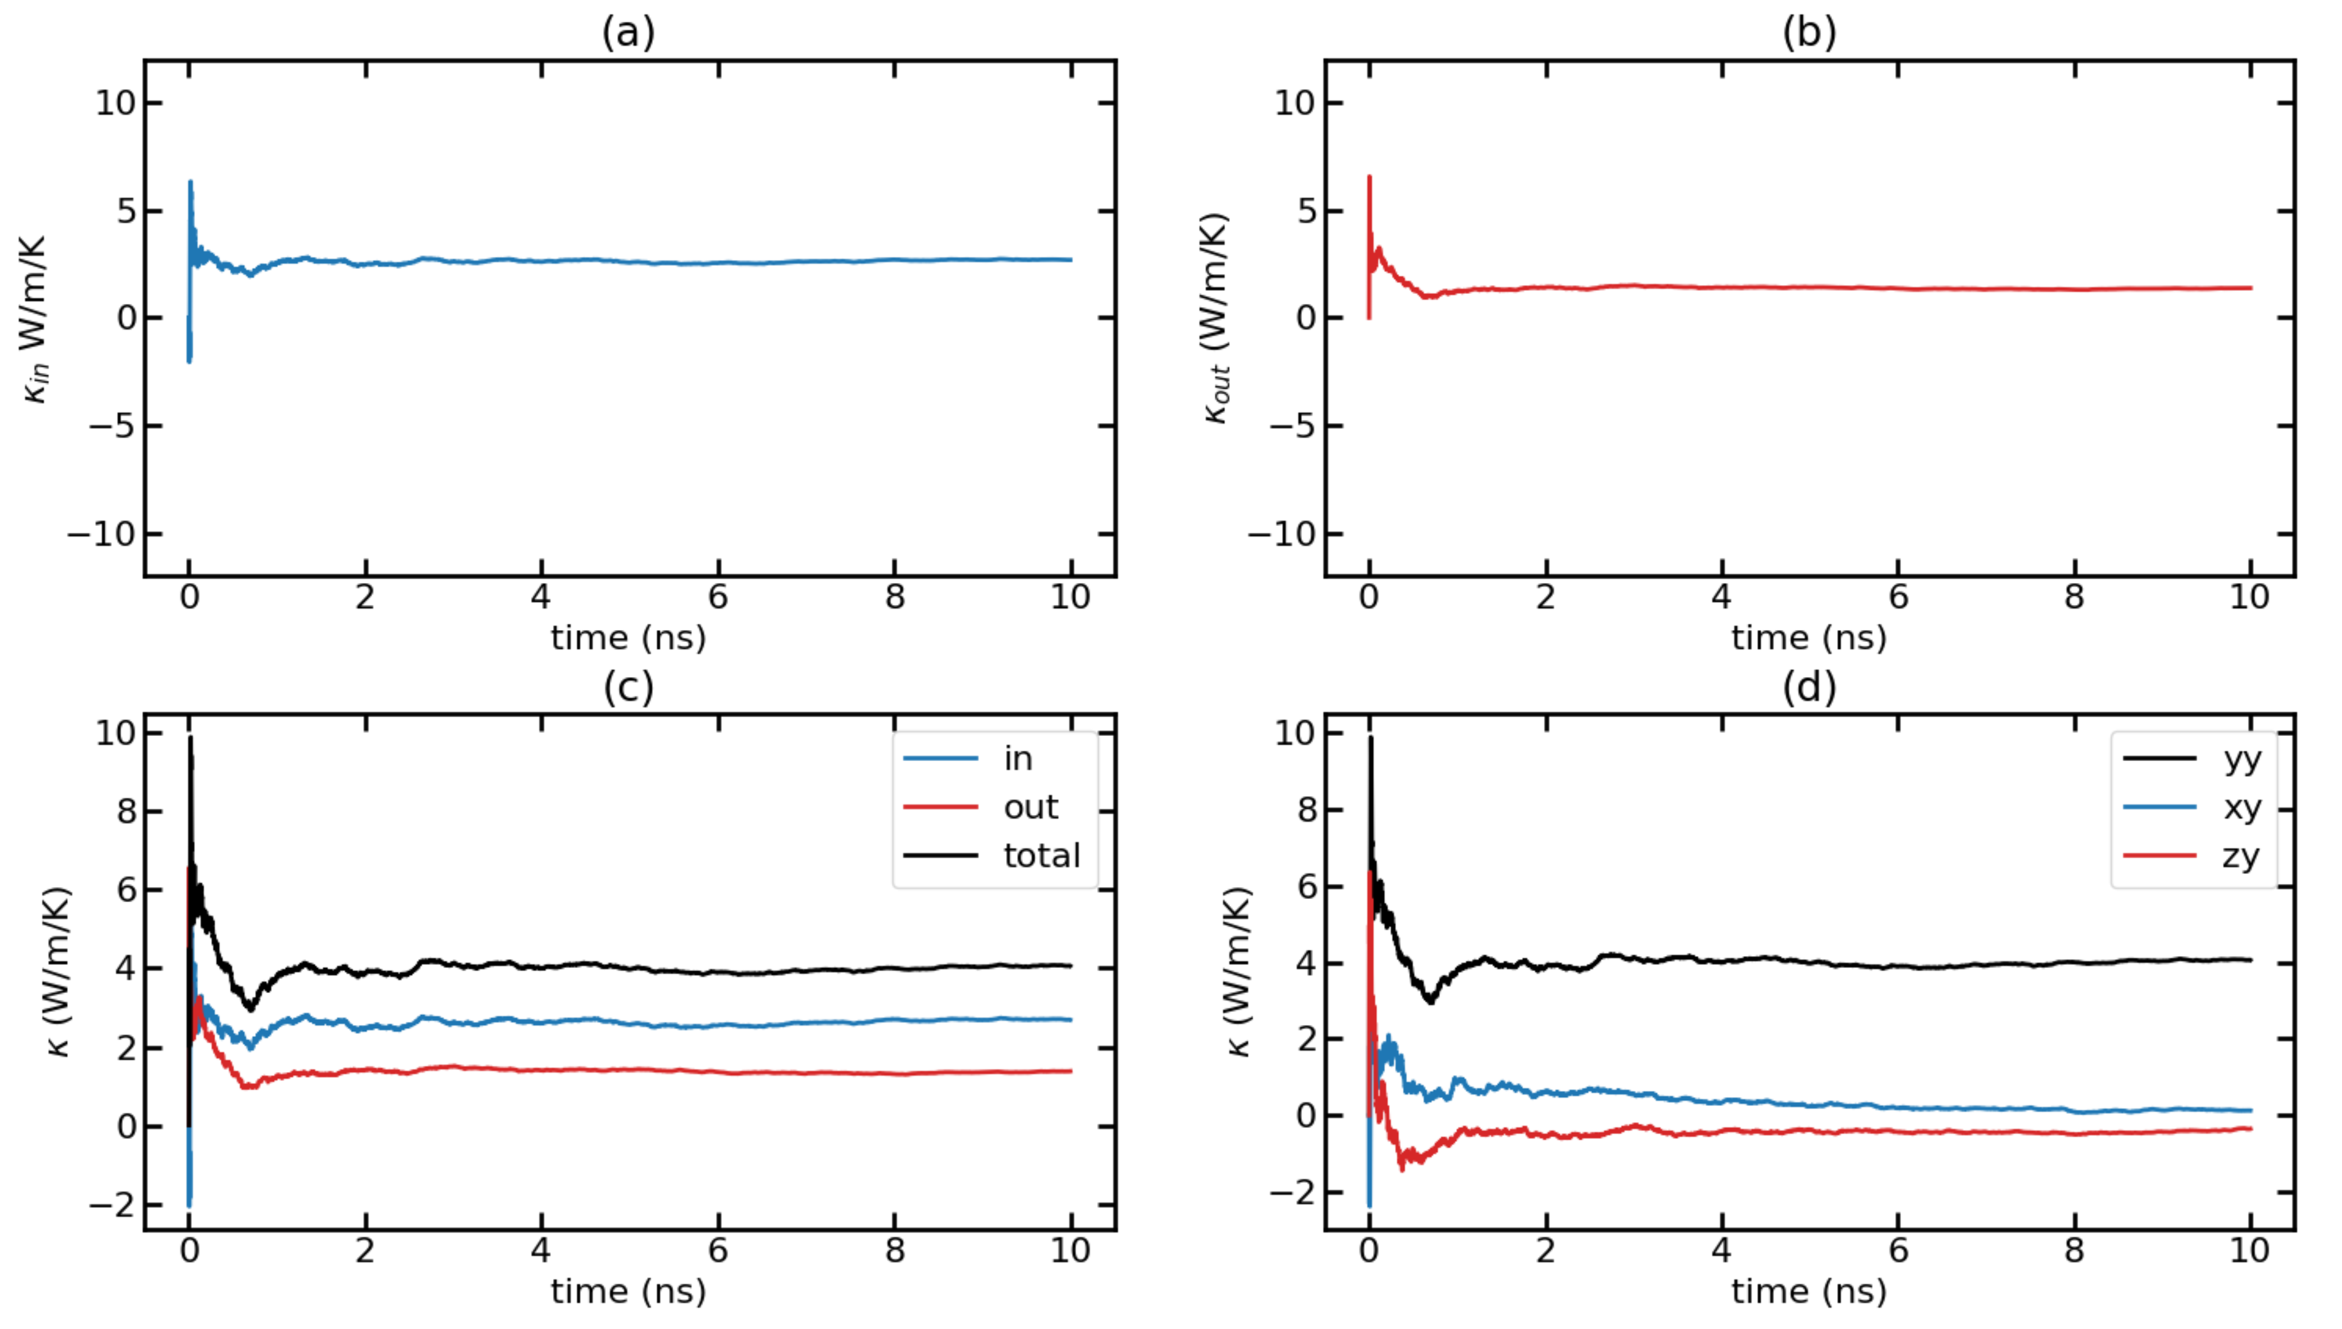
Time-dependent thermal conductivity (k(t) Vs. t) for T = 500K with F = 0.00024 Run 2

Slide 35
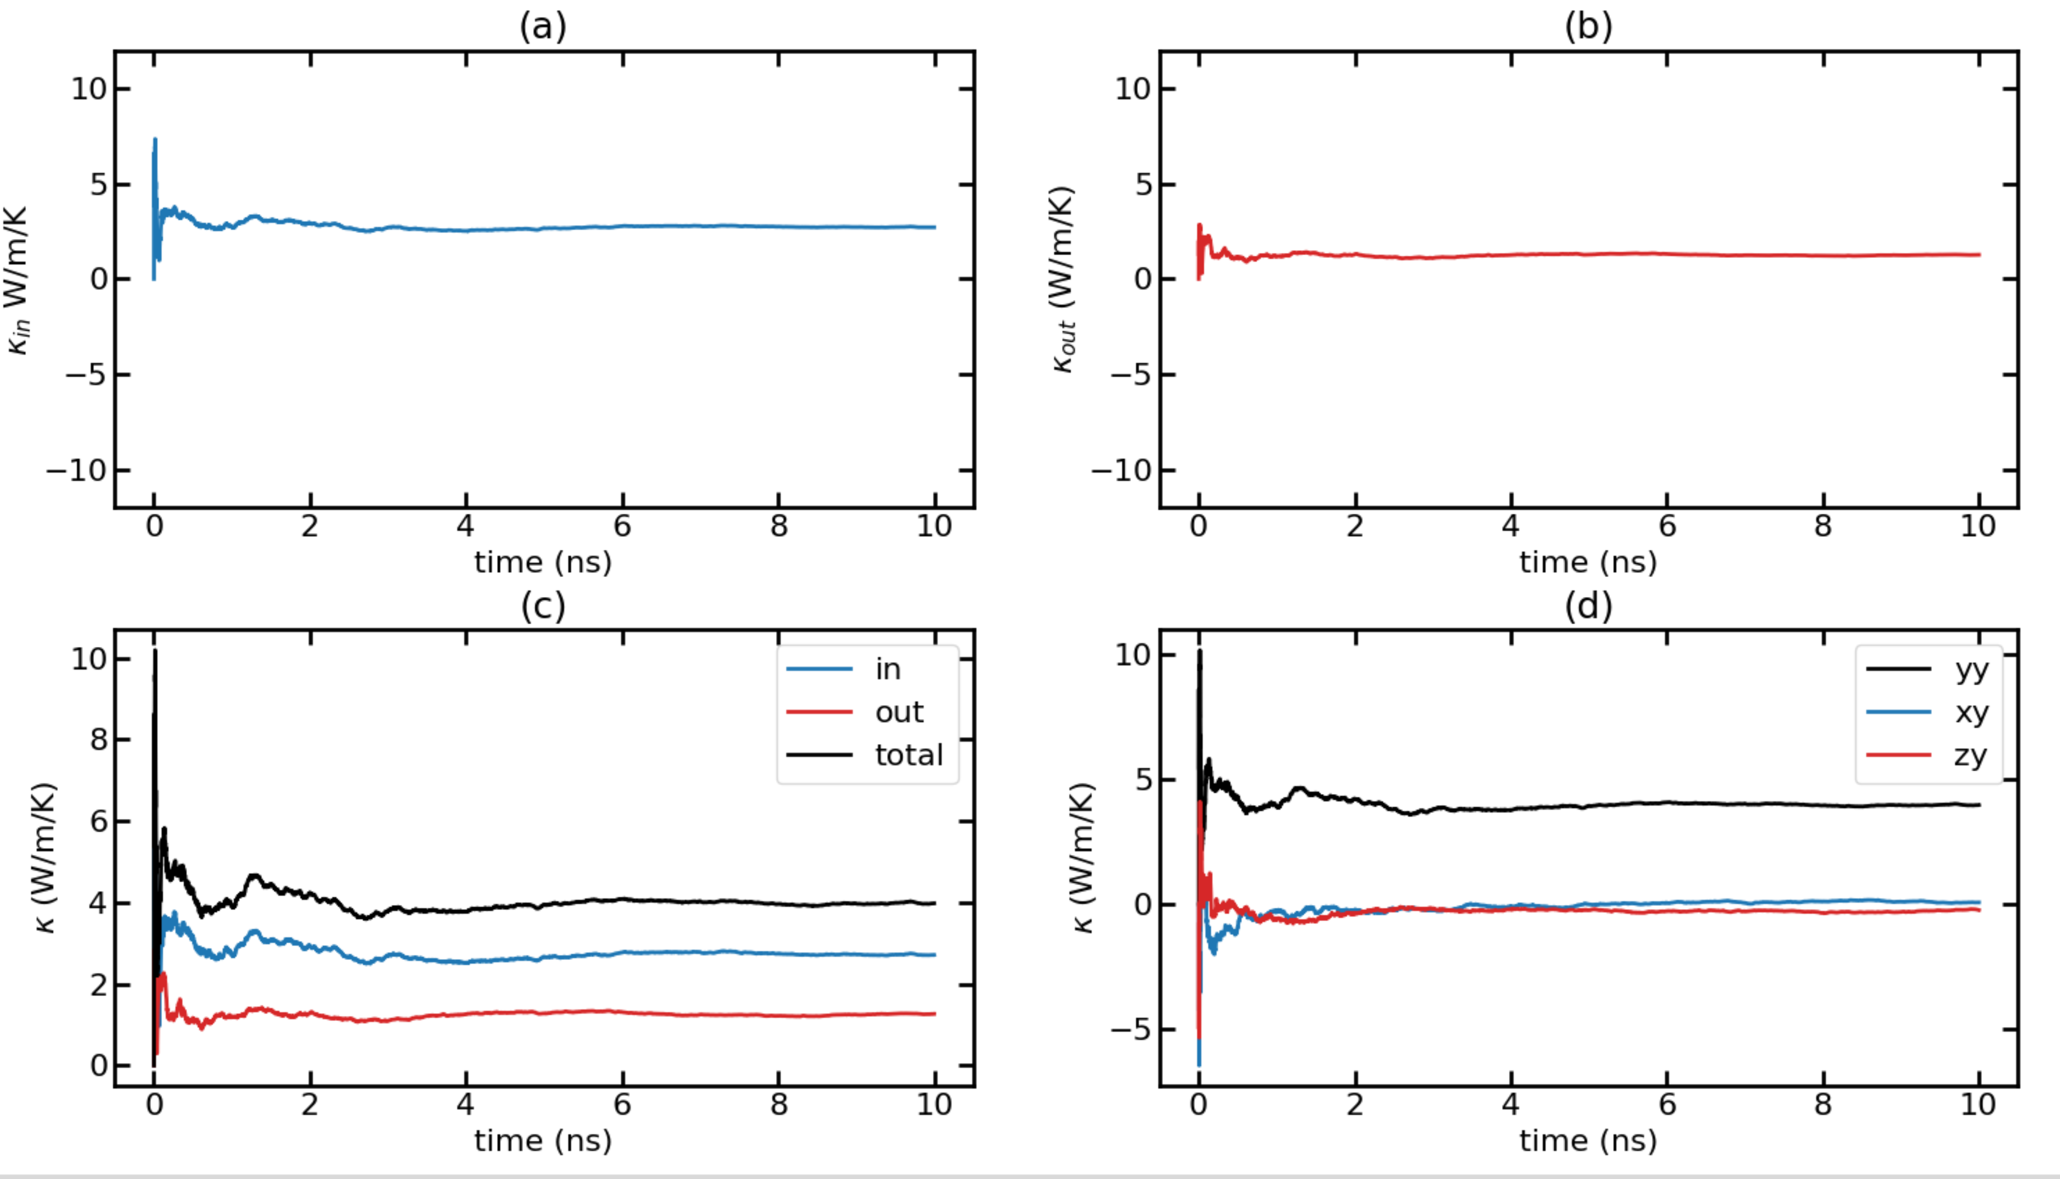
Time-dependent thermal conductivity (k(t) Vs. t) for T = 500K with F = 0.00024 Run 3

Slide 36
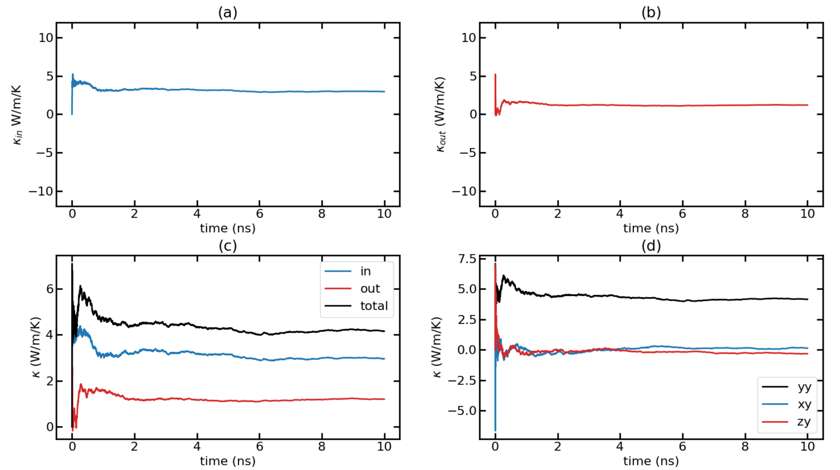
Time-dependent thermal conductivity (k(t) Vs. t) for T = 500K with F = 0.00024 Run 4

Slide 37
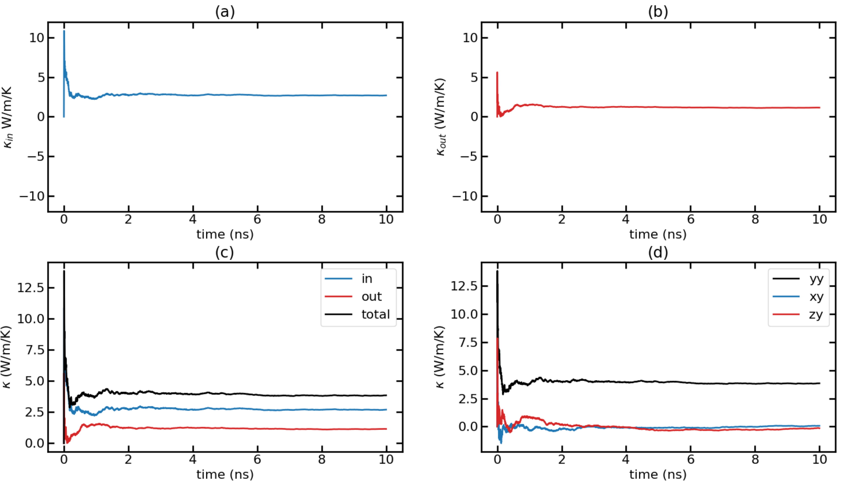
Time-dependent thermal conductivity (k(t) Vs. t) for T = 500K with F = 0.00024 Run 5

Slide 38
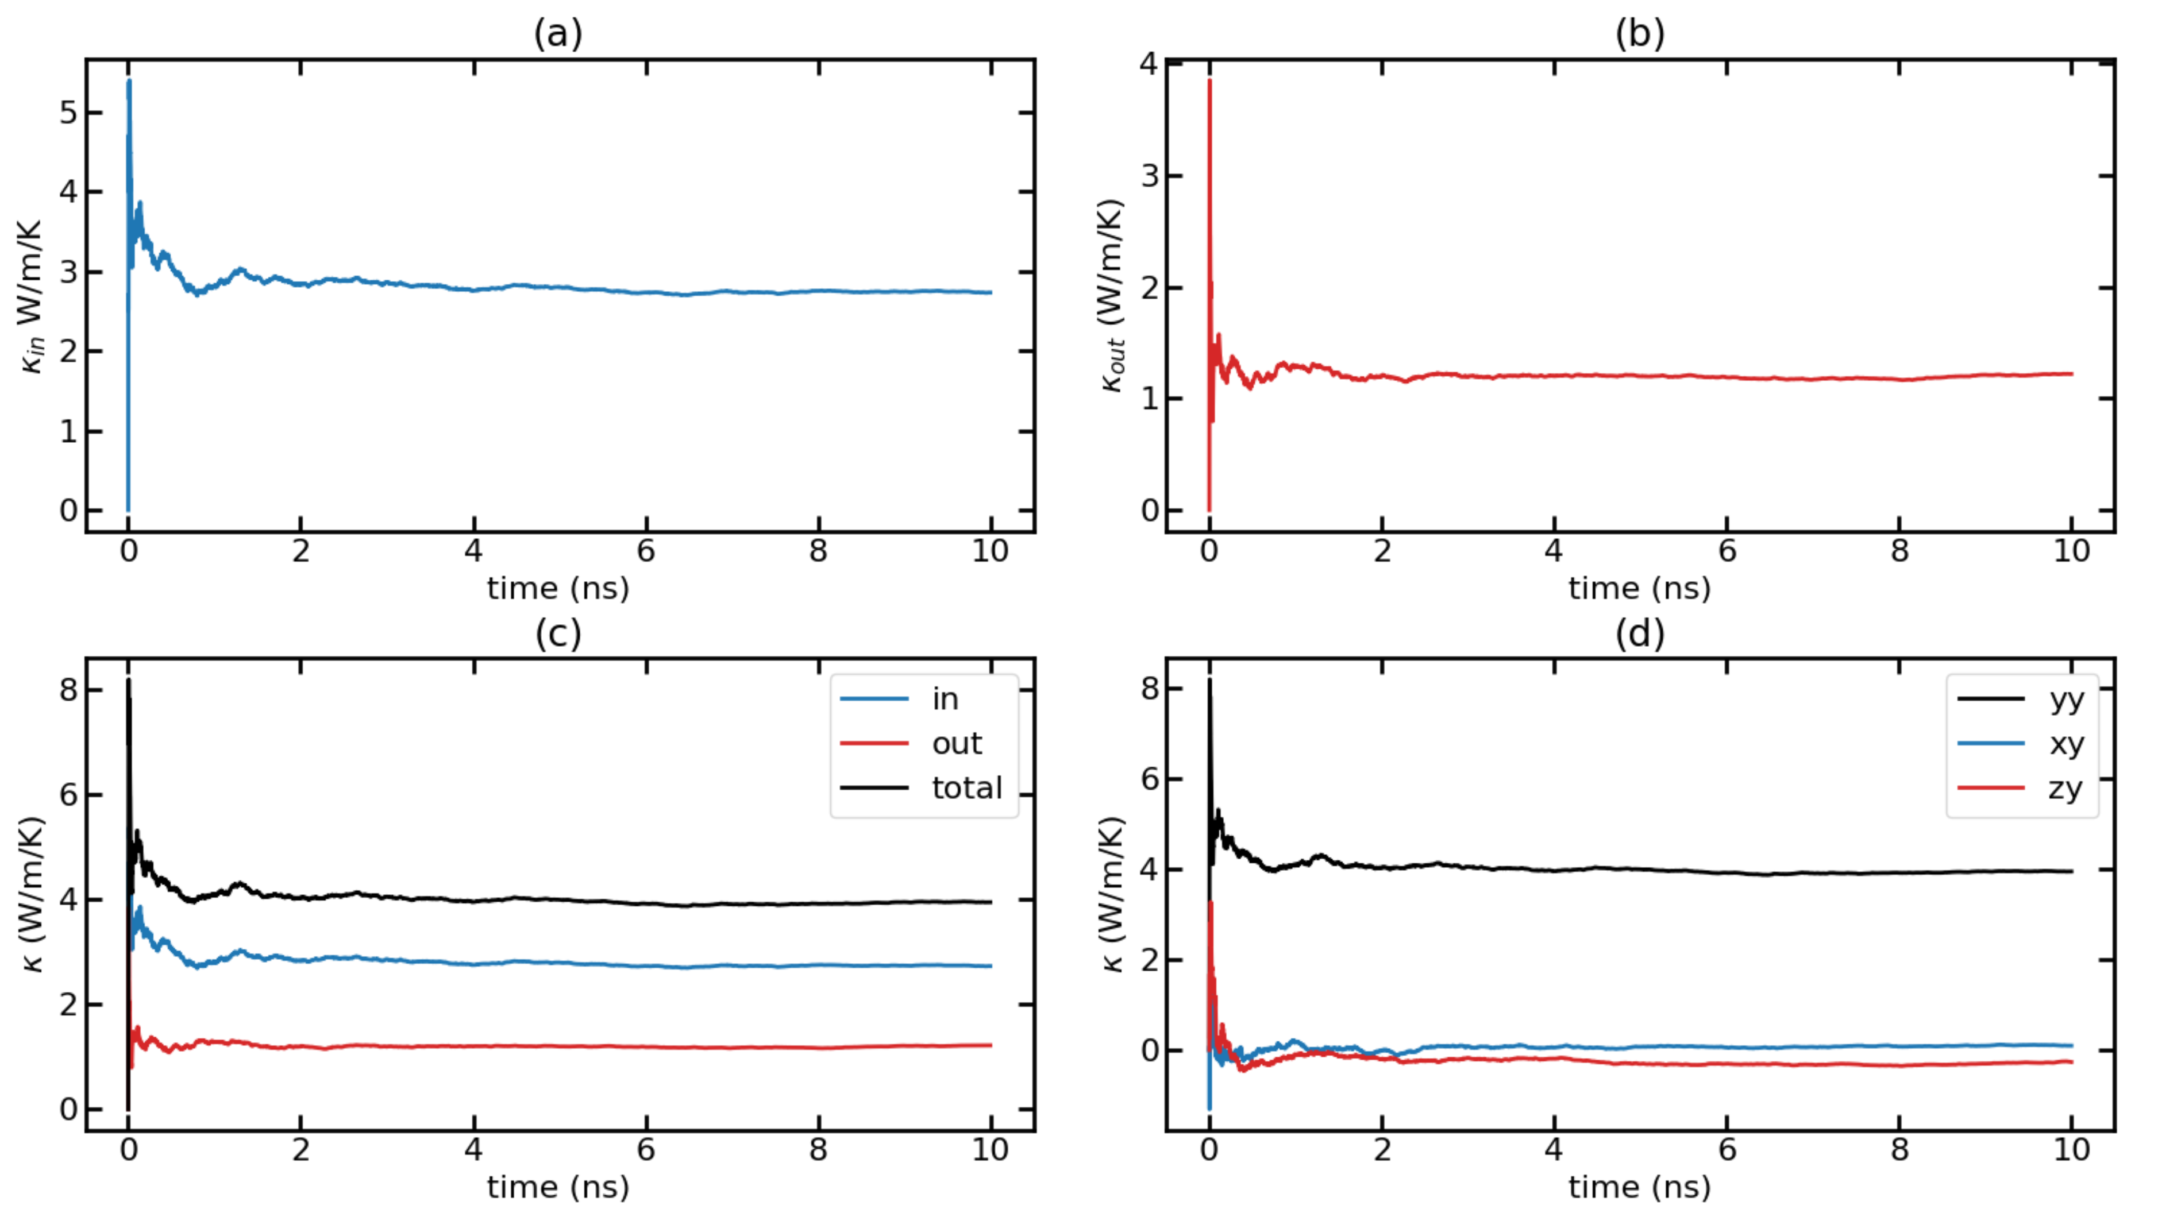
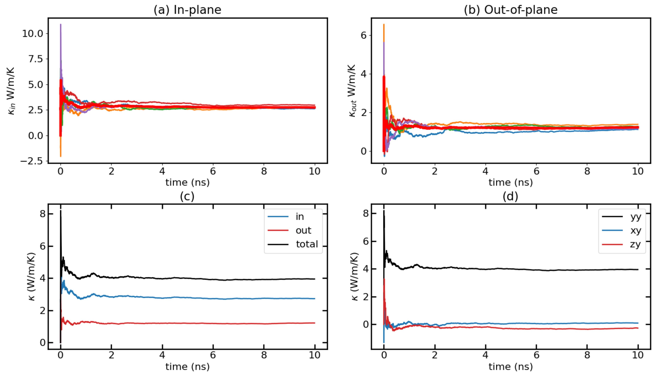
Time-dependent thermal conductivity (k(t) Vs. t) for T = 500K with F = 0.00024 Avg Runs

Slide 39
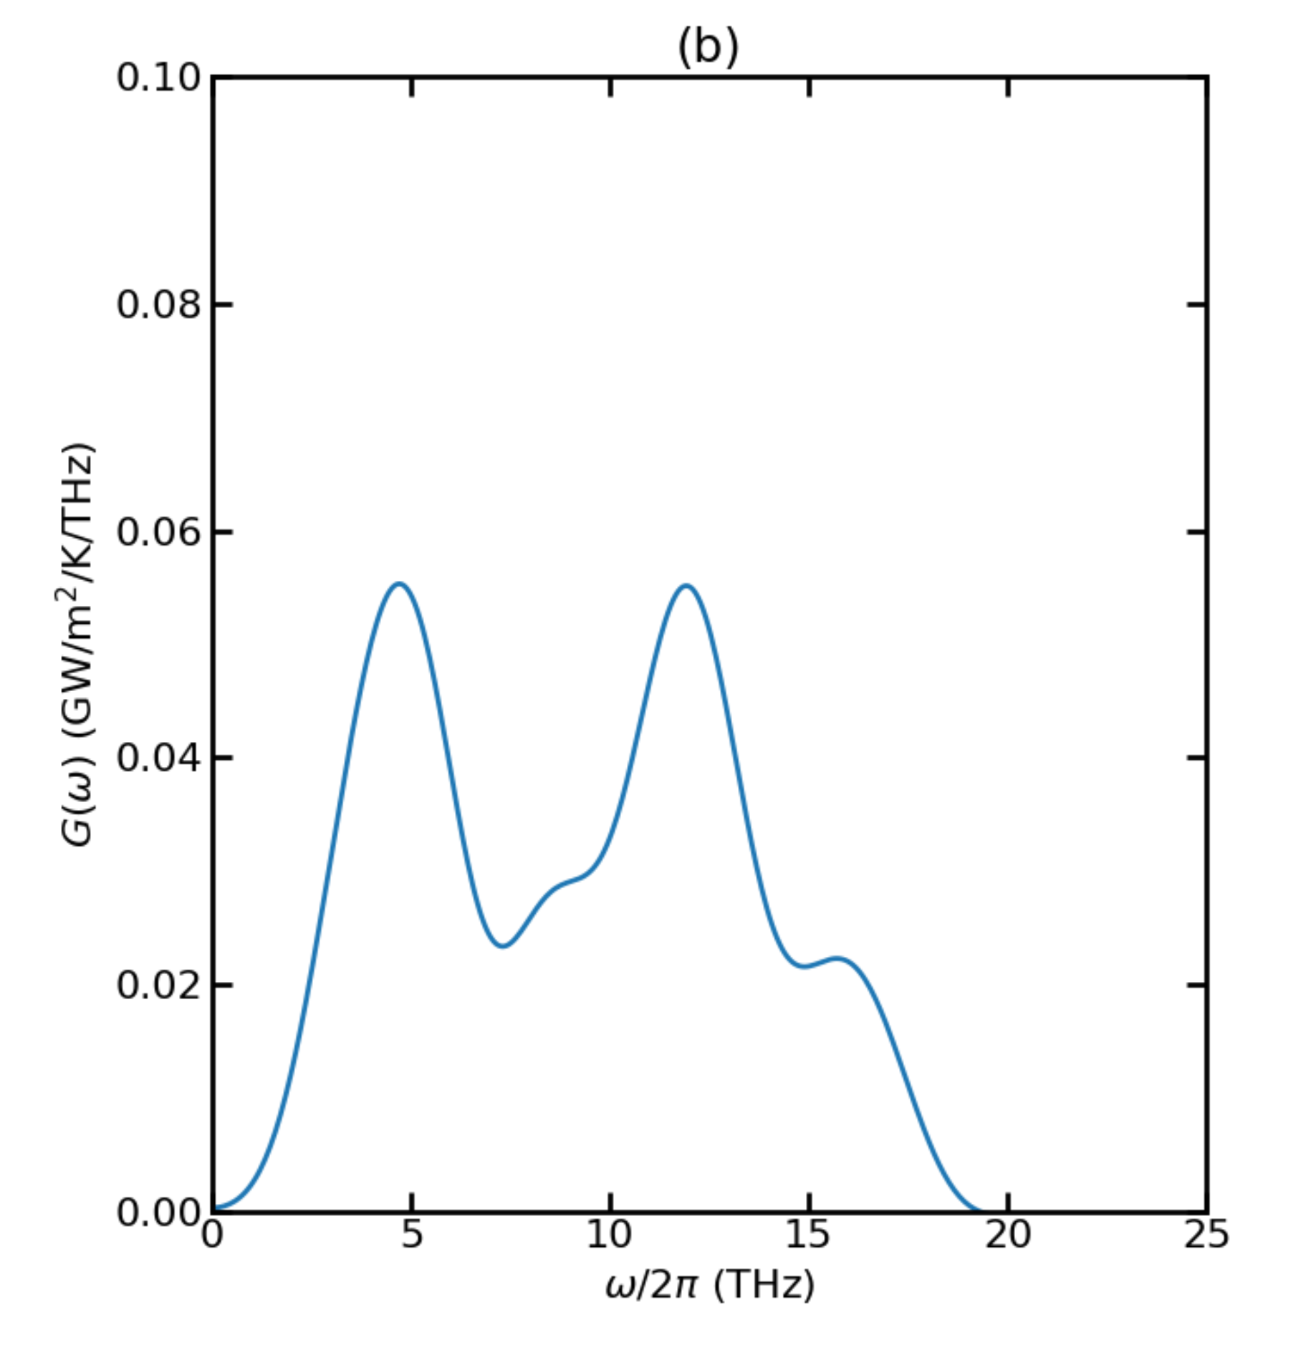
Thermal Conductance for T = 700K

Slide 40
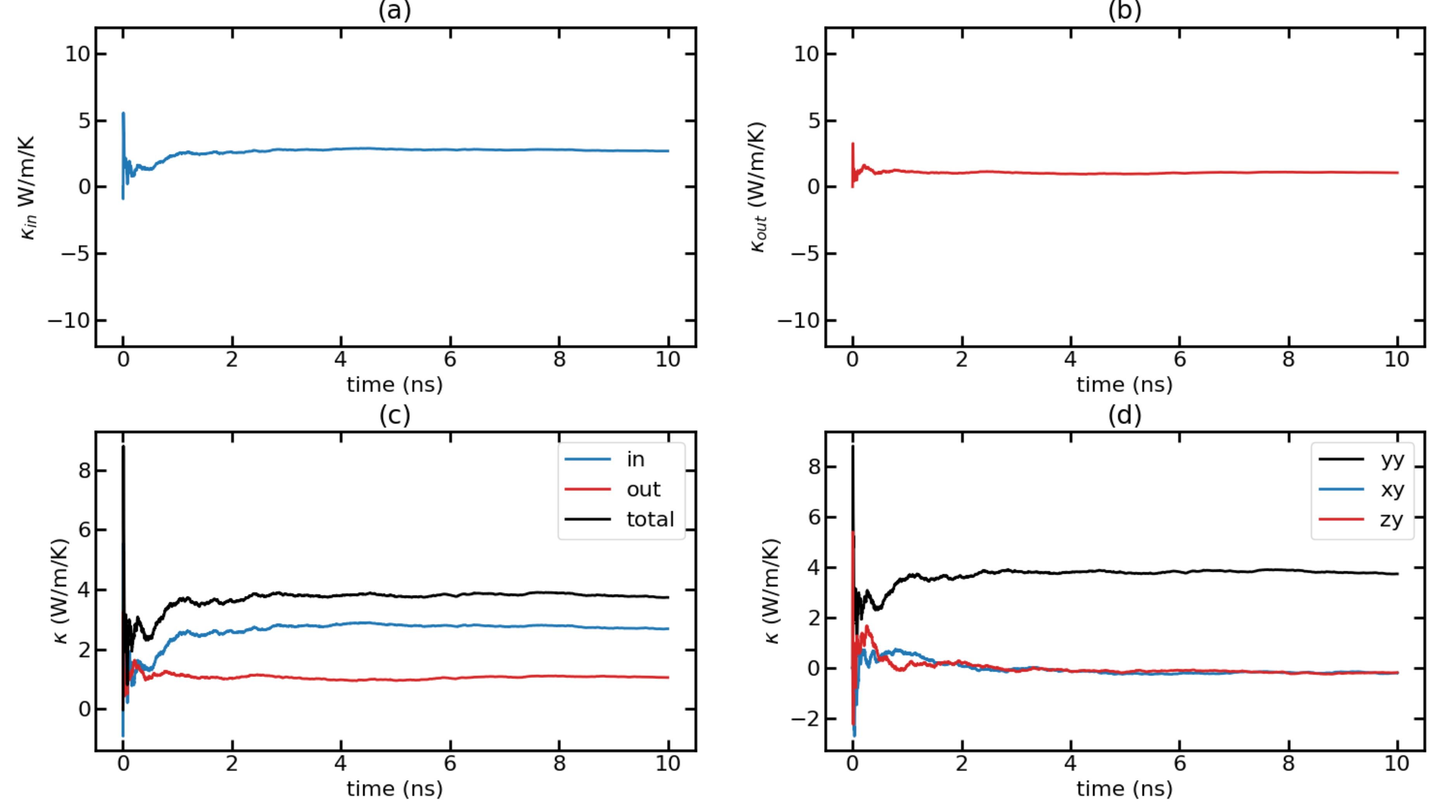
Time-dependent thermal conductivity (k(t) Vs. t) for T = 700K with F = 0.00032 Run 1

Slide 41
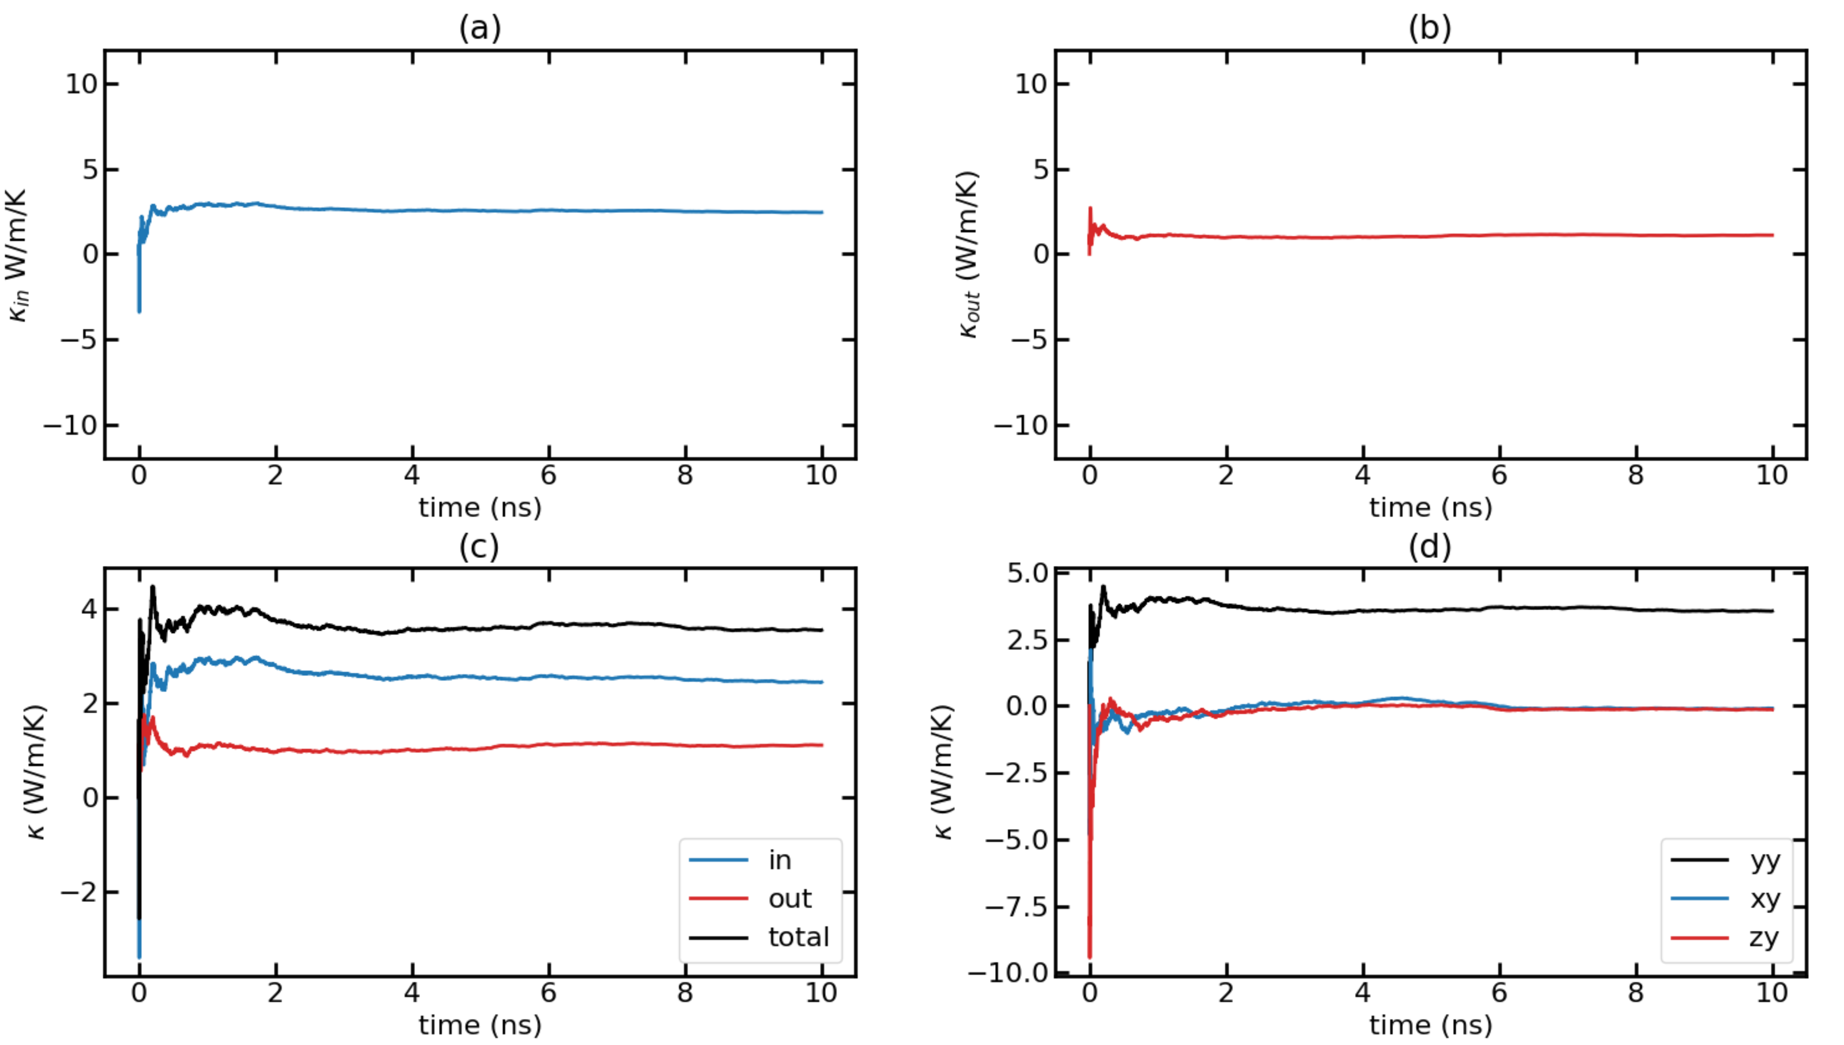
Time-dependent thermal conductivity (k(t) Vs. t) for T = 700K with F = 0.00032 Run 2

Slide 42
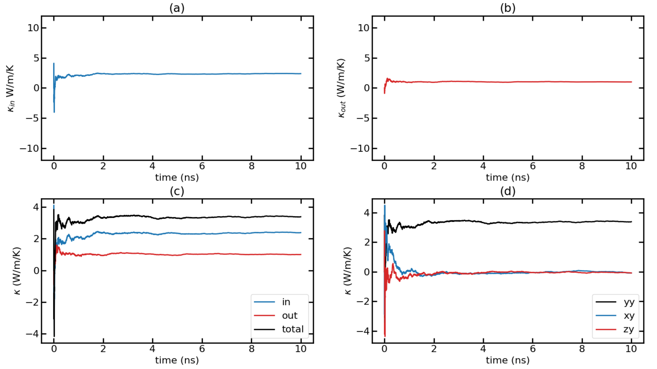
Time-dependent thermal conductivity (k(t) Vs. t) for T = 700K with F = 0.00032 Run 3

Slide 43
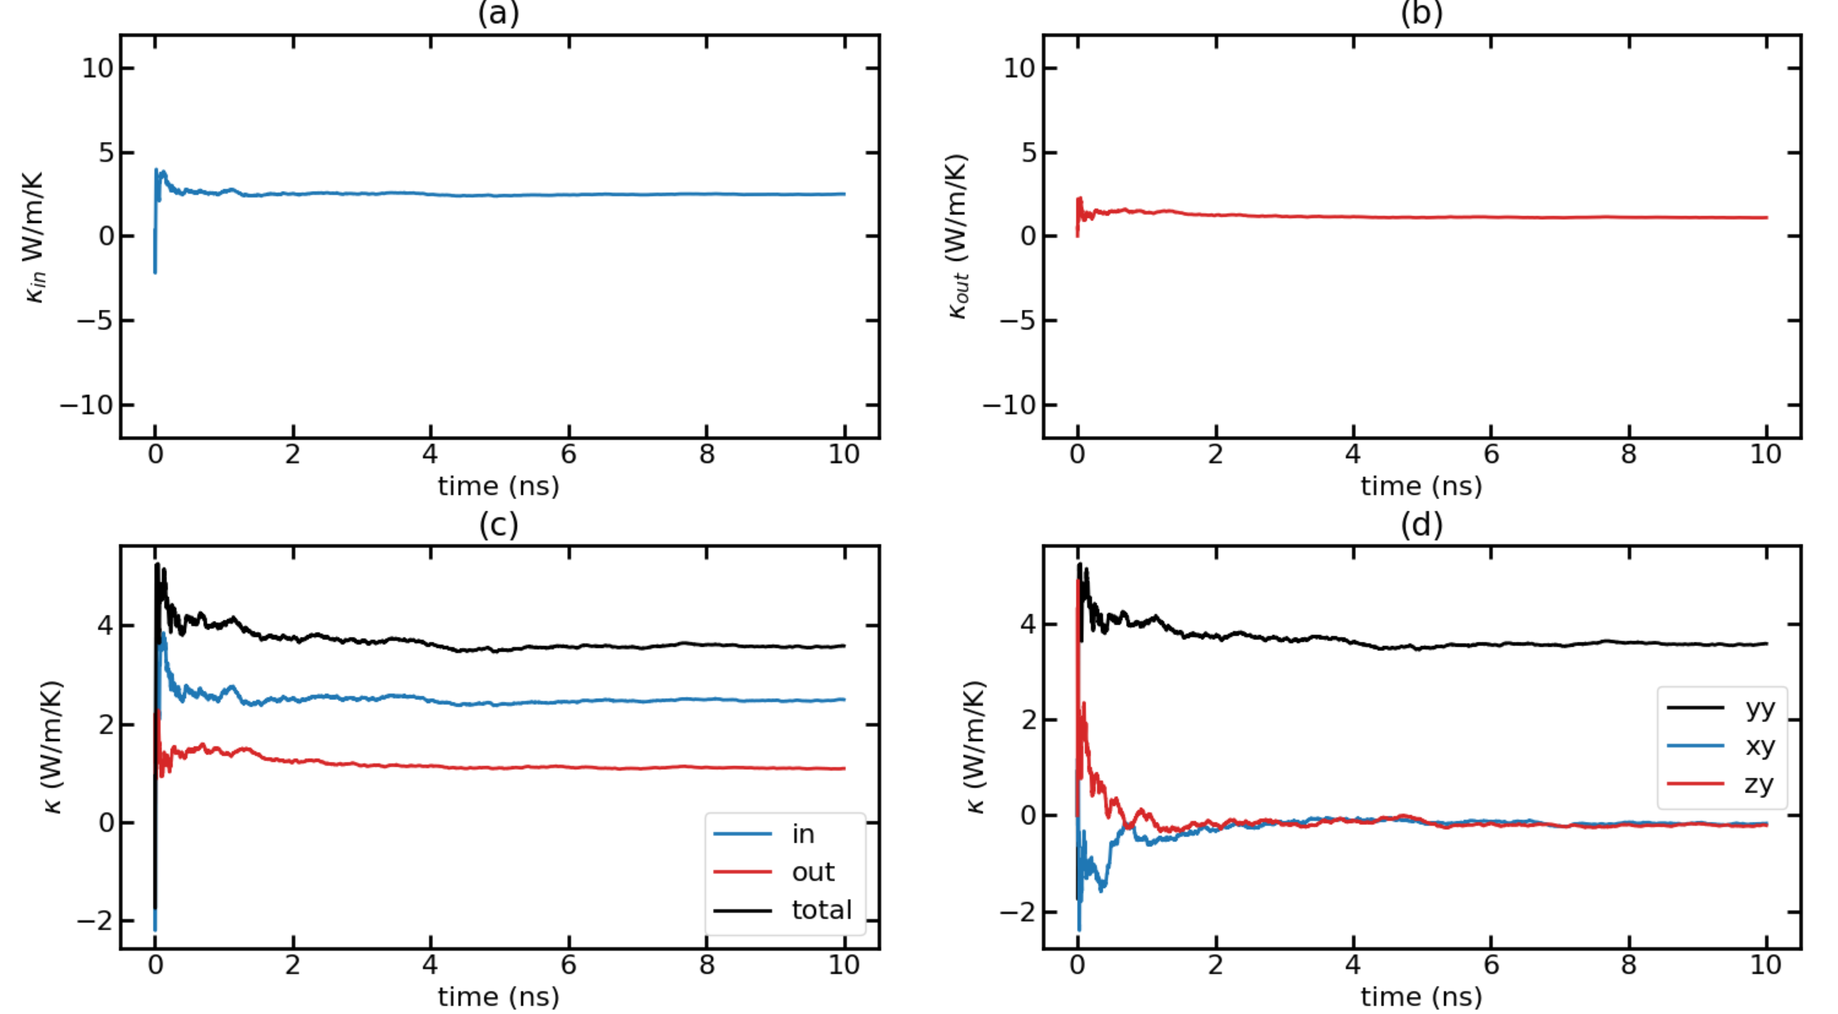
Time-dependent thermal conductivity (k(t) Vs. t) for T = 700K with F = 0.00032 Run 4

Slide 44
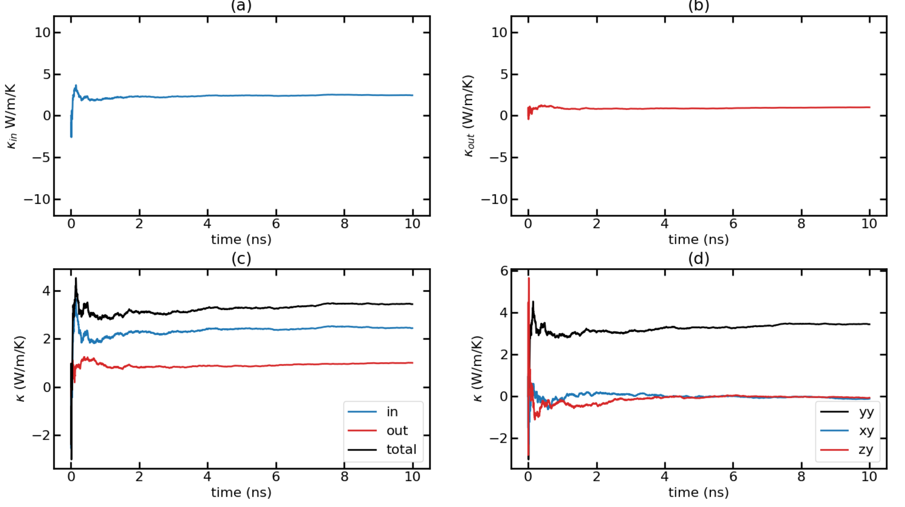
Time-dependent thermal conductivity (k(t) Vs. t) for T = 700K with F = 0.00032 Run 5

Slide 45
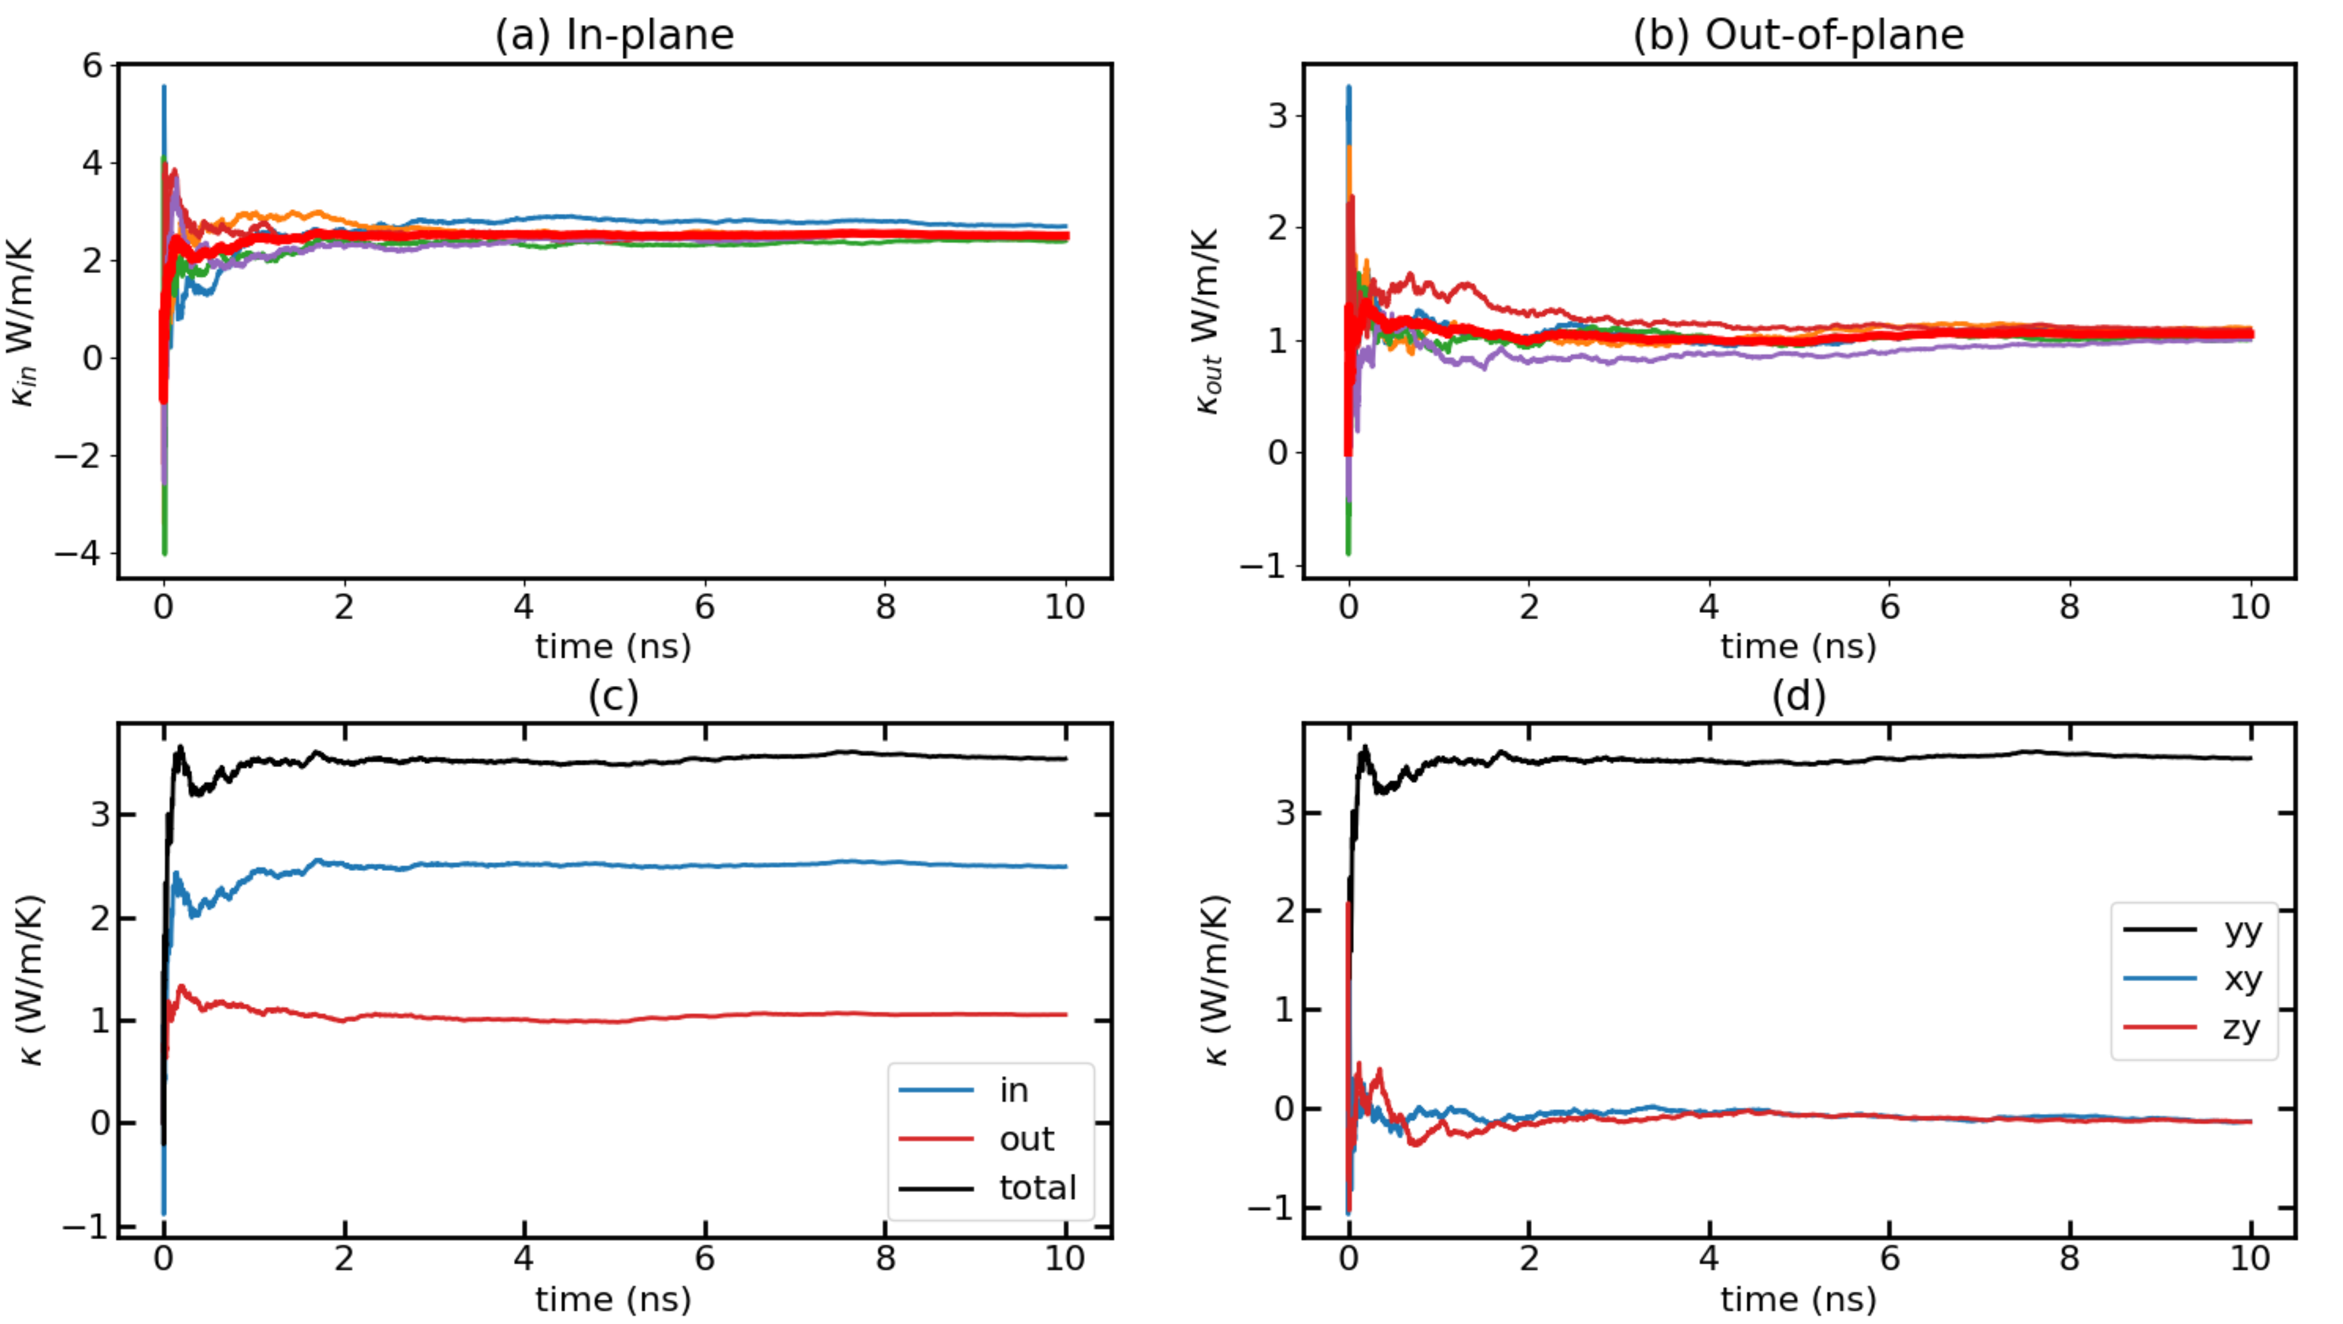
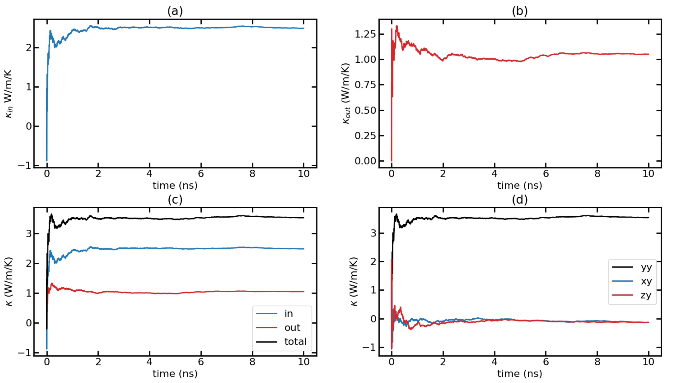
Time-dependent thermal conductivity (k(t) Vs. t) for T = 700K with F = 0.00032 Avg Runs

Slide 46
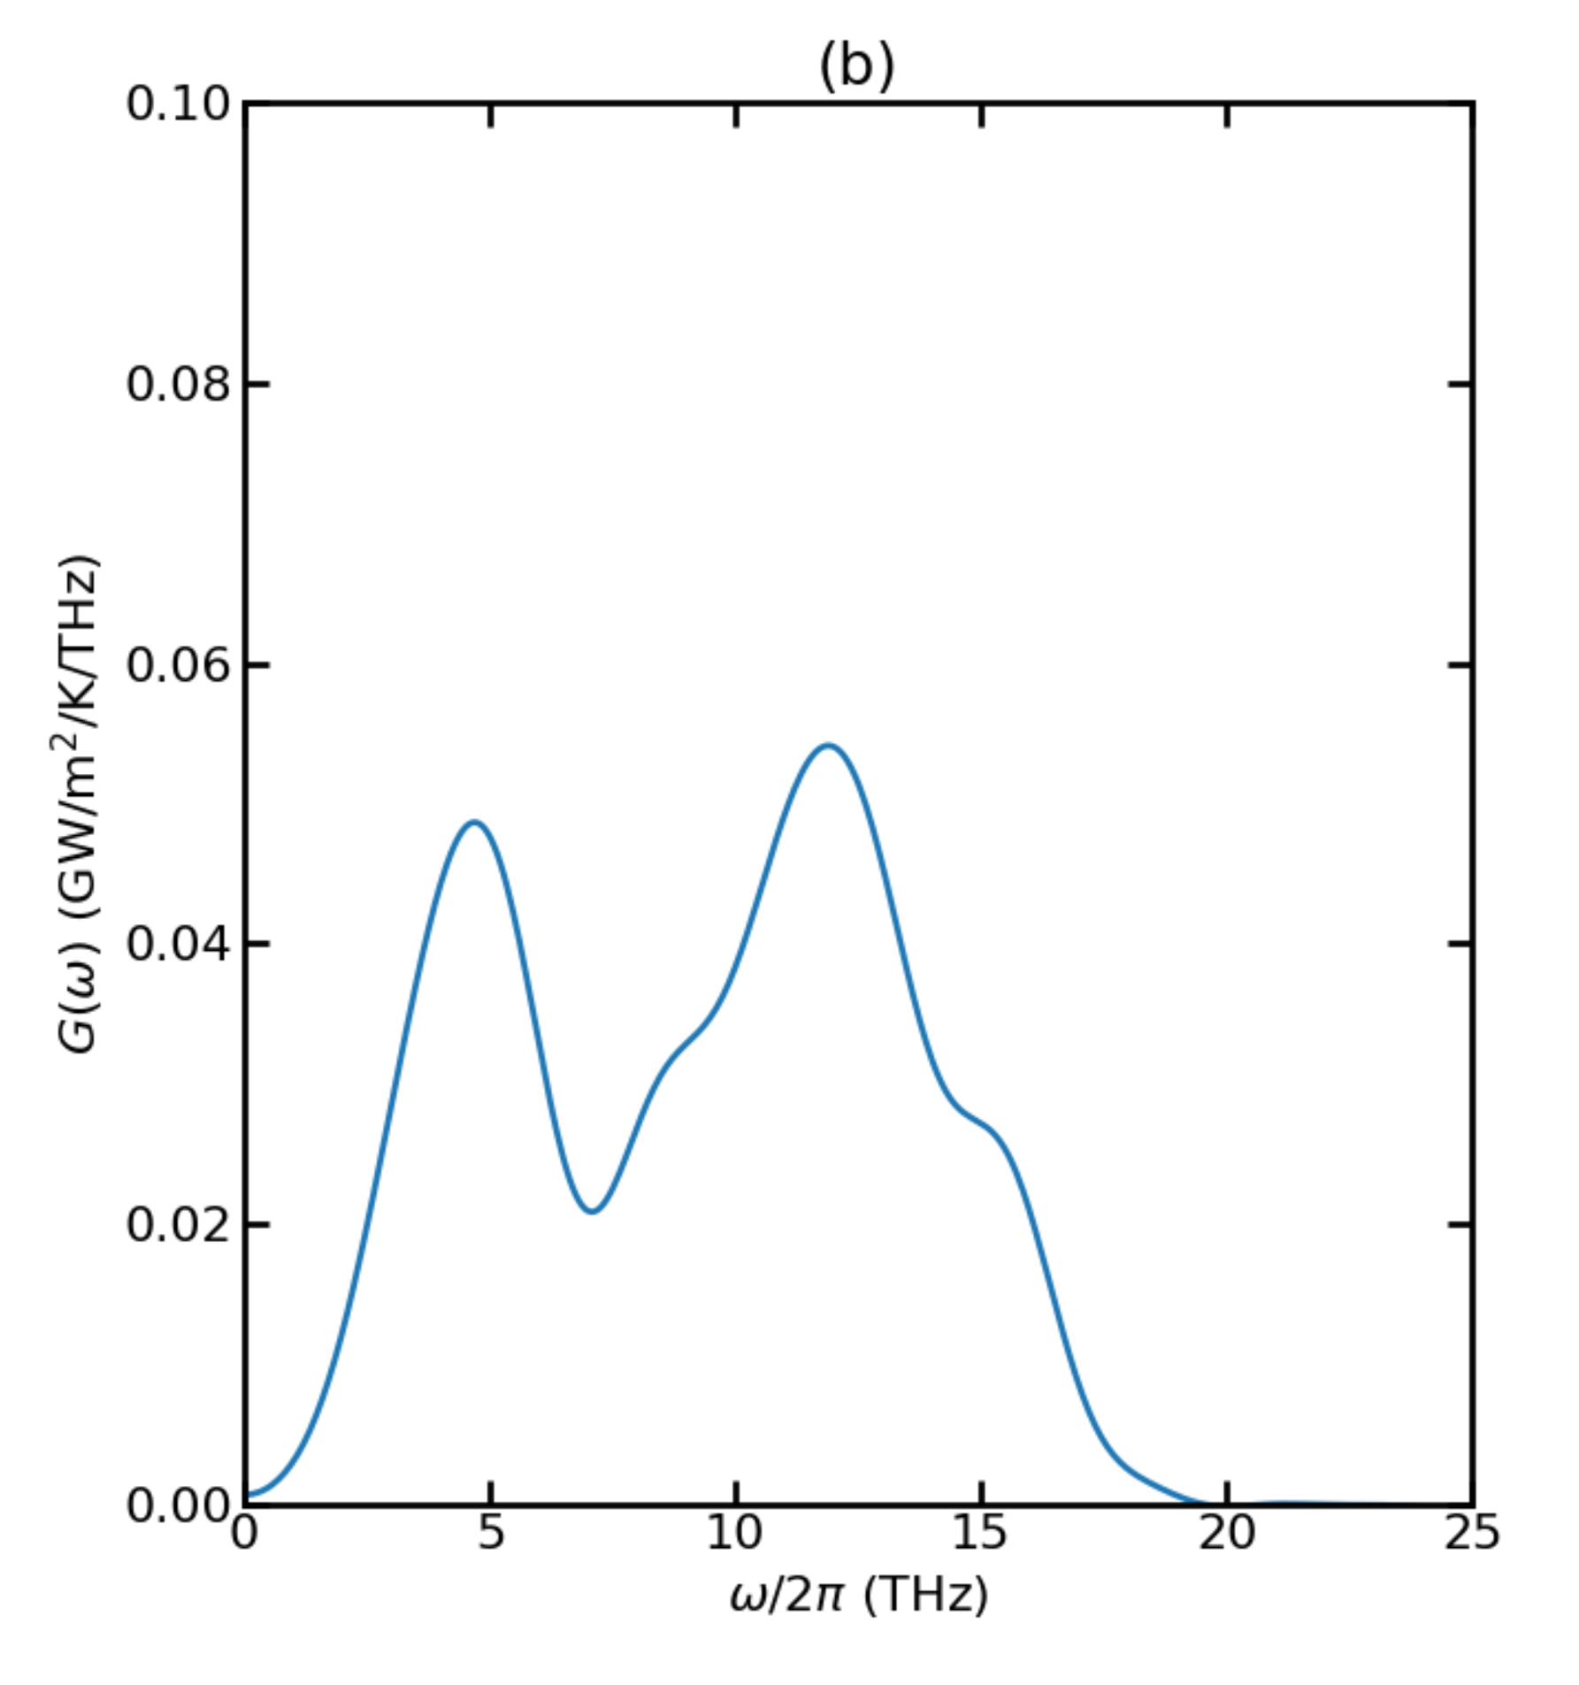
Thermal Conductance for T = 900K

Slide 47
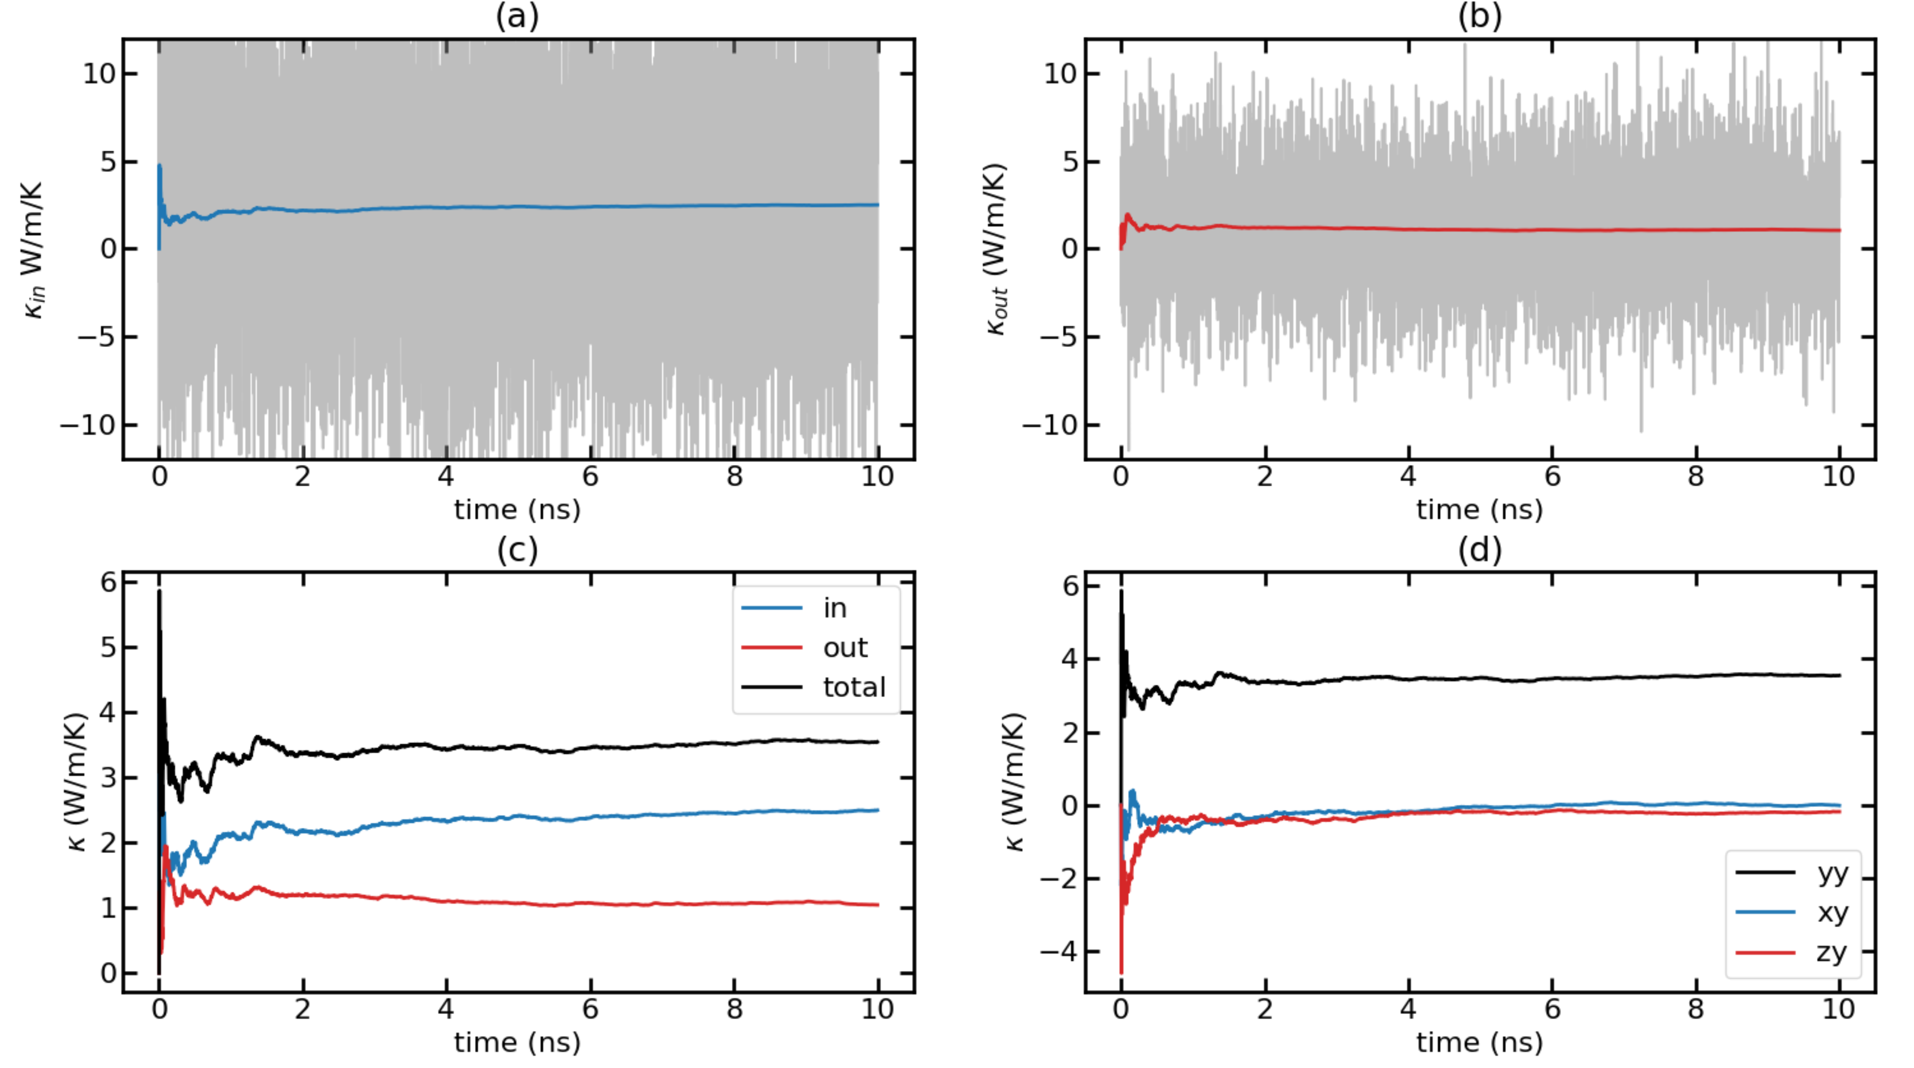
Time-dependent thermal conductivity (k(t) Vs. t) for T = 900K with F = 0.0004 Run 1

Slide 48

Time-dependent thermal conductivity (k(t) Vs. t) for T = 900K with F = 0.0004 Run 2

Slide 49

Time-dependent thermal conductivity (k(t) Vs. t) for T = 900K with F = 0.0004 Run 3

Slide 50

Time-dependent thermal conductivity (k(t) Vs. t) for T = 900K with F = 0.0004 Run 4

Slide 51

Time-dependent thermal conductivity (k(t) Vs. t) for T = 900K with F = 0.0004 Run 5

Slide 52


Time-dependent thermal conductivity (k(t) Vs. t) for T = 900K with F = 0.0004 Avg Runs

